Slide 1
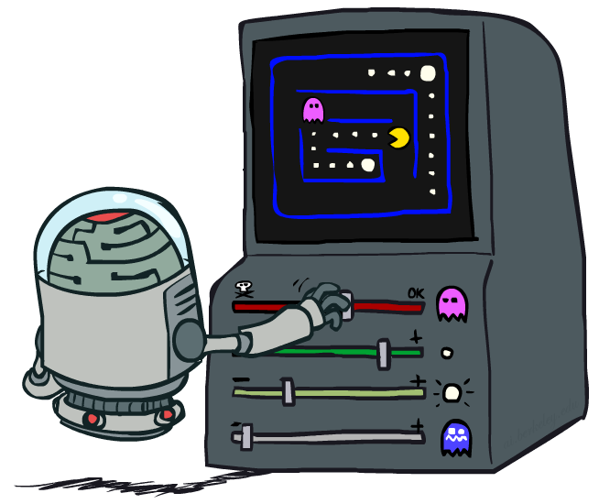
CS 188: Artificial Intelligence
Reinforcement Learning II
Instructor: Stuart Russell and Dawn Song, University of California, Berkeley
Notes:
Please retain proper attribution and the reference to ai.berkeley.edu. Thanks!

Slide 2
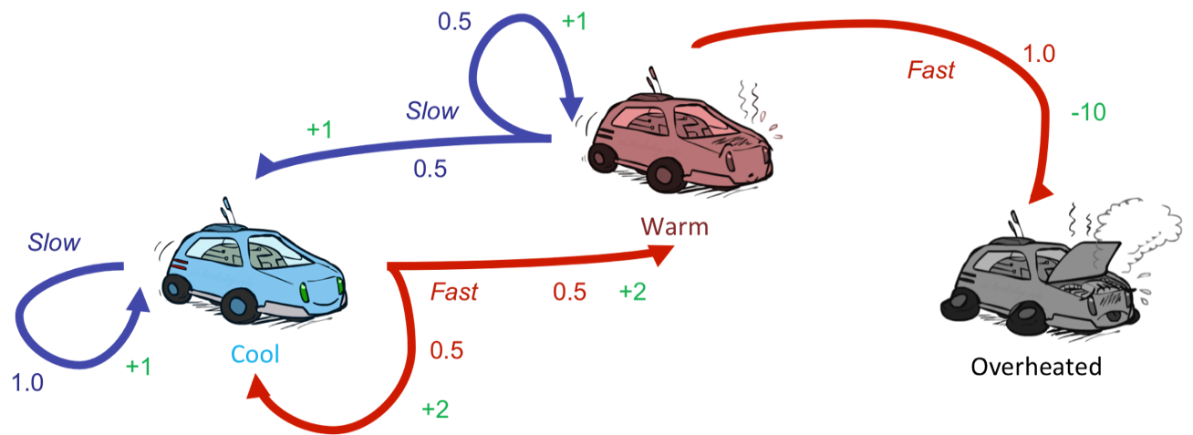
Recap: Reinforcement Learning
Still assume a Markov decision process (MDP):
  A set of states s ∈ S
  A set of actions (per state) A
  A model T(s,a,s’)
  A reward function R(s,a,s’)
Still looking for a policy π(s)
New twist: don’t know T or R
  I.e. we don’t know which states are good or what the actions do
  Must actually try actions and states out to learn

Slide 3
Recap: Reinforcement Learning
Passive reinforcement learning:
  A passive learning agent has a fixed policy that determines its behavior
Model-based learning:
  Learn an approximate MDP model based on experiences
Model-free learning:
  Do not learn an explicit MDP model

Slide 4
Recap: Temporal Difference Learning
Big idea: learn from every experience!
  Update V(s) each time we experience a transition (s, a, s’, r)
  Likely outcomes s’ will contribute updates more often
Temporal difference learning of values
  Policy still fixed, still doing evaluation!
  Move values toward value of whatever successor occurs: running average
s
π(s)
s, π(s)
s’
Sample of V(s):
Update to V(s):
Same update:

Slide 5
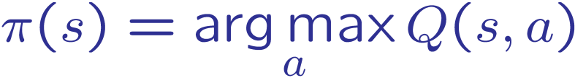
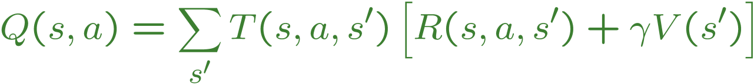
Recap: Problems with TD Value Learning
TD value leaning is a model-free way to do policy evaluation, mimicking Bellman updates with running sample averages
However, if we want to turn values into a (new) policy, we’re sunk:
Idea: learn Q-values, not values
Makes action selection model-free too!
s
a
s, a
s,a,s’
s’

Slide 6
Detour: Q-Value Iteration
Value iteration: find successive (depth-limited) values
  Start with V₀(s) = 0, which we know is right
  Given V_{k}, calculate the depth k+1 values for all states:
But Q-values are more useful, so compute them instead
  Start with Q₀(s,a) = 0
  Given Q_{k}, calculate the depth k+1 q-values for all q-states:

Slide 7

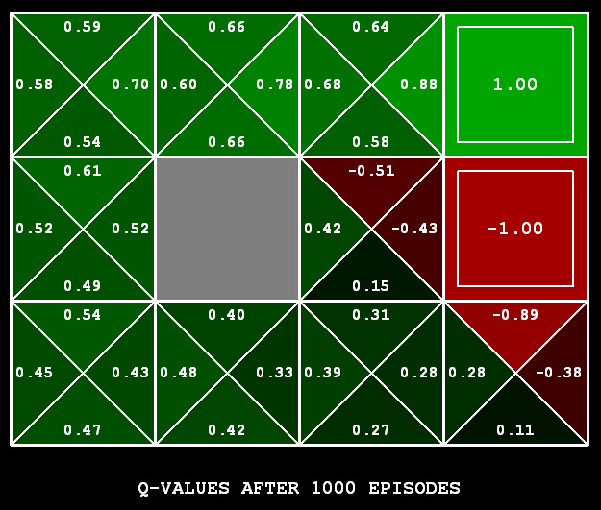
Q-Learning
Q-Learning: sample-based Q-value iteration
Learn Q(s,a) values as you go
  Receive a sample (s,a,s’,r)
  Consider your old estimate:
  Consider your new sample estimate:
  Incorporate the new estimate into a running average:
no longer policy evaluation!

Slide 8

Video of Demo Q-Learning -- Gridworld

Slide 9
Video of Demo Q-Learning -- Crawler

Slide 10
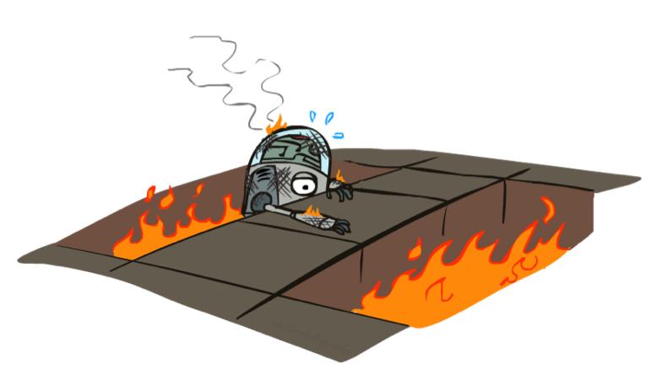
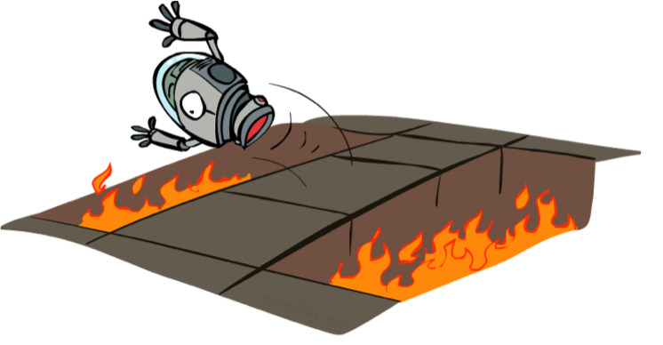
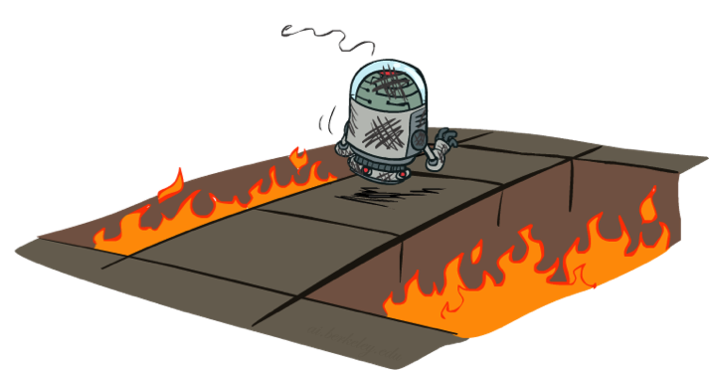
Active Reinforcement Learning
Passive reinforcement learning:
  A passive learning agent has a fixed policy that determines its behavior
Active reinforcement learning:
  An active learning agent gets to decide what actions to take

Slide 11
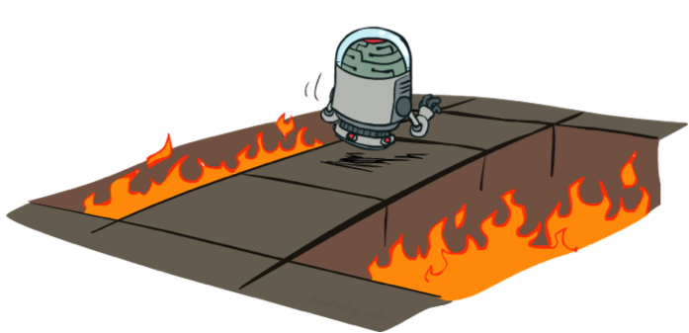
Q-Learning: act according to current optimal (and also explore…)
Full reinforcement learning: optimal policies (like value iteration)
  You don’t know the transitions T(s,a,s’)
  You don’t know the rewards R(s,a,s’)
  You choose the actions now
  Goal: learn the optimal policy / values
In this case:
  Learner makes choices!
  Fundamental tradeoff: exploration vs. exploitation
  This is NOT offline planning! You actually take actions in the world and find out what happens…

Slide 12

Q-Learning Properties
Amazing result: Q-learning converges to optimal policy -- even if you’re acting suboptimally!
This is called off-policy learning
Caveats:
  You have to explore enough
  You have to eventually make the learning rate
  small enough
  … but not decrease it too quickly
  Basically, in the limit, it doesn’t matter how you select actions (!)

Slide 13
Active Reinforcement Learning

Slide 14
Model-Free Learning
act according to current optimal (based on Q-Values)
but also explore…

Slide 15
Model-Based Learning
Input Policy π
 | A
B | C | D
 | E
act according to current optimal policy
also explore!

Slide 16
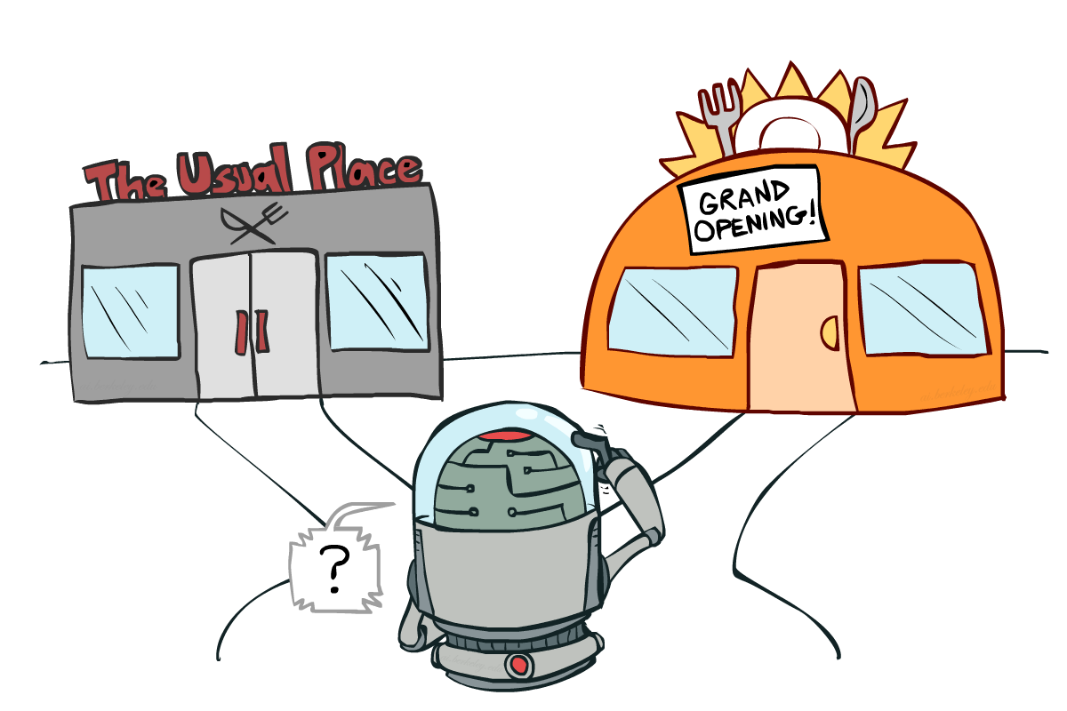
Exploration vs. Exploitation
Notes:
might be missing out on your favorite restaurant till end of time

Slide 17
Video of Demo Q-learning – Manual Exploration – Bridge Grid

Slide 18

How to Explore?
Several schemes for forcing exploration
  Simplest: random actions (ε-greedy)
    Every time step, flip a coin
    With (small) probability ε, act randomly
    With (large) probability 1-ε, act on current policy
  Problems with random actions?
    You do eventually explore the space, but keep thrashing around once learning is done
    One solution: lower ε over time
    Another solution: exploration functions
Notes:
you eventually learn the right thing but still thrash around

Slide 19
Video of Demo Q-learning – Epsilon-Greedy – Crawler

Slide 20
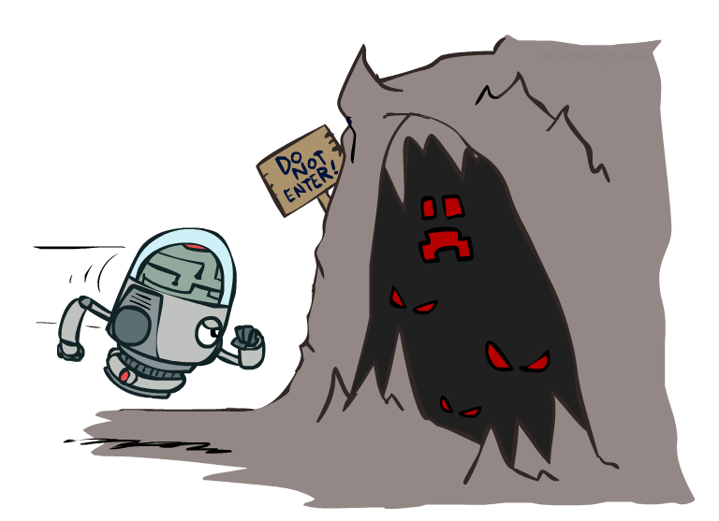

Exploration Functions
When to explore?
  Random actions: explore a fixed amount
  Better idea: explore areas whose badness is not
  (yet) established, eventually stop exploring
Exploration function
  Takes a value estimate u and a visit count n, and
  returns an optimistic utility, e.g. , k k is a predetermined constant
  N (s,a): number of times q-state (s,a) has been visited
  Note: this propagates the “bonus” back to states that lead to unknown states as well!
Regular Q-Update:
Modified Q-Update:
Notes:
Optimism in the face of uncertainty

Slide 21
Video of Demo Q-learning – Exploration Function – Crawler

Slide 22
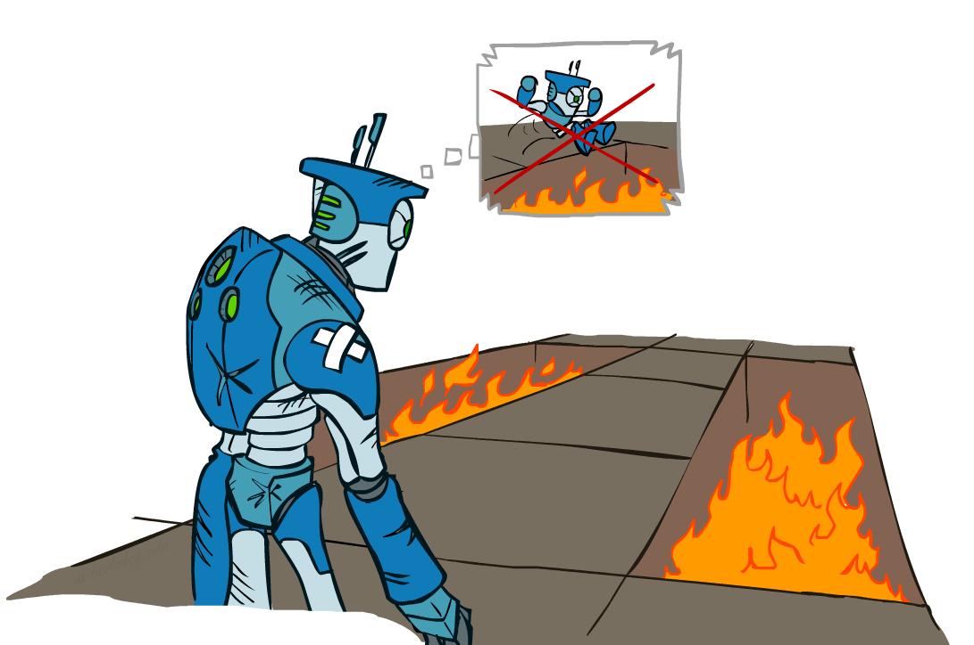
Regret
Even if you learn the optimal policy, you still make mistakes along the way!
Regret is a measure of your total mistake cost: the difference between your (expected) rewards, including youthful suboptimality, and optimal (expected) rewards
Minimizing regret goes beyond learning to be optimal – it requires optimally learning to be optimal
Example: random exploration and exploration functions both end up optimal, but random exploration has higher regret

Slide 23
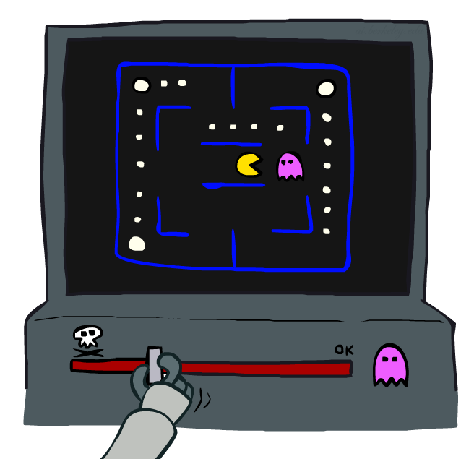
Approximate Q-Learning

Slide 24

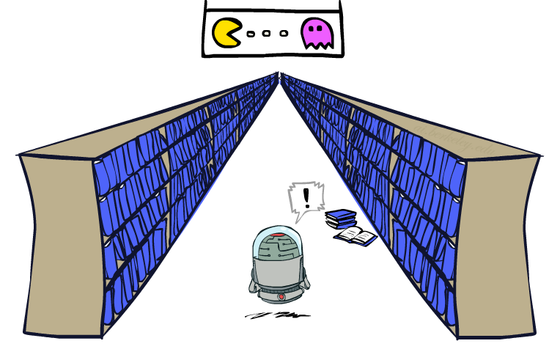
Generalizing Across States
Basic Q-Learning keeps a table of all q-values
In realistic situations, we cannot possibly learn about every single state!
  Too many states to visit them all in training
  Too many states to hold the q-tables in memory
Instead, we want to generalize:
  Learn about some small number of training states from experience
  Generalize that experience to new, similar situations
  This is a fundamental idea in machine learning, and we’ll see it over and over again

Slide 25
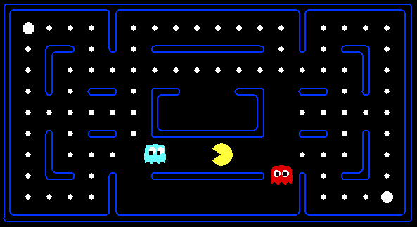



Example: Pacman
Let’s say we discover through experience that this state is bad:
In naïve q-learning, we know nothing about this state:
Or even this one!

Slide 26
Video of Demo Q-Learning Pacman – Tiny – Watch All

Slide 27
Video of Demo Q-Learning Pacman – Tiny – Silent Train

Slide 28
Video of Demo Q-Learning Pacman – Tricky – Watch All

Slide 29
Feature-Based Representations
Solution: describe a state using a vector of features (properties)
  Features are functions from states to real numbers (often 0/1) that capture important properties of the state
  Example features:
    Distance to closest ghost
    Distance to closest dot
    Number of ghosts
    1 / (dist to dot)²
    Is Pacman in a tunnel? (0/1)
    …… etc.
    Is it the exact state on this slide?
  Can also describe a q-state (s, a) with features (e.g. action moves closer to food)

Slide 30
Linear Value Functions
Using a feature representation, we can write a q function (or value function) for any state using a few weights:
Advantage: our experience is summed up in a few powerful numbers
Disadvantage: states may share features but actually be very different in value!

Slide 31

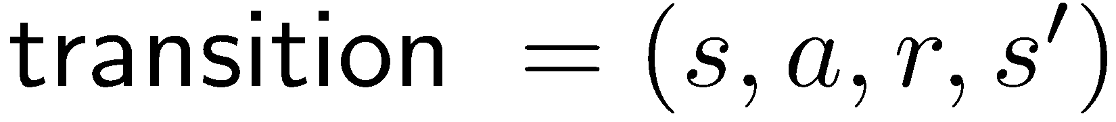
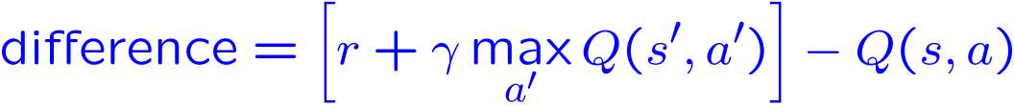
Approximate Q-Learning
Q-learning with linear Q-functions:
Intuitive interpretation:
  Adjust weights of active features
  E.g., if something unexpectedly bad happens, blame the features that were on: disprefer all states with that state’s features
Formal justification: online least squares
Exact Q’s
Approximate Q’s

Slide 32

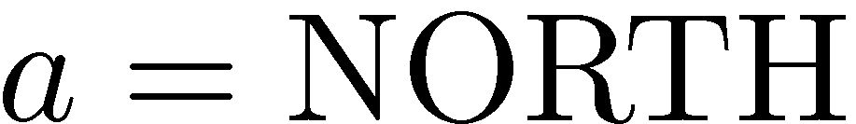
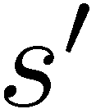
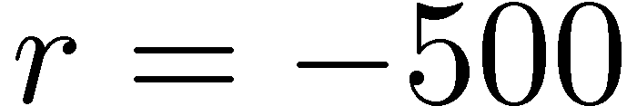


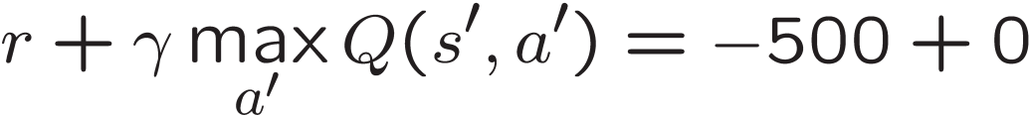
Example: Q-Pacman
Notes:
now when you run into ghosts you can figure out ghosts are bad; dots are good

Slide 33
Video of Demo Approximate Q-Learning -- Pacman

Slide 34
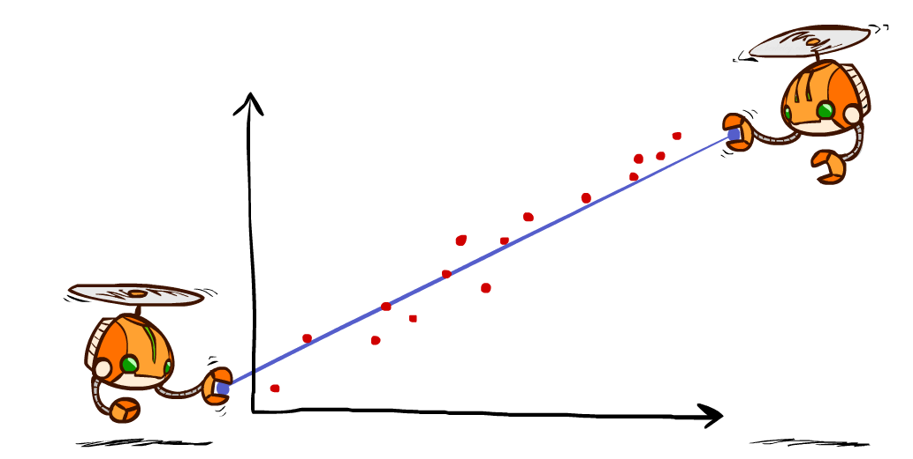
Q-Learning and Least Squares

Slide 35
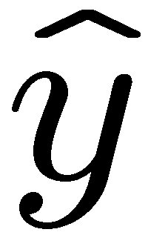
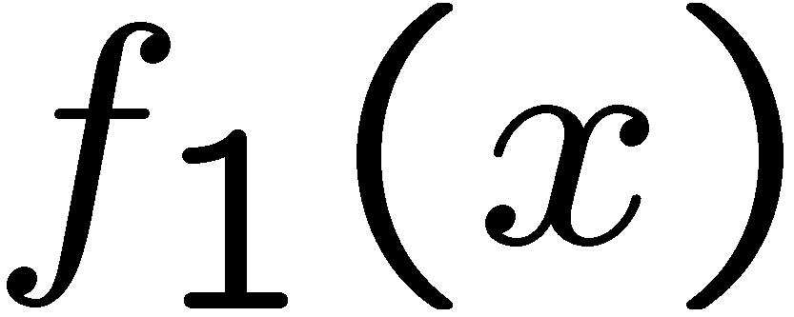
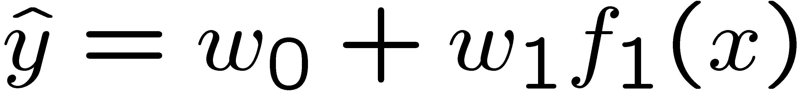
Linear Approximation: Regression
40
26
24
20
22
20
30
20
40
0
0
20
30
10
20
0
10
0
Prediction:
Prediction:
Notes:
Figure 1: scatter(1:20,10+(1:20)+2*randn(1,20),'k','filled'); a=axis; a(3)=0; axis(a);

Slide 36
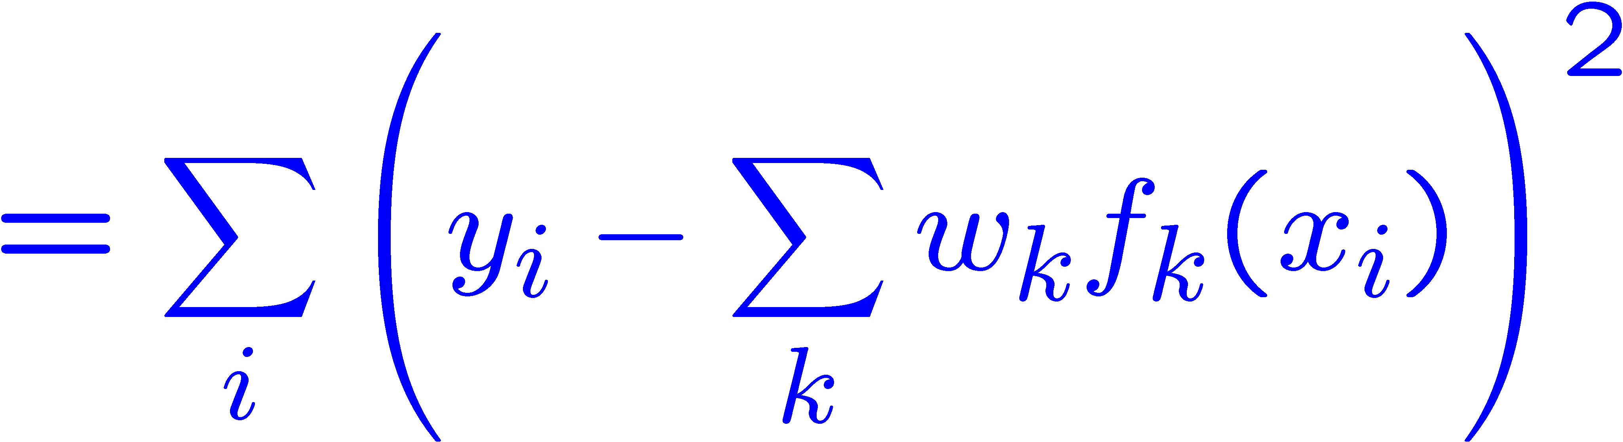
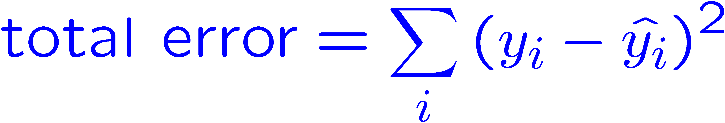
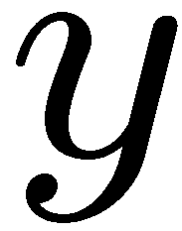
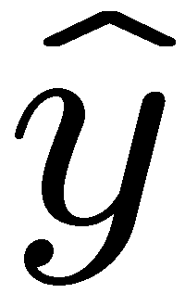

Optimization: Least Squares
Error or “residual”
Observation
Prediction
0
0
20
Notes:
Figure 1: scatter(1:20,10+(1:20)+2*randn(1,20),'k','filled'); a=axis; a(3)=0; axis(a);

Slide 37
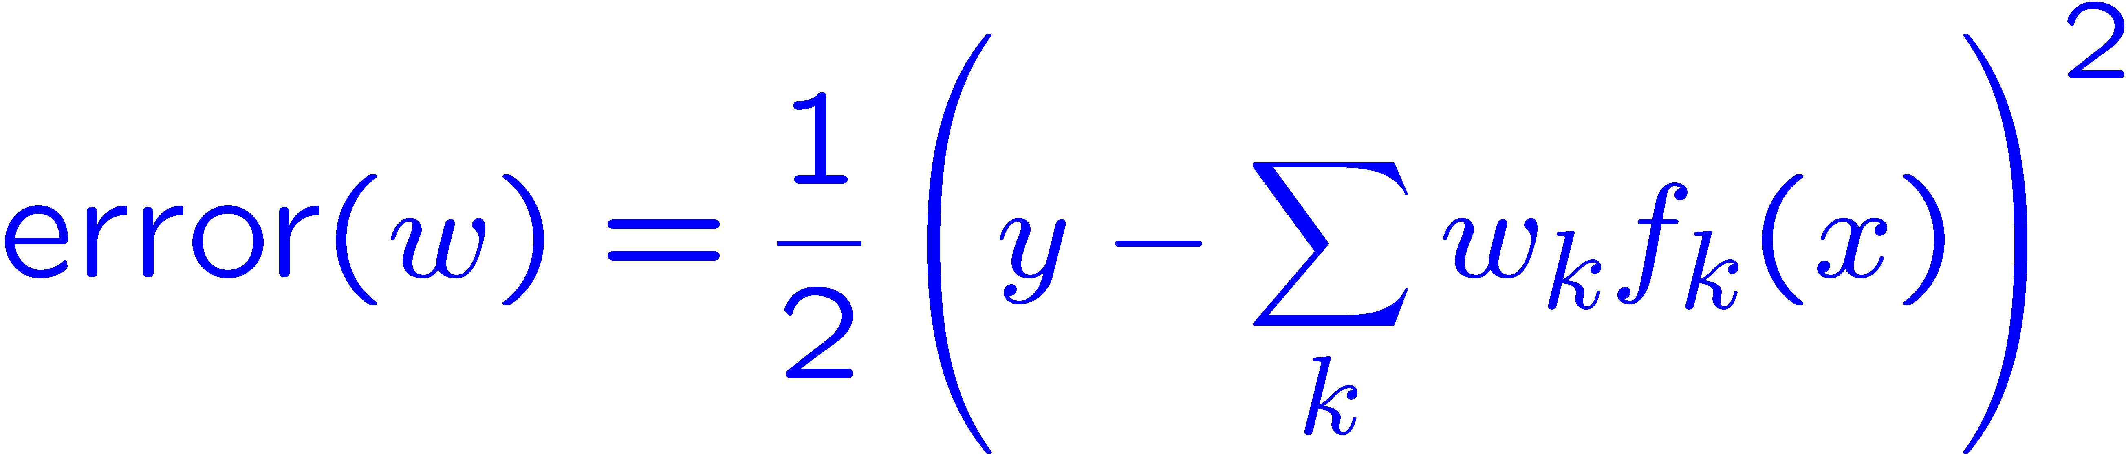
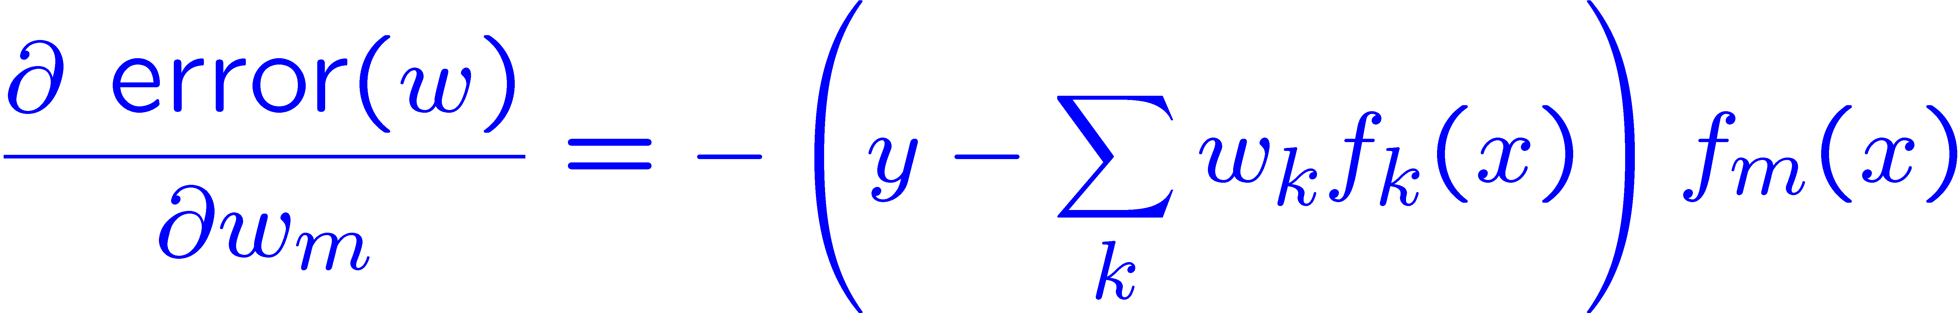
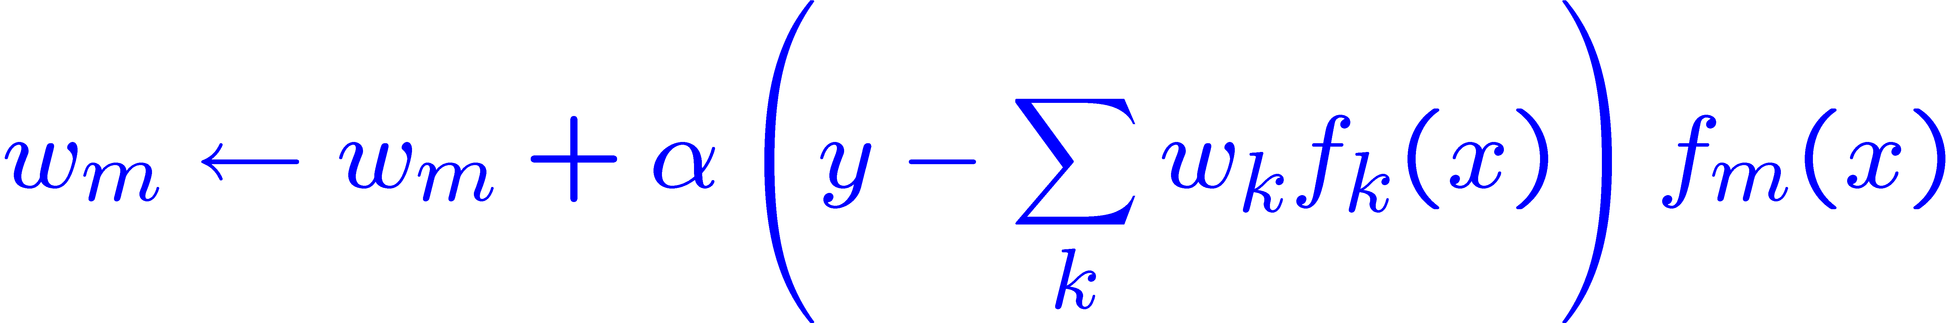
Minimizing Error
Imagine we had only one point x, with features f(x), target value y, and weights w:
Approximate q update explained:
“target”
“prediction”

Slide 38
Summary: MDPs and RL
Known MDP: Offline Solution
Goal Technique
Compute V*, Q*, π* Value / policy iteration
Evaluate a fixed policy π Policy evaluation
Unknown MDP: Model-Based
Unknown MDP: Model-Free
*use features
to generalize
*use features
to generalize
Goal Technique
Compute V*, Q*, π* VI/PI on approx. MDP
Evaluate a fixed policy π PE on approx. MDP
Goal Technique
Compute V*, Q*, π* Q-learning
Evaluate a fixed policy π Value Learning

Slide 39
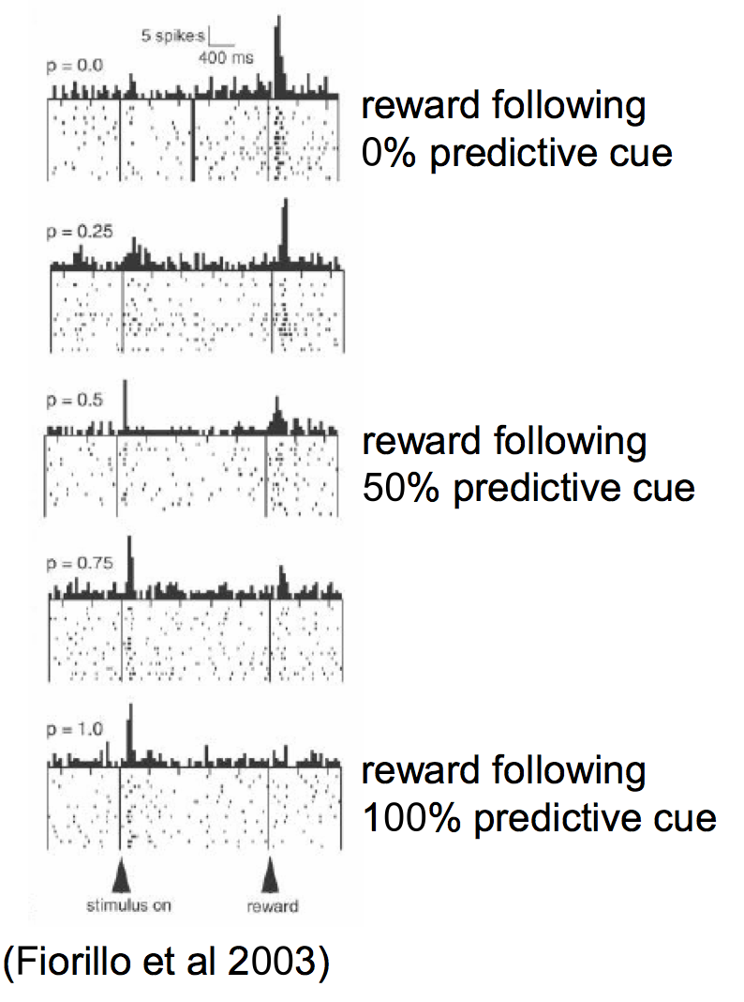
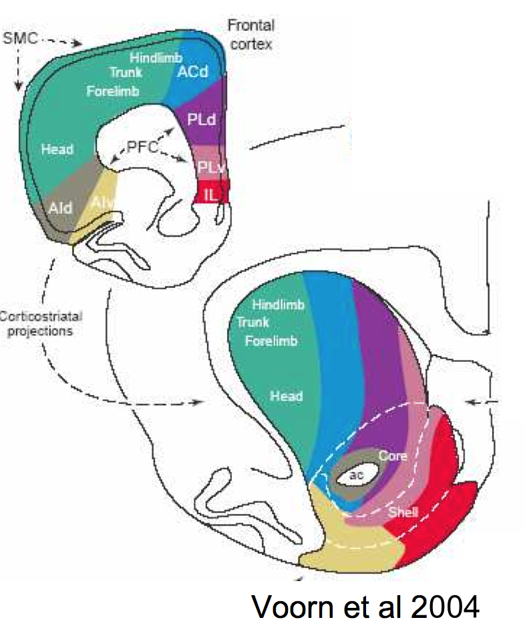
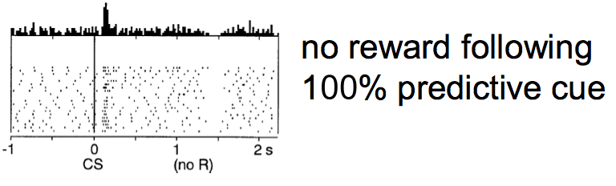
RL and dopamine
Dopamine signal generated by parts of the striatum
Encodes predictive error in value function (as in TD learning)

Slide 40
Next Section: Advanced Topics
Advanced topic I: Adversarial machine learning
Advanced topic II: Fairness in machine learning
Advanced topic III: CLIP
Final lecture: AI safety (Stuart)

