Slide 1
Prior Sampling
P(C)
c | 0.5
¬c | 0.5
Cloudy
P(S | C)
Cloudy
P(R | C)
c | s | 0.1
 | ¬s | 0.9
¬c | s | 0.5
 | ¬s | 0.5
c | r | 0.8
 | ¬r | 0.2
¬c | r | 0.2
 | ¬r | 0.8
Sprinkler
Sprinkler
Rain
Rain
P(W | S,R)
WetGrass
WetGrass
Samples:
s | r | w | 0.99
 |  | ¬w | 0.01
 | ¬r | w | 0.90
 |  | ¬w | 0.10
¬s | r | w | 0.90
 |  | ¬w | 0.10
 | ¬r | w | 0.01
 |  | ¬w | 0.99
c, ¬s, r, w
¬c, s, ¬r, w
…

Slide 2
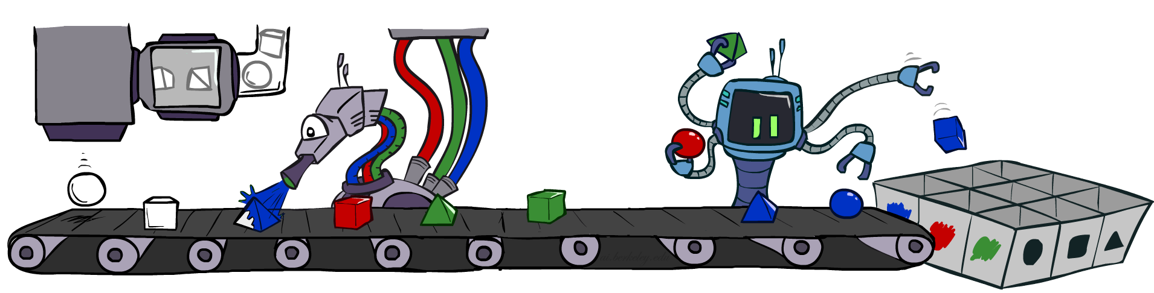
Prior Sampling
For i=1, 2, …, n (in topological order)
  Sample X_{i} from P(X_{i} | parents(X_{i}))
Return (x₁, x₂, …, x_{n})

Slide 3
Prior Sampling
This process generates samples with probability:
  S_{PS}(x₁,…,x_{n}) =
…i.e. the BN’s joint probability
Let the number of samples of an event be N_{PS}(x₁,…,x_{n})
Estimate from N samples is Q_{N}(x₁,…,x_{n}) = N_{PS}(x₁,…,x_{n})/N
Then lim_{N→∞} Q_{N}(x₁,…,x_{n}) = lim_{N→∞} N_{PS}(x₁,…,x_{n})/N
= S_{PS}(x₁,…,x_{n})
= P(x₁,…,x_{n})
I.e., the sampling procedure is consistent
∏_{i} P(x_{i} | parents(X_{i})) = P(x₁,…,x_{n})

Slide 4
Example
We’ll get a bunch of samples from the BN:
  c, ¬s, r, w
  c, s, r, w
  ¬c, s, r, ¬w
  c, ¬s, r, w
  ¬c, ¬s, ¬r, w
If we want to know P(W)
  We have counts <w:4, ¬w:1>
  Normalize to get P(W) = <w:0.8, ¬w:0.2>
  This will get closer to the true distribution with more samples
C
S
R
W

Slide 5
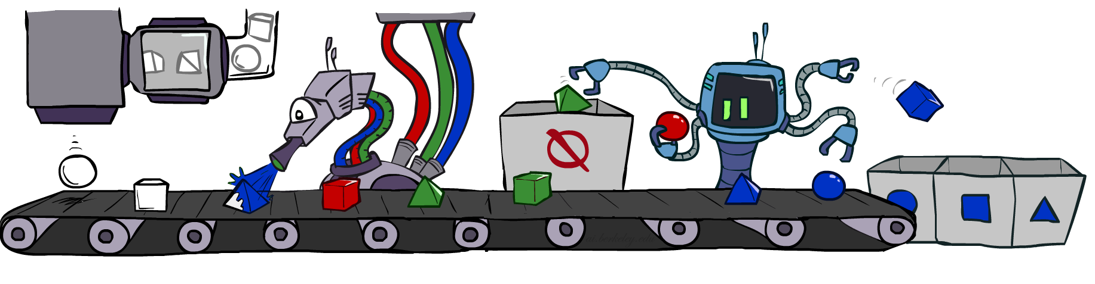
Rejection Sampling

Slide 6
Rejection Sampling
A simple application of prior sampling for estimating conditional probabilities
  Let’s say we want P(C| r, w) = α P(C, r, w)
  For these counts, samples with ¬r or ¬w are not relevant
  So count the C outcomes for samples with r, w and reject all other samples
This is called rejection sampling
  It is also consistent for conditional probabilities (i.e., correct in the limit)
C
S
R
W
  c, ¬s, r, w
  c, s, ¬r
  ¬c, s, r, ¬w
  c, ¬s, ¬r
  ¬c, ¬s, r, w

Slide 7
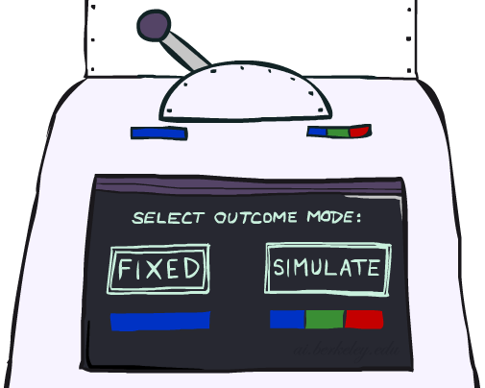
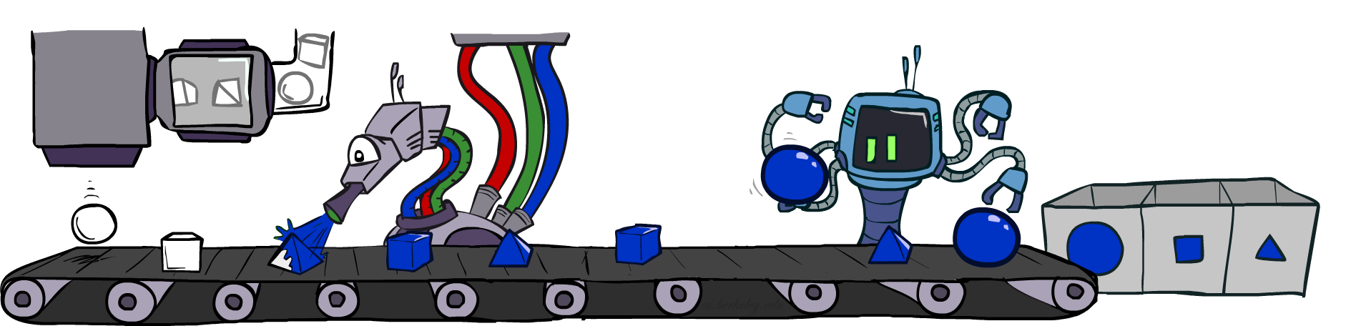
Likelihood Weighting

Slide 8
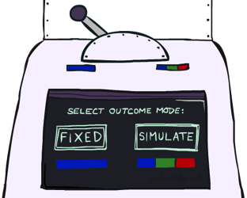


Likelihood Weighting
Problem with rejection sampling:
  If evidence is unlikely, rejects lots of samples
  Evidence not exploited as you sample
  Consider P(Shape|Color=blue)
Idea: fix evidence variables, sample the rest
  Problem: sample distribution not consistent!
  Solution: weight each sample by probability of evidence variables given parents
  pyramid, green
  pyramid, red
  sphere, blue
  cube, red
  sphere, green
  pyramid, blue
  pyramid, blue
  sphere, blue
  cube, blue
  sphere, blue
Shape
Color
Shape
Color

Slide 9
Likelihood Weighting
P(C)
c | 0.5
¬c | 0.5
P(S | C)
Cloudy
P(R | C)
Cloudy
c | s | 0.1
 | ¬s | 0.9
¬c | s | 0.5
 | ¬s | 0.5
c | r | 0.8
 | ¬r | 0.2
¬c | r | 0.2
 | ¬r | 0.8
Sprinkler
Sprinkler
Rain
Rain
P(W | S,R)
WetGrass
Samples:
WetGrass
s | r | w | 0.99
 |  | ¬w | 0.01
 | ¬r | w | 0.90
 |  | ¬w | 0.10
¬s | r | w | 0.90
 |  | ¬w | 0.10
 | ¬r | w | 0.01
 |  | ¬w | 0.99
c
, s, , w
r
w = 1.0
x 0.1
x 0.99

Slide 10
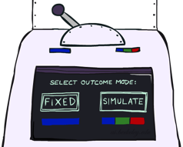
Likelihood Weighting
Input: evidence e₁,..,e_{k}
w = 1.0
for i=1, 2, …, n
  if X_{i} is an evidence variable
    x_{i} = observed value_{i} for X_{i}
    Set w = w * P(x_{i} | parents(X_{i}))
  else
    Sample x_{i} from P(X_{i} | parents(X_{i}))
return (x₁, x₂, …, x_{n}), w

Slide 11
Likelihood Weighting
Sampling distribution if Z sampled and e fixed evidence
S_{WS}(z,e) = ∏_{j} P(z_{j} | parents(Z_{j}))
Now, samples have weights
w(z,e) = ∏_{k} P(e_{k} | parents(E_{k}))
Together, weighted sampling distribution is consistent
S_{WS}(z,e) ⋅ w(z,e) = ∏_{j} P(z_{j} | parents(Z_{j})) ∏_{k} P(e_{k} | parents(E_{k}))
= P(z,e)
Likelihood weighting is an example of importance sampling
  Would like to estimate some quantity based on samples from P
  P is hard to sample from, so use Q instead
  Weight each sample x by P(x)/Q(x)
Cloudy
C
S
R
W

Slide 12
Car Insurance: P(PropertyCost | e)

Slide 13
Likelihood Weighting
Likelihood weighting is good
  All samples are used
  The values of downstream variables are influenced by upstream evidence
Likelihood weighting still has weaknesses
  The values of upstream variables are unaffected by downstream evidence
    E.g., suppose evidence is a video of a traffic accident
  With evidence in k leaf nodes, weights will be O(2^{-k})
  With high probability, one lucky sample will have much larger weight than the others, dominating the result
We would like each variable to “see” all the evidence!

Slide 14
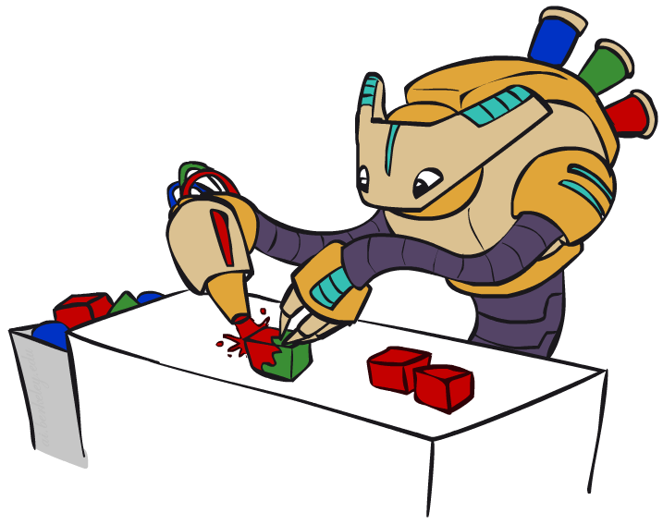
CS 188: Artificial Intelligence
Bayes Nets: Gibbs Sampling
Instructors: Stuart Russell and Dawn Song
University of California, Berkeley
Notes:
Please retain proper attribution, including the reference to ai.berkeley.edu. Thanks!

Slide 15
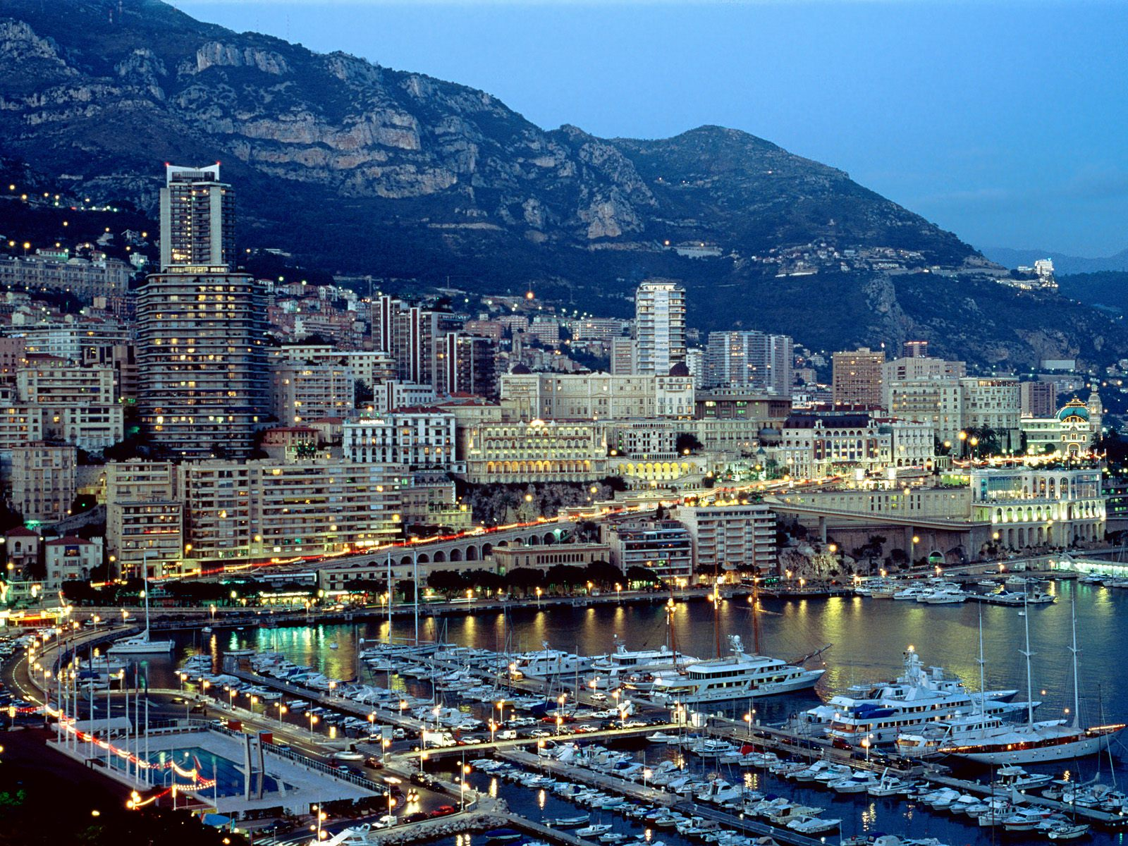
Markov Chain Monte Carlo
MCMC (Markov chain Monte Carlo) is a family of randomized algorithms for approximating some quantity of interest over a very large state space
  Markov chain = a sequence of randomly chosen states (“random walk”), where each state is chosen conditioned on the previous state
  Monte Carlo = a very expensive city in Monaco with a famous casino
  Monte Carlo = an algorithm (usually based on sampling) that has some probability of producing an incorrect answer
MCMC = wander around for a bit, average what you see

Slide 16
Gibbs sampling
A particular kind of MCMC
  States are complete assignments to all variables
    (Cf local search: closely related to simulated annealing!)
  Evidence variables remain fixed, other variables change
  To generate the next state, pick a variable and sample a value for it conditioned on all the other variables: X_{i}’ ~ P(X_{i} | x₁,..,x_{i-1},x_{i+1},..,x_{n})
    Will tend to move towards states of higher probability, but can go down too
    In a Bayes net, P(X_{i} | x₁,..,x_{i-1},x_{i+1},..,x_{n}) = P(X_{i} | markov_blanket(X_{i}))
Theorem: Gibbs sampling is consistent*
Provided all Gibbs distributions are bounded away from 0 and 1 and variable selection is fair

Slide 17
Why would anyone do this?
Samples soon begin to reflect all the evidence in the network
Eventually they are being drawn from the true posterior!

Slide 18
How would anyone do this?
  Repeat many times
    Sample a non-evidence variable X_{i} from
    P(X_{i} | x₁,..,x_{i-1},x_{i+1},..,x_{n}) = P(X_{i} | markov_blanket(X_{i}))
    = α P(X_{i} | parents (X_{i})) ∏_{j} P(y_{j} | parents(Y_{j}))

Slide 19
Gibbs Sampling Example: P( S | r)
Step 1: Fix evidence
  R = true
Step 3: Repeat
  Choose a non-evidence variable X
  Resample X from P(X | markov_blanket(X))
Step 2: Initialize other variables
  Randomly
C
C
S
r
S
r
W
W
C
C
C
C
C
C
S
r
S
r
S
r
S
r
S
r
S
r
W
W
W
W
W
W
Sample S ~ P(S | c, r, ¬w)
Sample C ~ P(C | s, r)
Sample W ~ P(W | s, r)
Notes:
Better animation

Slide 20
Markov chain given s, w

Slide 21
Car Insurance: P(Age | mc,lc,pc)

Slide 22
Gibbs sampling and MCMC in practice
The most commonly used method for large Bayes nets
  See, e.g., BUGS, JAGS, STAN, infer.net, BLOG, etc.
Can be compiled to run very fast
  Eliminate all data structure references, just multiply and sample
  ~100 million samples per second on a laptop
Can run asynchronously in parallel (one processor per variable)
Many cognitive scientists suggest the brain runs on MCMC

Slide 23
Quiz
Suppose I perform a random walk on a graph, following the arcs out of a node uniformly at random. In the infinite limit, what fraction of time do I spend at each node?
  Consider these two examples:
a
a
b
c
b
c

Slide 24
Why does it work? (see AIMA 13.4.2 for details)
Suppose we run it for a long time and predict the probability of reaching any given state at time t: π_{t}(x₁,...,x_{n}) or π_{t}(x)
    Each Gibbs sampling step (pick a variable, resample its value) applied to a state x has a probability k(x’ | x) of reaching a next state x’
    So π_{t+1}(x’) = ∑_{x} k(x’ | x) π_{t}(x) or, in matrix/vector form π_{t+1} = Kπ_{t}
When the process is in equilibrium π_{t+1} = π_{t} = π so Kπ = π
This has a unique* solution π = P(x₁,...,x_{n} | e₁,...,e_{k})
So for large enough t the next sample will be drawn from the true posterior
  “Large enough” depends on CPTs in the Bayes net; takes longer if nearly deterministic

Slide 25


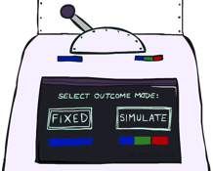
Bayes Net Sampling Summary
Prior Sampling P
Likelihood Weighting P( Q | e)
Rejection Sampling P( Q | e )
Gibbs Sampling P( Q | e )

