Slide 1
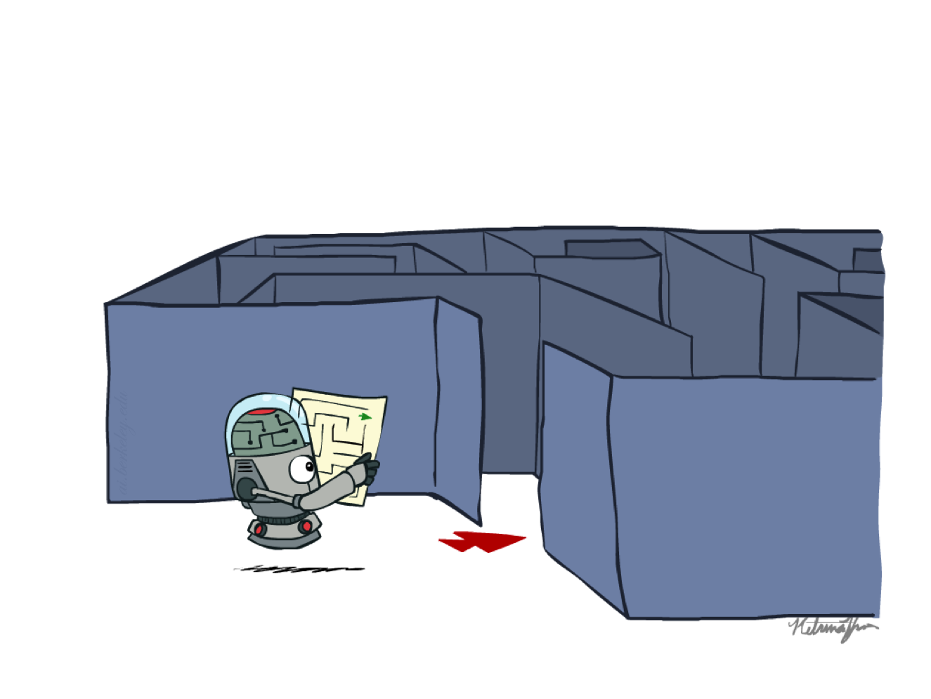
CS 188: Artificial Intelligence
Search
Instructors: Stuart Russell and Dawn Song
University of California, Berkeley
[slides adapted from Dan Klein, Pieter Abbeel]
Notes:
Please retain proper attribution, including the reference to ai.berkeley.edu. Thanks!

Slide 2
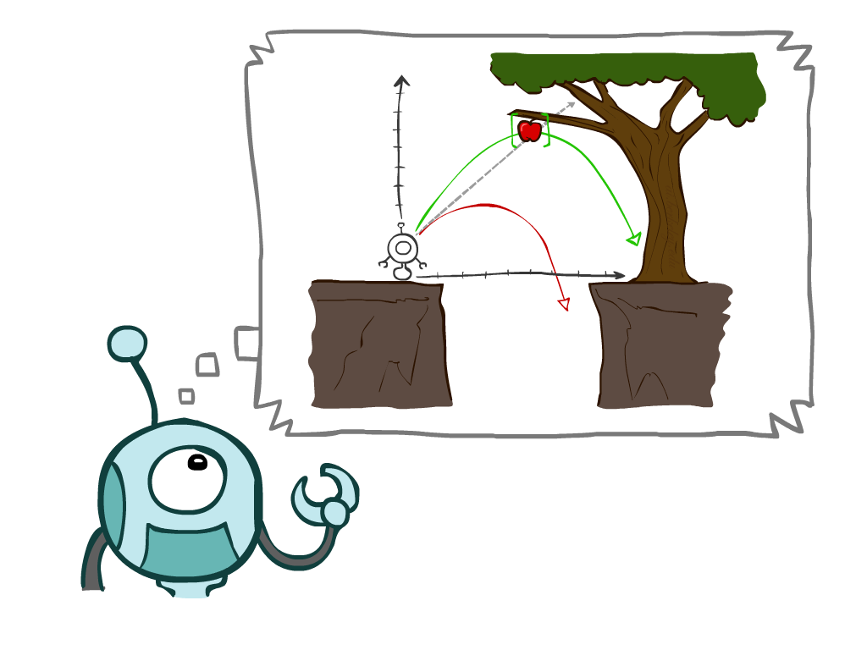
Today
Agents that Plan Ahead
Search Problems
Uninformed Search Methods
  Depth-First Search
  Breadth-First Search
  Uniform-Cost Search
Notes:
General theme in the class:
A goal we have in mind.
A mathematical abstraction to formalize this
Algorithms that operate on these abstractions

Slide 3

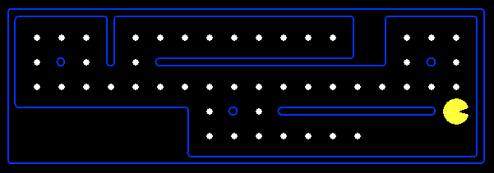

Planning Agents
Planning agents decide based on evaluating future action sequences
Must have a model of how the world evolves in response to actions
Usually have a definite goal
Optimal: Achieve goal at least cost

Slide 4
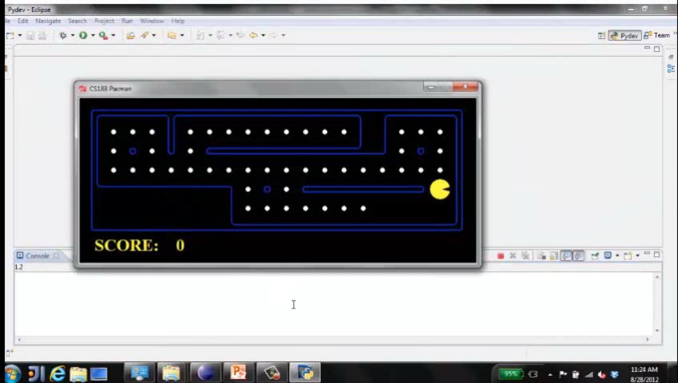
Move to nearest dot and eat it

Slide 5
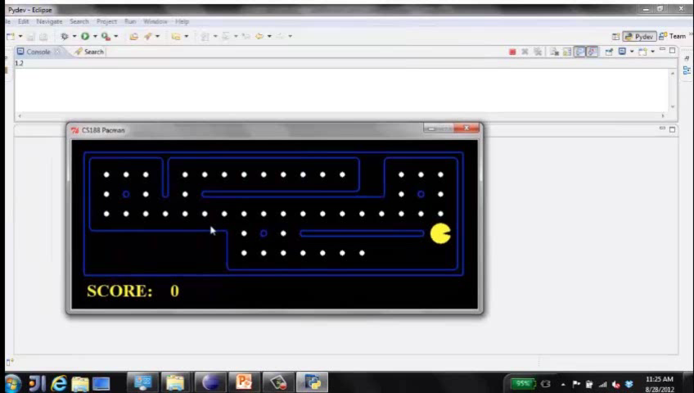
Precompute optimal plan, execute it

Slide 6

Search Problems

Slide 7







Search Problems
A search problem consists of:
  A state space S
  An initial state s₀
  Actions A(s) in each state
  Transition model Result(s,a)
  A goal test G(s)
    S has no dots left
  Action cost c(s,a,s’)
    +1 per step; -10 food; -500 win; +500 die; -200 eat ghost
A solution is an action sequence that reaches a goal state
An optimal solution has least cost among all solutions
N
-9
-9
E
Notes:
Often comes back on exams
Goal test – sometimes more than one state that satisfies having achieved the goal, for example, “eat all the dots”
Abstraction

Slide 8

Search Problems Are Models

Slide 9

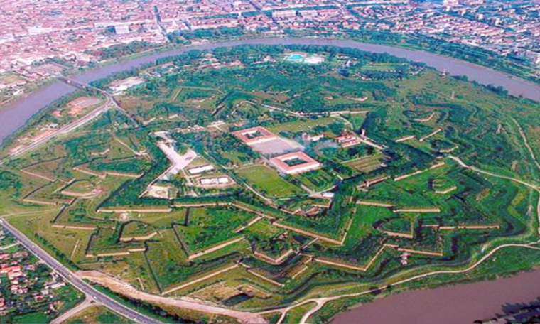
Example: Traveling in Romania

Slide 10
But then…

Slide 11
Example: Traveling in Romania
State space:
  Cities
Initial state:
  Arad
Actions:
  Go to adjacent city
Transition model:
  Reach adjacent city
Goal test:
  s = Bucharest?
Action cost:
  Road distance from s to s’
Solution?

Slide 12
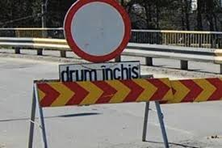
Models are almost always wrong

Slide 13
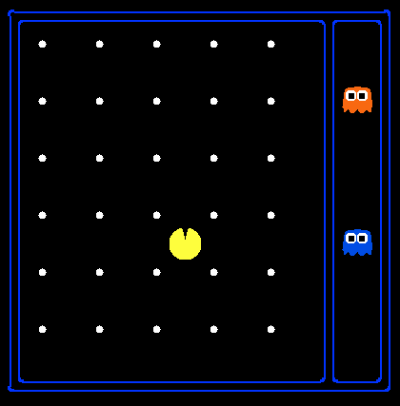
State Space Sizes
World state:
  Agent positions: 120
  Food count: 30
  Ghost positions: 12
  Agent facing: NSEW
How many
  World states?
  120x(2³⁰)x(12²)x4
  States for pathing?
  120
  States for eat-all-dots?
  120x(2³⁰)
Notes:
90 * (2^30-1) + 30 * 2^29 = 145 billion
2^29 = 536 870 912

Slide 14

State Space Graphs and Search Trees

Slide 15
State Space Graphs
E
E
E
State space graph: A mathematical representation of a search problem
  Nodes are (abstracted) world configurations
  Arcs represent transitions (labeled with actions)
  The goal test is a set of goal nodes (maybe only one)
In a state space graph, each state occurs only once!
We can rarely build this full graph in memory (it’s too big), but it’s a useful idea
S
S
N
N
N
E
E
W
S
N
N
N
E
N
S
W
N
E
E
E
E
W
W

Slide 16
State Space Graphs
State space graph: A mathematical representation of a search problem
  Nodes are (abstracted) world configurations
  Arcs represent successors (action results)
  The goal test is a set of goal nodes (maybe only one)
In a state space graph, each state occurs only once!
We can rarely build this full graph in memory (it’s too big), but it’s a useful idea
a
G
b
c
e
d
f
S
h
p
q
r
Tiny state space graph for a tiny search problem

Slide 17
State Space Graphs vs. Search Trees
State Space Graph
Each NODE in in the search tree is an entire PATH in the state space graph.
Search Tree
S
a
G
d
e
p
b
c
q
b
c
e
h
r
d
e
f
a
a
h
r
p
q
f
S
h
We construct the tree on demand – and we construct as little as possible.
p
q
f
q
c
G
p
q
r
q
c
G
a
a

Slide 18

Quiz: State Space Graphs vs. Search Trees
Consider this 4-state graph:
How big is its search tree (from S)?
a
S
G
b

Slide 19
Quiz: State Space Graphs vs. Search Trees
Consider this 4-state graph:
How big is its search tree (from S)?
a
s
a
b
S
G
b
G
a
G
b
a
G
b
G
…
…
Important: Those who don’t know history are doomed to repeat it!

Slide 20
Quiz: State Space Graphs vs. Search Trees
Consider a rectangular grid:
How many states within d steps of start?
How many states in search tree of depth d?

Slide 21
Tree Search

Slide 22
Search Example: Romania

Slide 23
Creating the search tree
frontier

Slide 24
Creating the search tree
expanded
frontier

Slide 25
Creating the search tree
expanded
frontier

Slide 26
General Tree Search
Main variations:
  Which leaf node to expand next
  Whether to check for repeated states
  Data structures for frontier, expanded nodes

Slide 27
Systematic search
frontier
expanded
reached =
expanded U frontier
unexplored
Frontier separates expanded from unexplored region of state-space graph
Expanding a frontier node:
  Moves a node from frontier into expanded
  Adds nodes from unexplored into frontier, maintaining property 1

Slide 28
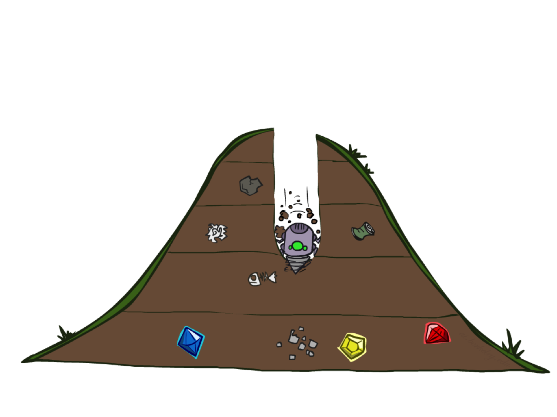
Depth-First Search

Slide 29
Depth-First Search
Strategy: expand a deepest node first
Implementation: Frontier is a LIFO stack
a
G
a
c
b
c
b
e
d
e
d
f
f
S
h
h
p
p
r
q
r
q
S
d
e
p
b
c
e
h
r
q
a
a
h
r
p
q
f
p
q
f
q
c
G
q
c
G
a
a

Slide 30
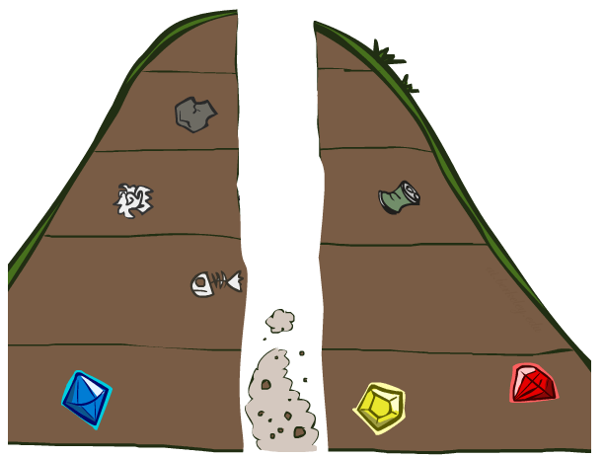
Search Algorithm Properties

Slide 31
Search Algorithm Properties
Complete: Guaranteed to find a solution if one exists?
Optimal: Guaranteed to find the least cost path?
Time complexity?
Space complexity?
Cartoon of search tree:
  b is the branching factor
  m is the maximum depth
  solutions at various depths
Number of nodes in entire tree?
  1 + b + b² + …. b^{m} = O(b^{m})
1 node
b
…
b nodes
b² nodes
m tiers
b^{m} nodes

Slide 32
Depth-First Search (DFS) Properties
What nodes does DFS expand?
  Some left prefix of the tree down to depth m.
  Could process the whole tree!
  If m is finite, takes time O(b^{m})
How much space does the frontier take?
  Only has siblings on path to root, so O(bm)
Is it complete?
  m could be infinite
  preventing cycles may help (more later)
Is it optimal?
  No, it finds the “leftmost” solution, regardless of depth or cost
1 node
b
…
b nodes
b² nodes
m tiers
b^{m} nodes

Slide 33
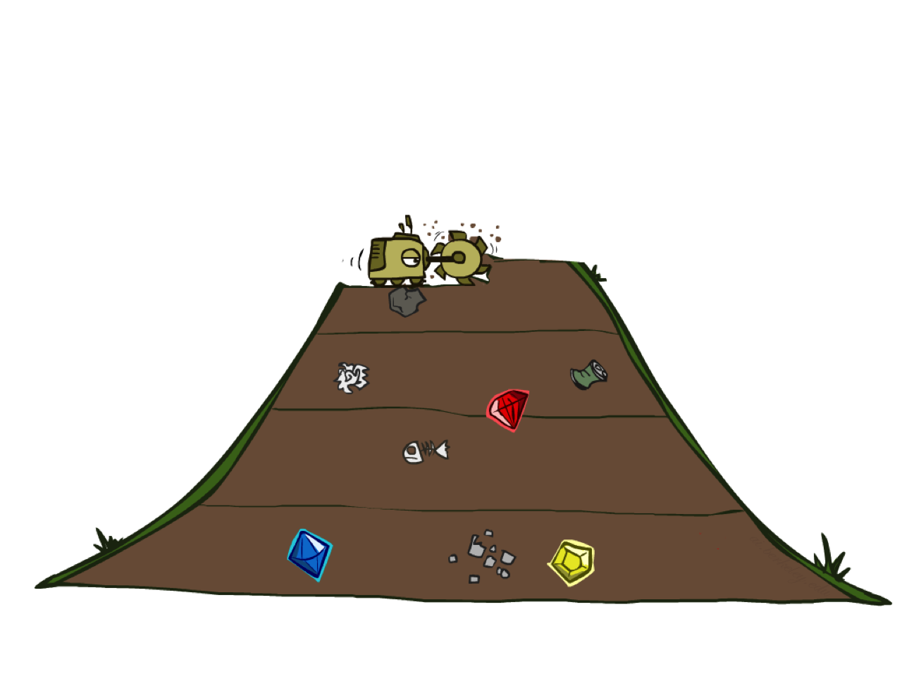
Breadth-First Search

Slide 34
Breadth-First Search
Strategy: expand a shallowest node first
Implementation: Frontier is a FIFO queue
a
G
b
c
d
e
f
S
h
p
q
r
S
d
e
p
Search
Tiers
b
c
e
h
r
q
a
a
h
r
p
q
f
p
q
f
q
c
G
q
c
G
a
a

Slide 35
Breadth-First Search (BFS) Properties
What nodes does BFS expand?
  Processes all nodes above shallowest solution
  Let depth of shallowest solution be s
  Search takes time O(b^{s})
How much space does the frontier take?
  Has roughly the last tier, so O(b^{s})
Is it complete?
  s must be finite if a solution exists, so yes!
Is it optimal?
  If costs are equal (e.g., 1)
1 node
b
…
b nodes
s tiers
b² nodes
b^{s} nodes
b^{m} nodes

Slide 36
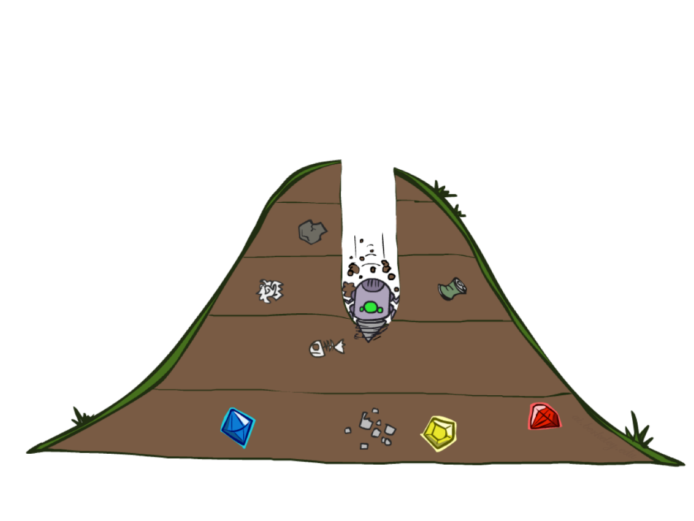
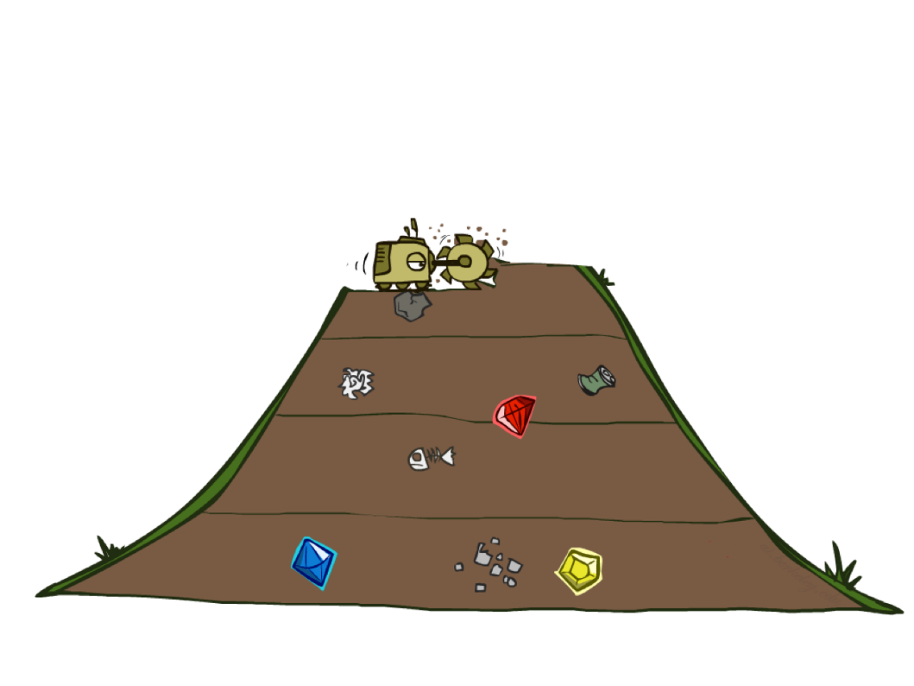
Quiz: DFS vs BFS

Slide 37
Quiz: DFS vs BFS
When will BFS outperform DFS?
When will DFS outperform BFS?
[Demo: dfs/bfs maze water (L2D6)]
Notes:
BFS best when there is a shallow solution, s << m
DFS best when solutions all at m, and fairly common at m

Slide 38

Example: Maze Water DFS/BFS (part 1)
Notes:
This is breadth-first – spreads out in concentric circles from root. Explores a lot of the state space

Slide 39
Example: Maze Water DFS/BFS (part 2)
Notes:
This is DFS – explores less but finds a terrible solution.
Is it checking for repeated states? Yes! (Otherwise it would never complete)

Slide 40
Iterative Deepening
Idea: get DFS’s space advantage with BFS’s time / shallow-solution advantages
  Run a DFS with depth limit 1. If no solution…
  Run a DFS with depth limit 2. If no solution…
  Run a DFS with depth limit 3. …..
Isn’t that wastefully redundant?
  Generally most work happens in the lowest level searched, so not so bad!
b
…
Notes:
1 + (1+b) + (1+b+b²) + … + (1+b+…+b^{s}) = (s+1) + sb + (s-1)b² + … + b^{s} = O(b^{s})

Slide 41
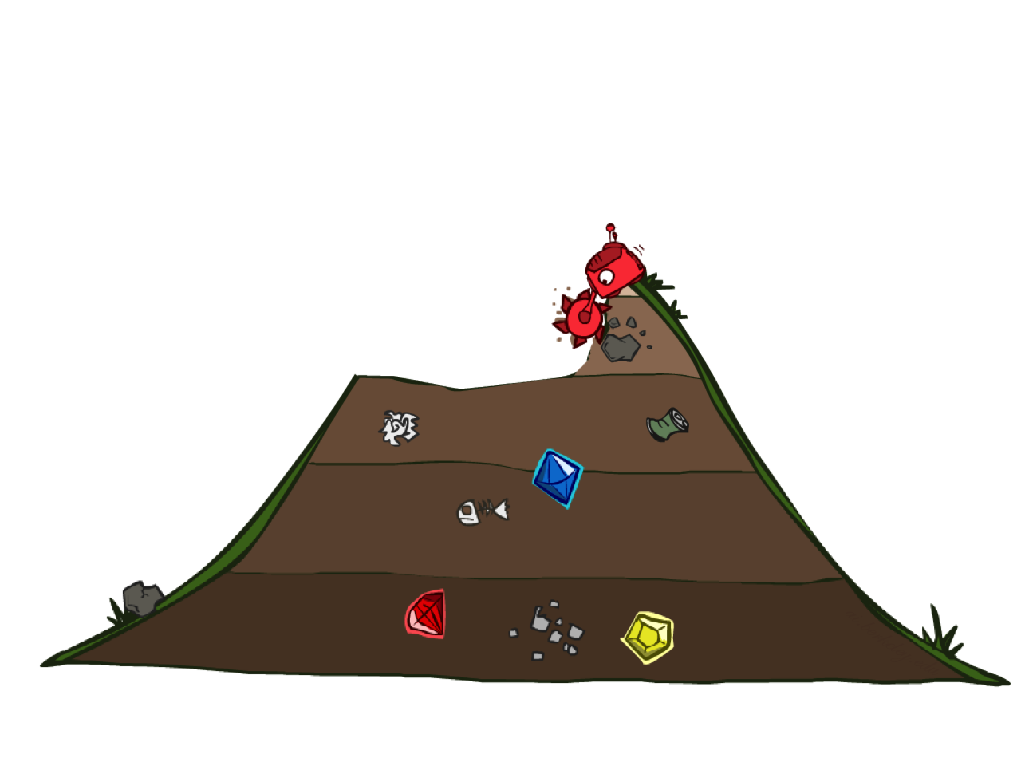
Uniform Cost Search

Slide 42
Uniform Cost Search
2
G
a
g(n) = cost from root to n
Strategy: expand lowest g(n)
Frontier is a priority queue sorted by g(n)
b
c
1
8
2
2
e
3
d
f
9
8
2
S
h
1
1
p
q
r
15
0
S
d
3
e
9
p
1
b
4
e
5
h
17
r
11
q
16
c
11
Cost contours
a
6
a
h
13
r
7
p
q
f
p
q
f
8
q
c
G
q
c
a
11
G
10
a

Slide 43
Uniform Cost Search (UCS) Properties
What nodes does UCS expand?
  Processes all nodes with cost less than cheapest solution!
  If that solution costs C* and arcs cost at least ε , then the “effective depth” is roughly C*/ε
  Takes time O(b^{C*/ε}) (exponential in effective depth)
How much space does the frontier take?
  Has roughly the last tier, so O(b^{C*/ε})
Is it complete?
  Assuming C* is finite and ε > 0, yes!
Is it optimal?
  Yes! (Proof next lecture via A*)
b
g ≤ 1
…
C*/ε “tiers”
g ≤ 2
g ≤ 3

Slide 44
Video of Demo Maze with Deep/Shallow Water --- BFS or UCS? (part 1)
Notes:
Cost 1 for shallow, 2 for deep water. Let students guess which one of the three it is. (This is BFS.)

Slide 45
Video of Demo Maze with Deep/Shallow Water --- BFS or UCS? (part 2)
Notes:
Let students guess which one of the three it is. (This is UCS.)

