Slide 1
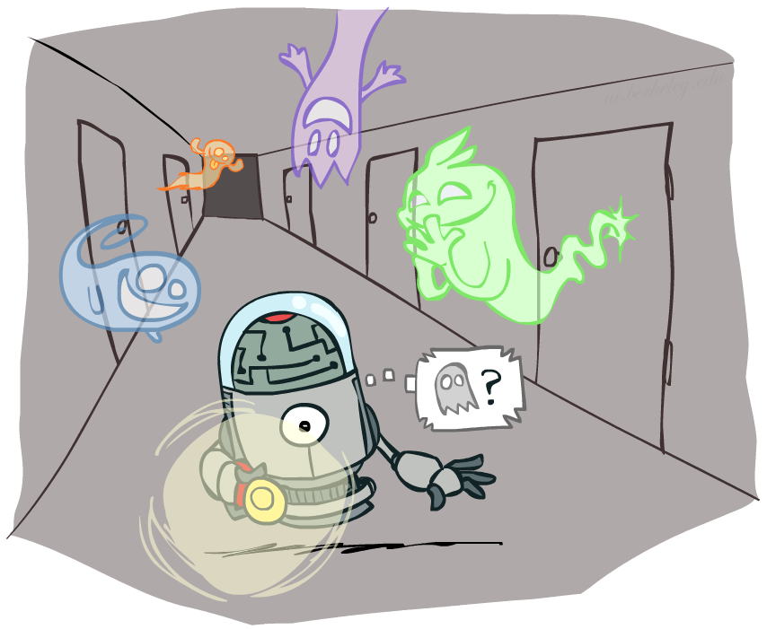
CS 188: Artificial Intelligence
Hidden Markov Models
Instructor: Anca Dragan --- University of California, Berkeley
[These slides were created by Dan Klein, Pieter Abbeel, and Anca. http://ai.berkeley.edu.]
Notes:
Please retain proper attribution, including the reference to ai.berkeley.edu. Thanks!

Slide 2

Reasoning over Time or Space
Often, we want to reason about a sequence of observations
  Speech recognition
  Robot localization
  User attention
  Medical monitoring
Need to introduce time (or space) into our models

Slide 3


Markov Models
  Value of X at a given time is called the state
  Parameters: called transition probabilities or dynamics, specify how the state evolves over time (also, initial state probabilities)
  Stationarity assumption: transition probabilities the same at all times
  Same as MDP transition model, but no choice of action
  A (growable) BN: We can always use generic BN reasoning on it if we truncate the chain at a fixed length
X₁
X₂
X₃
X₄

Slide 4

Markov Assumption: Conditional Independence
Basic conditional independence:
  Past and future independent given the present
  Each time step only depends on the previous
  This is called the (first order) Markov property

Slide 5
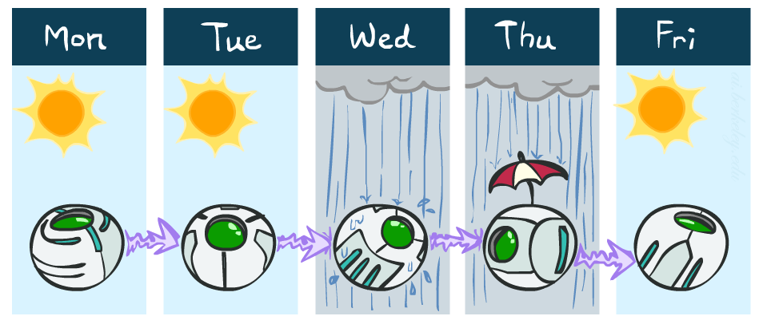
Example Markov Chain: Weather
States: X = {rain, sun}
Initial distribution: 1.0 sun
CPT P(X_{t} | X_{t-1}):
Two new ways of representing the same CPT
X_{t-1} | X_{t} | P(X_{t}|X_{t-1})
sun | sun | 0.9
sun | rain | 0.1
rain | sun | 0.3
rain | rain | 0.7
0.9
0.3
0.9
rain
sun
sun
sun
0.1
0.3
rain
rain
0.7
0.7
0.1

Slide 6
Example Markov Chain: Weather
0.9
0.3
Initial distribution: 1.0 sun
What is the probability distribution after one step?
rain
sun
0.7
0.1

Slide 7
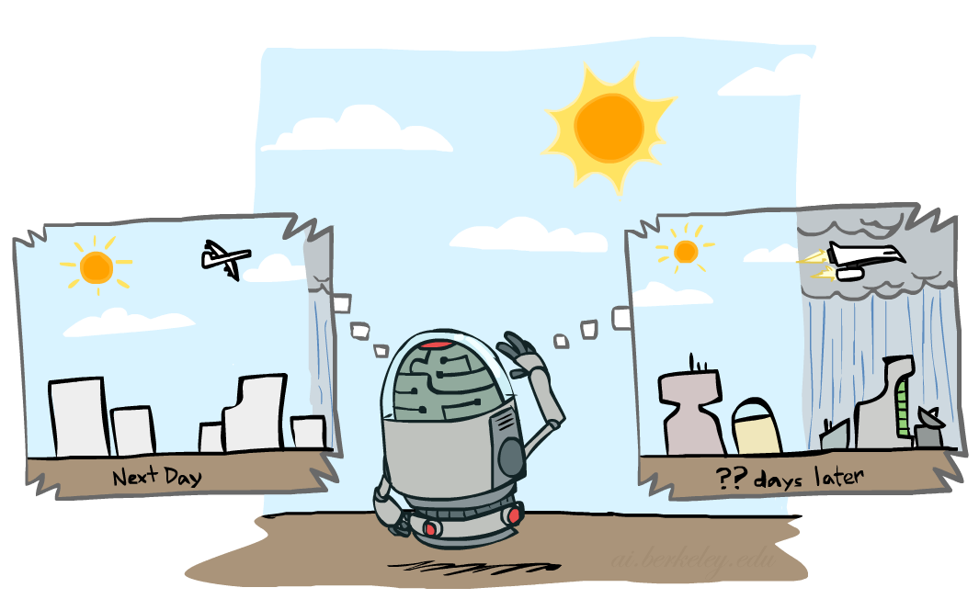

Mini-Forward Algorithm
Question: What’s P(X) on some day t?
X₁
X₂
X₃
X₄
Forward simulation

Slide 8
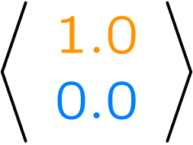
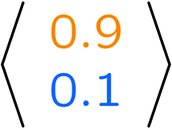
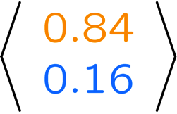
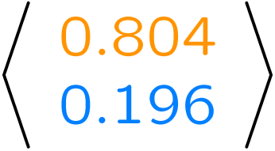
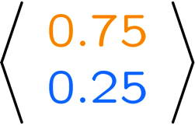
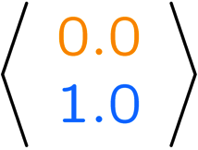
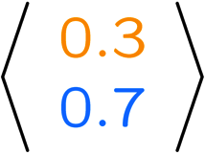
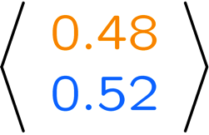
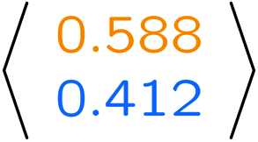
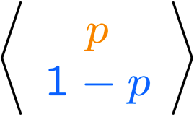
Example Run of Mini-Forward Algorithm
From initial observation of sun
From initial observation of rain
From yet another initial distribution P(X₁):
P(X₁)
P(X₂)
P(X₃)
P(X₄)
P(X∞)
P(X₁)
P(X₂)
P(X₃)
P(X₄)
P(X∞)
…
P(X₁)
P(X∞)
[Demo: L13D1,2,3]

Slide 9

Video of Demo Ghostbusters Basic Dynamics

Slide 10
Video of Demo Ghostbusters Circular Dynamics

Slide 11
Video of Demo Ghostbusters Whirlpool Dynamics

Slide 12

Stationary Distributions
For most chains:
  Influence of the initial distribution gets less and less over time.
  The distribution we end up in is independent of the initial distribution
Stationary distribution:
  The distribution we end up with is called the stationary distribution of the chain
  It satisfies

Slide 13
Example: Stationary Distributions
Question: What’s P(X) at time t = infinity?
X₁
X₂
X₃
X₄
X_{t-1} | X_{t} | P(X_{t}|X_{t-1})
sun | sun | 0.9
sun | rain | 0.1
rain | sun | 0.3
rain | rain | 0.7
Also:

Slide 14

Application of Stationary Distribution: Web Link Analysis
PageRank over a web graph
  Each web page is a possible value of a state
  Initial distribution: uniform over pages
  Transitions:
    With prob. c, uniform jump to a
    random page (dotted lines, not all shown)
    With prob. 1-c, follow a random
    outlink (solid lines)
Stationary distribution
  Will spend more time on highly reachable pages
  E.g. many ways to get to the Acrobat Reader download page
  Somewhat robust to link spam.
  Google 1.0 returned the set of pages containing all your keywords in decreasing rank, now all search engines use link analysis along with many other factors (rank actually getting less important over time)
Notes:
Before: most search engines were merely based on how well a page matches your search words.
Note: currently dominated by clickstreams

Slide 15

Application of Stationary Distributions: Gibbs Sampling*
Each joint instantiation over all hidden and query variables is a state: {X₁, …, X_{n}} = H U Q
Transitions:
  With probability 1/n resample variable X_{j} according to
  P(X_{j} | x₁, x₂, …, x_{j-1,} x_{j+1}, …, x_{n,} e_{1,} …, e_{m})
Stationary distribution:
  Conditional distribution P(X₁, X₂ , … , X_{n}|e_{1,} …, e_{m})
  Means that when running Gibbs sampling long enough we get a sample from the desired distribution
  Requires some proof to show this is true!
Notes:
With re-ordering of topics, can’t cover this here yet, need to wait till after sampling.

Slide 16

Hidden Markov Models

Slide 17
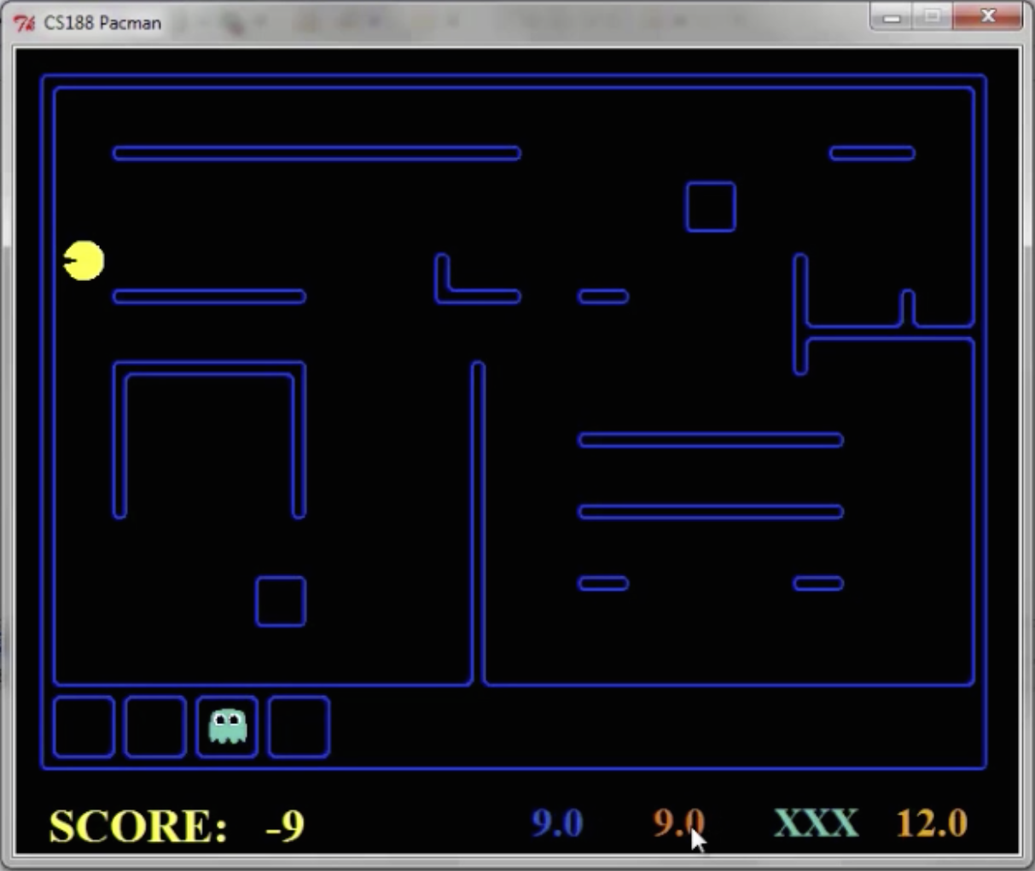
Pacman – Sonar
[Demo: Pacman – Sonar – No Beliefs(L14D1)]

Slide 18
Video of Demo Pacman – Sonar (no beliefs)

Slide 19
Hidden Markov Models
Markov chains not so useful for most agents
  Need observations to update your beliefs
Hidden Markov models (HMMs)
  Underlying Markov chain over states X
  You observe outputs (effects) at each time step
X₁
X₂
X₃
X₄
X₅
E₁
E₂
E₃
E₄
E₅

Slide 20


Example: Weather HMM
Rain_{t-1}
Rain_{t}
Rain_{t+1}
Umbrella_{t-1}
Umbrella_{t}
Umbrella_{t+1}
An HMM is defined by:
  Initial distribution:
  Transitions:
  Emissions:
R_{t-1} | R_{t} | P(R_{t}|R_{t-1})
+r | +r | 0.7
+r | -r | 0.3
-r | +r | 0.3
-r | -r | 0.7
R_{t} | U_{t} | P(U_{t}|R_{t})
+r | +u | 0.9
+r | -u | 0.1
-r | +u | 0.2
-r | -u | 0.8
Notes:
demo

Slide 21
Video of Demo Ghostbusters – Circular Dynamics -- HMM

Slide 22


Example: Ghostbusters HMM
P(X₁) = uniform
P(X|X’) = usually move clockwise, but sometimes move in a random direction or stay in place
P(R_{ij}|X) = same sensor model as before:
red means close, green means far away.
1/9
1/9
1/9
1/9
1/9
1/9
1/9
1/9
1/9
P(X₁)
1/6
1/6
1/2
0
1/6
0
X₁
X₂
X₃
X₄
0
0
0
X₅
P(X|X’=<1,2>)
R_{i,j}
R_{i,j}
R_{i,j}
R_{i,j}
[Demo: Ghostbusters – Circular Dynamics – HMM (L14D2)]
Notes:
Dan has some demo for this.

Slide 23
Conditional Independence
HMMs have two important independence properties:
  Markov hidden process: future depends on past via the present
  Current observation independent of all else given current state
Does this mean that evidence variables are guaranteed to be independent?
  [No, they tend to correlated by the hidden state]
X₁
X₂
X₃
X₄
X₅
E₁
E₂
E₃
E₄
E₅

Slide 24
Real HMM Examples
Robot tracking:
  Observations are range readings (continuous)
  States are positions on a map (continuous)
Speech recognition HMMs:
  Observations are acoustic signals (continuous valued)
  States are specific positions in specific words (so, tens of thousands)
Machine translation HMMs:
  Observations are words (tens of thousands)
  States are translation options

Slide 25
Filtering / Monitoring
Filtering, or monitoring, is the task of tracking the distribution B_{t}(X) = P_{t}(X_{t} | e₁, …, e_{t}) (the belief state) over time
We start with B₁(X) in an initial setting, usually uniform
As time passes, or we get observations, we update B(X)
The Kalman filter was invented in the 60’s and first implemented as a method of trajectory estimation for the Apollo program
Notes:
Dan has some demo for this

Slide 26
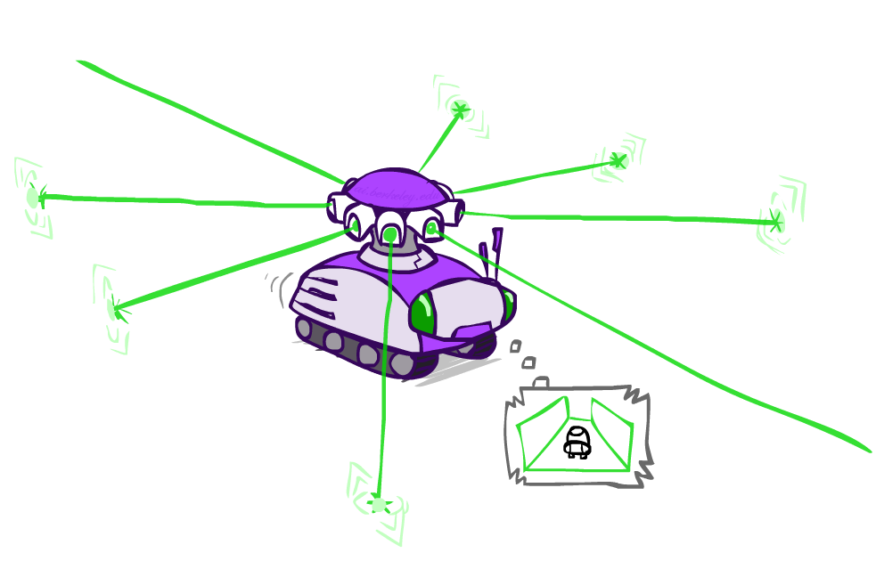
Example: Robot Localization
Example from Michael Pfeiffer
Prob
0
1
t=0
Sensor model: can read in which directions there is a wall, never more than 1 mistake
Motion model: may not execute action with small prob.

Slide 27
Example: Robot Localization
Prob
0
1
t=1
Lighter grey: was possible to get the reading, but less likely b/c required 1 mistake

Slide 28
Example: Robot Localization
Prob
0
1
t=2

Slide 29
Example: Robot Localization
Prob
0
1
t=3

Slide 30
Example: Robot Localization
Prob
0
1
t=4

Slide 31
Example: Robot Localization
Prob
0
1
t=5

Slide 32

Inference: Find State Given Evidence
We are given evidence at each time and want to know
Idea: start with P(X₁) and derive B_{t} in terms of B_{t-1}
  equivalently, derive B_{t+1} in terms of B_{t}

