Slide 1
CS162
Operating Systems and
Systems Programming
Lecture 18
General I/O (Con’t), Storage Devices, Performance
March 31st, 2022
Prof. Anthony Joseph and John Kubiatowicz
http://cs162.eecs.Berkeley.edu

Slide 2
Recall: How does the Processor Talk to the Device?
Processor Memory Bus
Regular
Memory
CPU
Bus
Adaptor
Bus
Adaptor
Device
Controller
Address +
Data
Other Devices
or Buses
Bus
Interface
Hardware
Controller
Interrupt
Controller
Interrupt Request
read
Addressable
Memory
and/or
Queues
write
control
CPU interacts with a Controller
  Contains a set of registers that can be read and written
  May contain memory for request queues, etc.
Processor accesses registers in two ways:
  Port-Mapped I/O: in/out instructions
    Example from the Intel architecture: out 0x21,AL
  Memory-mapped I/O: load/store instructions
    Registers/memory appear in physical address space
    I/O accomplished with load and store instructions
status
Registers
(port 0x20)
Memory Mapped
Region: 0x8f008020

Slide 3
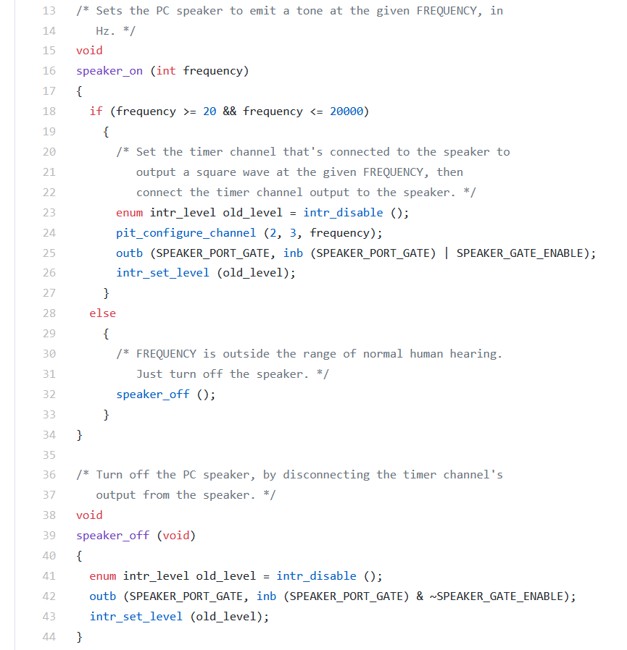
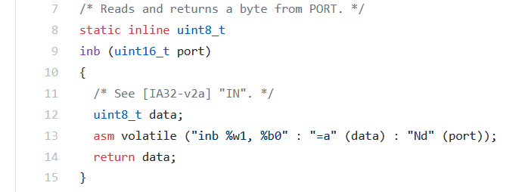
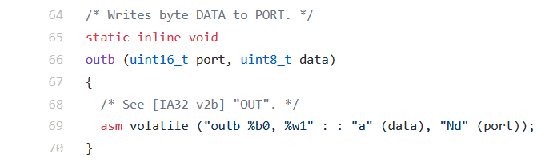
Port-Mapped I/O in Pintos Speaker Driver
Pintos: devices/speaker.c
Pintos: threads/io.h

Slide 4
Example: Memory-Mapped Display Controller
Memory-Mapped:
  Hardware maps control registers and display memory into physical address space
    Addresses set by HW jumpers or at boot time
  Simply writing to display memory (also called the “frame buffer”) changes image on screen
    Addr: 0x8000F000 — 0x8000FFFF
  Writing graphics description to cmd queue
    Say enter a set of triangles describing some scene
    Addr: 0x80010000 — 0x8001FFFF
  Writing to the command register may cause on-board graphics hardware to do something
    Say render the above scene
    Addr: 0x0007F004
Can protect with address translation
0x80020000
Graphics
Command
Queue
0x80010000
Display
Memory
0x8000F000
0x0007F004
Command
0x0007F000
Status
Physical
Address
Space

Slide 5
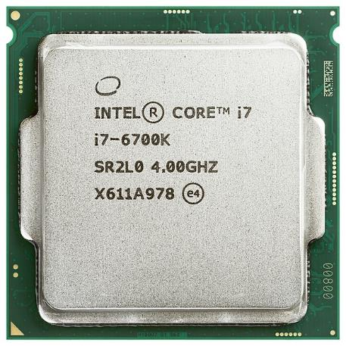
There’s more than just a CPU in there!

Slide 6
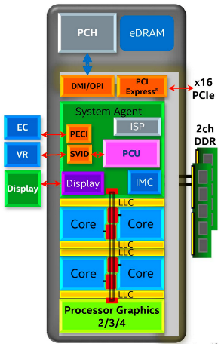
Chip-scale Features of 2015 x86 (Sky Lake)
Significant pieces:
  Four OOO cores with deeper buffers
    Intel MPX (Memory Protection Extensions)
    Intel SGX (Software Guard Extensions)
    Issue up to 6 μ-ops/cycle
  GPU, System Agent (Mem, Fast I/O)
  Large shared L3 cache with on-chip ring bus
    2 MB/core instead of 1.5 MB/core
    High-BW access to L3 Cache
Integrated I/O
  Integrated memory controller (IMC)
    Two independent channels of DRAM
  High-speed PCI-Express (for Graphics cards)
  Direct Media Interface (DMI) Connection to PCH (Platform Control Hub)
Notes:
Let’s look at I/O in a modern processor.

Slide 7
Sky Lake I/O: PCH
Platform Controller Hub
  Connected to processor with proprietary bus
    Direct Media Interface
Types of I/O on PCH:
  USB, Ethernet
  Thunderbolt 3
  Audio, BIOS support
  More PCI Express (lower speed than on Processor)
  SATA (for Disks)
Sky Lake
System Configuration

Slide 8
Operational Parameters for I/O
Data granularity: Byte vs. Block
  Some devices provide single byte at a time (e.g., keyboard)
  Others provide whole blocks (e.g., disks, networks, etc.)
Access pattern: Sequential vs. Random
  Some devices must be accessed sequentially (e.g., tape)
  Others can be accessed “randomly” (e.g., disk, cd, etc.)
    Fixed overhead to start transfers
  Some devices require continual monitoring
  Others generate interrupts when they need service
Transfer Mechanism: Programmed IO and DMA

Slide 9
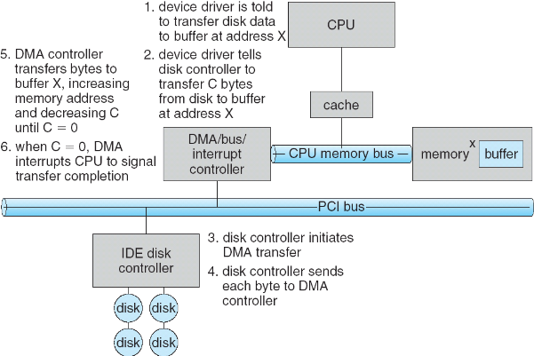
Transferring Data To/From Controller
Programmed I/O:
  Each byte transferred via processor in/out or load/store
  Pro: Simple hardware, easy to program
  Con: Consumes processor cycles proportional to data size
Direct Memory Access:
  Give controller access to memory bus
  Ask it to transfer
  data blocks to/from
  memory directly
Sample interaction with DMA controller
(from OSC book):
1
2
3

Slide 10
Transferring Data To/From Controller
Programmed I/O:
  Each byte transferred via processor in/out or load/store
  Pro: Simple hardware, easy to program
  Con: Consumes processor cycles proportional to data size
Direct Memory Access:
  Give controller access to memory bus
  Ask it to transfer
  data blocks to/from
  memory directly
Sample interaction with DMA controller
(from OSC book):
6
5
4

Slide 11
I/O Device Notifying the OS
The OS needs to know when:
  The I/O device has completed an operation
  The I/O operation has encountered an error
I/O Interrupt:
  Device generates an interrupt whenever it needs service
  Pro: handles unpredictable events well
  Con: interrupts relatively high overhead
Polling:
  OS periodically checks a device-specific status register
    I/O device puts completion information in status register
  Pro: low overhead
  Con: may waste many cycles on polling if infrequent or unpredictable I/O operations
Actual devices combine both polling and interrupts
  For instance – High-bandwidth network adapter:
    Interrupt for first incoming packet
    Poll for following packets until hardware queues are empty
Notes:
After the OS has issued a command to the I/O device either via a special I/O instruction or by writing to a location in the I/O address space, the OS needs to be notified when:
(a) The I/O device has completed the operation.
(b) Or when the I/O device has encountered an error.
This can be accomplished in two different ways: Polling and I/O interrupt.
+1 = 58 min. (Y:38)

Slide 12

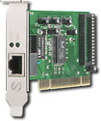
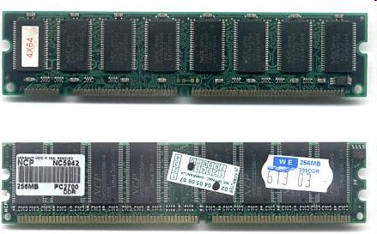
Kernel Device Structure
The System Call Interface
Process
Management
Memory
Management
Filesystems
Device
Control
Networking
Concurrency,
multitasking
Virtual
memory
Files and dirs:
the VFS
TTYs and
device access
Connectivity
Architecture
Dependent
Code
Memory
Manager
File System Types
Device
Control
Network
Subsystem
Block
Devices
IF drivers

Slide 13
Recall: Device Drivers
Device Driver: Device-specific code in the kernel that interacts directly with the device hardware
  Supports a standard, internal interface
  Same kernel I/O system can interact easily with different device drivers
  Special device-specific configuration supported with the ioctl() system call
Device Drivers typically divided into two pieces:
  Top half: accessed in call path from system calls
    implements a set of standard, cross-device calls like open(), close(), read(), write(), ioctl(), strategy()
    This is the kernel’s interface to the device driver
    Top half will start I/O to device, may put thread to sleep until finished
  Bottom half: run as interrupt routine
    Gets input or transfers next block of output
    May wake sleeping threads if I/O now complete

Slide 14
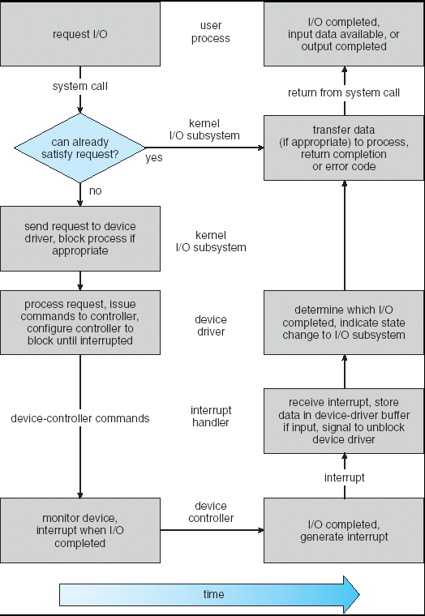
Recall: Life Cycle of An I/O Request
User
Program
Kernel I/O
Subsystem
Device Driver
Top Half
Device Driver
Bottom Half
Device
Hardware

Slide 15
The Goal of the I/O Subsystem
Provide Uniform Interfaces, Despite Wide Range of Different Devices
  This code works on many different devices:
  FILE fd = fopen("/dev/something", "rw");
  for (int i = 0; i < 10; i++) {
  fprintf(fd, "Count %d\n", i);
  }
  close(fd);
  Why? Because code that controls devices (“device driver”) implements standard interface
We will try to get a flavor for what is involved in actually controlling devices in rest of lecture
  Can only scratch surface!

Slide 16
Want Standard Interfaces to Devices
Block Devices: e.g. disk drives, tape drives, DVD-ROM
  Access blocks of data
  Commands include open(), read(), write(), seek()
  Raw I/O or file-system access
  Memory-mapped file access possible
Character Devices: e.g. keyboards, mice, serial ports, some USB devices
  Single characters at a time
  Commands include get(), put()
  Libraries layered on top allow line editing
Network Devices: e.g. Ethernet, Wireless, Bluetooth
  Different enough from block/character to have own interface
  Unix and Windows include socket interface
    Separates network protocol from network operation
    Includes select() functionality
  Usage: pipes, FIFOs, streams, queues, mailboxes

Slide 17
How Does User Deal with Timing?
Blocking Interface: “Wait”
  When request data (e.g. read() system call), put process to sleep until data is ready
  When write data (e.g. write() system call), put process to sleep until device is ready for data
Non-blocking Interface: “Don’t Wait”
  Returns quickly from read or write request with count of bytes successfully transferred
  Read may return nothing, write may write nothing
Asynchronous Interface: “Tell Me Later”
  When request data, take pointer to user’s buffer, return immediately; later kernel fills buffer and notifies user
  When send data, take pointer to user’s buffer, return immediately; later kernel takes data and notifies user

Slide 18
Storage Devices
Magnetic disks
  Storage that rarely becomes corrupted
  Large capacity at low cost
  Block level random access (except for SMR – later!)
  Slow performance for random access
  Better performance for sequential access
Flash memory
  Storage that rarely becomes corrupted
  Capacity at intermediate cost (5-20x disk)
  Block level random access
  Good performance for reads; worse for random writes
  Erasure requirement in large blocks
  Wear patterns issue

Slide 19
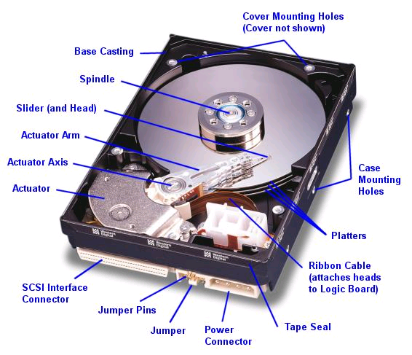
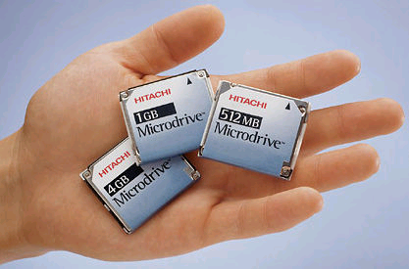
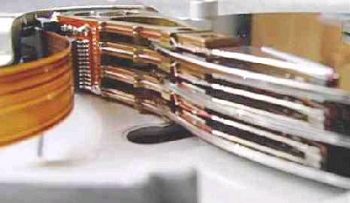
Hard Disk Drives (HDDs)
Read/Write Head
Side View
IBM/Hitachi Microdrive
IBM Personal Computer/AT (1986)
  30 MB hard disk - $500
  30-40ms seek time
  0.7-1 MB/s (est.)
Western Digital Drive
http://www.storagereview.com/guide/

Slide 20
The Amazing Magnetic Disk
Unit of Transfer: Sector
  Ring of sectors form a track
  Stack of tracks form a cylinder
  Heads position on cylinders
Disk Tracks ~ 1µm (micron) wide
  Wavelength of light is ~ 0.5µm
  Resolution of human eye: 50µm
  100K tracks on a typical 2.5” disk
Separated by unused guard regions
  Reduces likelihood neighboring tracks are corrupted during writes (still a small non-zero chance)

Slide 21
The Amazing Magnetic Disk
Track length varies across disk
  Outside: More sectors per track, higher bandwidth
  Disk is organized into
  regions of tracks with
  same # of sectors/track
  Only outer half of radius is used
    Most of the disk area in the outer regions of the disk
Disks so big that some companies (like Google) reportedly only use part of disk for active data
  Rest is archival data

Slide 22
Shingled Magnetic Recording (SMR)
Overlapping tracks yields greater density, capacity
Restrictions on writing, complex DSP for reading

Slide 23
Review: Magnetic Disks
Track
Sector
Cylinders: all the tracks under the
head at a given point on all surfaces
Read/write data is a three-stage process:
  Seek time: position the head/arm over the proper track
  Rotational latency: wait for desired sector to rotate under r/w head
  Transfer time: transfer a block of bits (sector) under r/w head
Head
Cylinder
Platter
Disk Latency = Queueing Time + Controller time +
Seek Time + Rotation Time + Xfer Time
Software
Queue
(Device Driver)
Hardware
Controller
Media Time
(Seek+Rot+Xfer)
Request
Result

Slide 24
Typical Numbers for Magnetic Disk
Parameter | Info/Range
Space/Density | Space: 18TB (Seagate), 9 platters, in 3½ inch form factor! Areal Density: ≥ 1 Terabit/square inch! (PMR, Helium, …)
Average Seek Time | Typically 4-6 milliseconds
Average Rotational Latency | Most laptop/desktop disks rotate at 3600-7200 RPM (16-8 ms/rotation). Server disks up to 15,000 RPM. Average latency is halfway around disk so 4-8 milliseconds
Controller Time | Depends on controller hardware
Transfer Time | Typically 50 to 270 MB/s. Depends on: Transfer size (usually a sector): 512B – 1KB per sector Rotation speed: 3600 RPM to 15000 RPM Recording density: bits per inch on a track Diameter: ranges from 1 in to 5.25 in
Cost | Used to drop by a factor of two every 1.5 years (or faster), now slowing down

Slide 25
Disk Performance Example
Assumptions:
  Ignoring queuing and controller times for now
  Avg seek time of 5ms,
  7200RPM ⇒ Time for rotation: 60000 (ms/min) / 7200(rev/min) ~= 8ms
  Transfer rate of 50MByte/s, block size of 4Kbyte ⇒
  4096 bytes/50×10⁶ (bytes/s) = 81.92 × 10⁻⁶ sec ≅ 0.082 ms for 1 sector
Read block from random place on disk:
  Seek (5ms) + Rot. Delay (4ms) + Transfer (0.082ms) = 9.082ms
  Approx 9ms to fetch/put data: 4096 bytes/9.082×10⁻³ s ≅ 451KB/s
Read block from random place in same cylinder:
  Rot. Delay (4ms) + Transfer (0.082ms) = 4.082ms
  Approx 4ms to fetch/put data: 4096 bytes/4.082×10⁻³ s ≅ 1.03MB/s
Read next block on same track:
  Transfer (0.082ms): 4096 bytes/0.082×10⁻³ s ≅ 50MB/sec
Key to using disk effectively (especially for file systems) is to minimize seek and rotational delays

Slide 26
Lots of Intelligence in the Controller
Sectors contain sophisticated error correcting codes
  Disk head magnet has a field wider than track
  Hide corruptions due to neighboring track writes
Sector sparing
  Remap bad sectors transparently to spare sectors on the same surface
Slip sparing
  Remap all sectors (when there is a bad sector) to preserve sequential behavior
Track skewing
  Sector numbers offset from one track to the next, to allow for disk head movement for sequential ops

Slide 27
Hard Drive Prices over Time

Slide 28
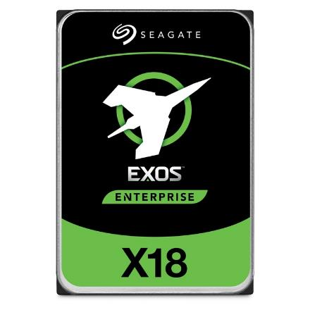
Example of Current HDDs
Seagate Exos X18 (2020)
  18 TB hard disk
    9 platters, 18 heads
    Helium filled: reduce friction and power
  4.16ms average seek time
  4096 byte physical sectors
  7200 RPMs
  Dual 6 Gbps SATA /12Gbps SAS interface
    270MB/s MAX transfer rate
    Cache size: 256MB
  Price: $ 562 (~ $0.03/GB)
IBM Personal Computer/AT (1986)
  30 MB hard disk
  30-40ms seek time
  0.7-1 MB/s (est.)
  Price: $500 ($17K/GB, 340,000x more expensive !!)

Slide 29
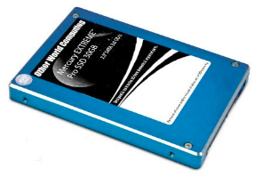
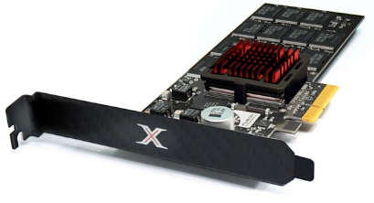
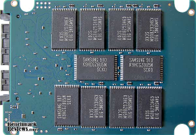
Solid State Disks (SSDs)
1995 – Replace rotating magnetic media with non-volatile memory (battery backed DRAM)
2009 – Use NAND Multi-Level Cell (2 or 3-bit/cell) flash memory
  Sector (4 KB page) addressable, but stores 4-64 “pages” per memory block
  Trapped electrons distinguish between 1 and 0
No moving parts (no rotate/seek motors)
  Eliminates seek and rotational delay (0.1-0.2ms access time)
  Very low power and lightweight
  Limited “write cycles”
Rapid advances in capacity and cost ever since!

Slide 30
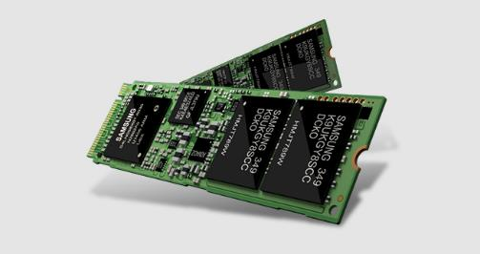
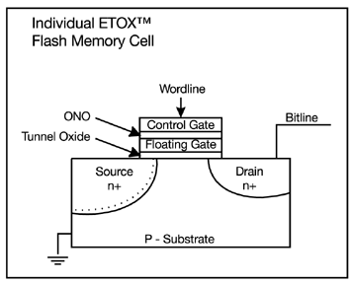
FLASH Memory
Samsung 2015:
512GB, NAND Flash
Like a normal transistor but:
  Has a floating gate that can hold charge
  To write: raise or lower wordline high enough to cause charges to tunnel
  To read: turn on wordline as if normal transistor
    presence of charge changes threshold and thus measured current
Two varieties:
  NAND: denser, must be read and written in blocks
  NOR: much less dense, fast to read and write
V-NAND: 3D stacking (Samsung claims 1TB possible in 1 chip)

Slide 31
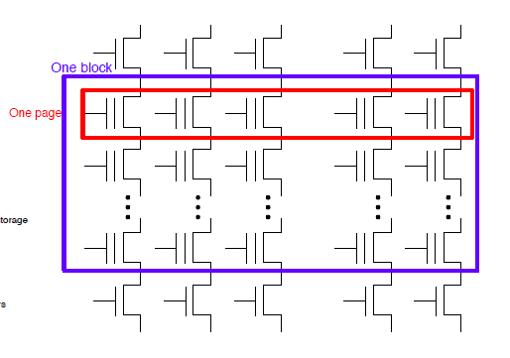
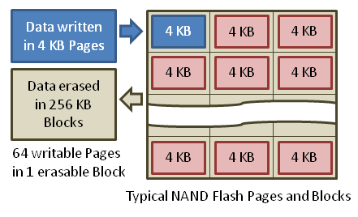
Flash Memory (Con’t)
Data read and written in page-sized chunks (e.g. 4K)
  Cannot be addressed at byte level
  Random access at block level for reads (no locality advantage)
  Writing of new blocks handled in order (kinda like a log)
Before writing, must be erased (256K block at a time)
  Requires free-list management
  CANNOT write over existing block (Copy-on-Write is normal case)

Slide 32
SSD Architecture – Reads
NAND
NAND
NAND
NAND
NAND
NAND
NAND
NAND
Host
Buffer
Manager
(software
Queue)
Flash
Memory
Controller
NAND
NAND
NAND
NAND
SATA
NAND
NAND
NAND
NAND
NAND
NAND
NAND
NAND
DRAM
NAND
NAND
  Read 4 KB Page: ~25 usec
  No seek or rotational latency
  Transfer time: transfer a 4KB page
    SATA: 300-600MB/s => ~4 x10³ b / 400 x 10⁶ bps => 10 us
  Latency = Queuing Time + Controller time + Xfer Time
  Highest Bandwidth: Sequential OR Random reads
NAND
NAND
NAND
NAND
NAND
NAND
NAND
NAND
NAND
NAND

Slide 33
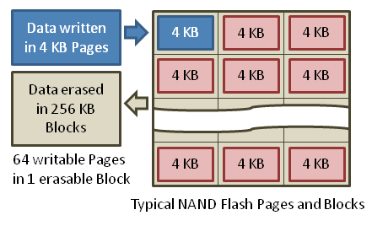
SSD Architecture – Writes
Writing data is complex! (~200μs – 1.7ms)
  Can only write empty pages in a block
  Erasing a block takes ~1.5ms
  Controller maintains pool of empty blocks by coalescing used pages (read, erase, write), also reserves some % of capacity
Rule of thumb: writes 10x reads, erasure 10x writes
https://en.wikipedia.org/wiki/Solid-state_drive

Slide 34
SSD Architecture – Writes
SSDs provide same interface as HDDs to OS – read and write chunk (4KB) at a time
But can only overwrite data 256KB at a time!
Why not just erase and rewrite new version of entire 256KB block?
  Erasure is very slow (milliseconds)
  Each block has a finite lifetime, can only be erased and rewritten about 10K times
  Heavily used blocks likely to wear out quickly

Slide 35
Solution – Two Systems Principles
Layer of Indirection
  Maintain a Flash Translation Layer (FTL) in SSD
  Map virtual block numbers (which OS uses) to physical page numbers (which flash mem. controller uses)
  Can now freely relocate data w/o OS knowing
Copy on Write
  Don’t overwrite a page when OS updates its data
  Instead, write new version in a free page
  Update FTL mapping to point to new location

Slide 36
Flash Translation Layer
No need to erase and rewrite entire 256KB block when making small modifications
SSD controller can assign mappings to spread workload across pages
  Wear Levelling
What to do with old versions of pages?
  Garbage Collection in background
  Erase blocks with old pages, add to free list

Slide 37
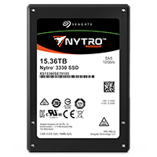
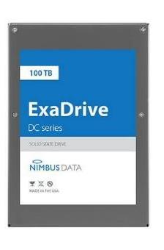
Some “Current” (large) 3.5in SSDs
Seagate Exos SSD: 15.36TB (2017)
  Dual 12Gb/s interface
  Seq reads 860MB/s
  Seq writes 920MB/s
  Random Reads (IOPS): 102K
  Random Writes (IOPS): 15K
  Price (Amazon): $5495 ($0.36/GB)
Nimbus SSD: 100TB (2019)
  Dual port: 12Gb/s interface
  Seq reads/writes: 500MB/s
  Random Read Ops (IOPS): 100K
  Unlimited writes for 5 years!
  Price: ~ $40K? ($0.4/GB)
    However, 50TB drive costs $12500 ($0.25/GB)

Slide 38
Amusing calculation:
Is a full Kindle heavier than an empty one?
Actually, “Yes”, but not by much
Flash works by trapping electrons:
  So, erased state lower energy than written state
Assuming that:
  Kindle has 4GB flash
  ½ of all bits in full Kindle are in high-energy state
  High-energy state about 10⁻¹⁵ joules higher
  Then: Full Kindle is 1 attogram (10⁻¹⁸gram) heavier
  (Using E = mc²)
Of course, this is less than most sensitive scale can measure (it can measure 10⁻⁹ grams)
Of course, this weight difference overwhelmed by battery discharge, weight from getting warm, ….
Source: John Kubiatowicz (New York Times, Oct 24, 2011)

Slide 39
SSD Summary
Pros (vs. hard disk drives):
  Low latency, high throughput (eliminate seek/rotational delay)
  No moving parts:
    Very light weight, low power, silent, very shock insensitive
  Read at memory speeds (limited by controller and I/O bus)
Cons
  Small storage (0.1-0.5x disk), expensive (3-20x disk)
    Hybrid alternative: combine small SSD with large HDD

Slide 40
SSD Summary
Pros (vs. hard disk drives):
  Low latency, high throughput (eliminate seek/rotational delay)
  No moving parts:
    Very light weight, low power, silent, very shock insensitive
  Read at memory speeds (limited by controller and I/O bus)
Cons
  Small storage (0.1-0.5x disk), expensive (3-20x disk)
    Hybrid alternative: combine small SSD with large HDD
  Asymmetric block write performance: read pg/erase/write pg
    Controller garbage collection (GC) algorithms have major effect on performance
  Limited drive lifetime
    1-10K writes/page for MLC NAND
    Avg failure rate is 6 years, life expectancy is 9–11 years
These are changing rapidly!
No longer true!

Slide 41
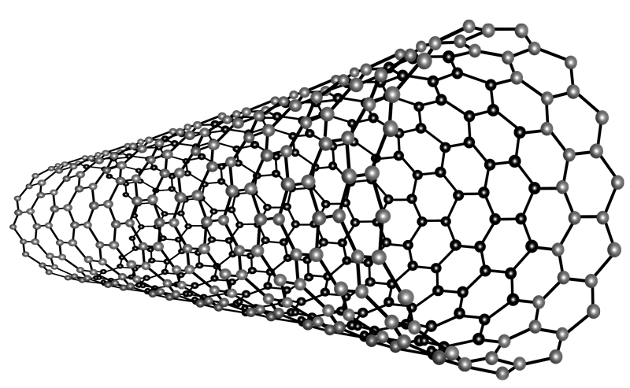
Nano-Tube Memory (NANTERO)
Yet another possibility: Nanotube memory
  NanoTubes between two electrodes, slight conductivity difference between ones and zeros
  No wearout!
Better than DRAM?
  Speed of DRAM, no wearout, non-volatile!
  Nantero promises 512Gb/dice for 8Tb/chip! (with 16 die stacking)

Slide 42
Ways of Measuring Performance: Times (s) and Rates (op/s)
Latency – time to complete a task
  Measured in units of time (s, ms, us, …, hours, years)
Response Time - time to initiate and operation and get its response
  Able to issue one that depends on the result
  Know that it is done (anti-dependence, resource usage)
Throughput or Bandwidth – rate at which tasks are performed
  Measured in units of things per unit time (ops/s, GFLOP/s)
Start up or “Overhead” – time to initiate an operation
Most I/O operations are roughly linear in b bytes
  Latency(b) = Overhead + b/TransferCapacity
Performance???
  Operation time (4 mins to run a mile…)
  Rate (mph, mpg, …)

Slide 43
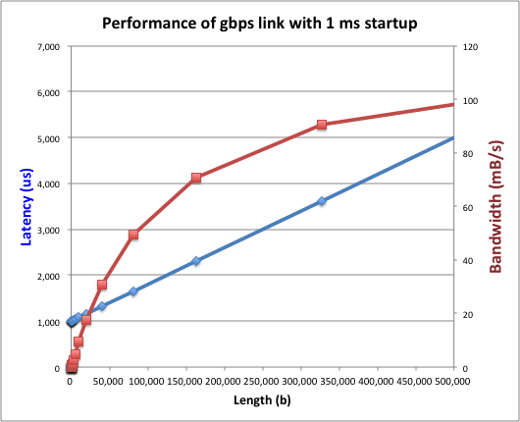
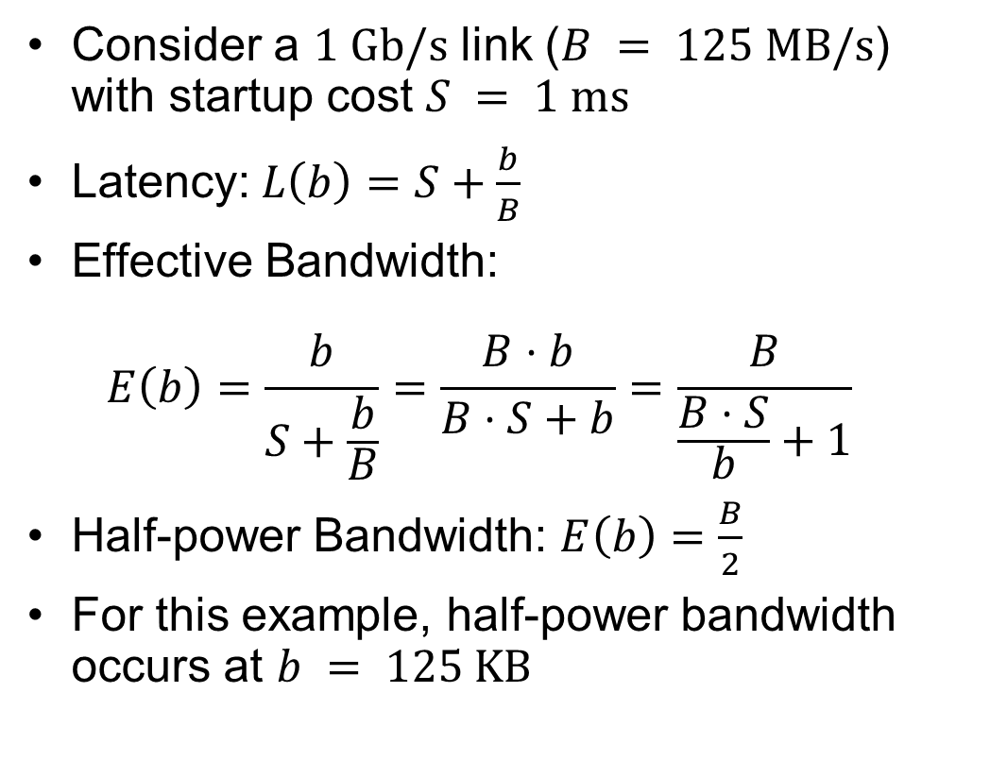
Example: Overhead in Fast Network
Consider a $1 \text{Gb}\text{/}\text{s}$ link ($B = 125 \text{MB}\text{/}\text{s}$) with startup cost $S = 1 \text{ms}$
Latency:$L\left(b\right)=S+\frac{b}{B}$
Effective Bandwidth:
$E\left(b\right)=\frac{b}{S+\frac{b}{B}}=\frac{B⋅b}{B⋅S+b}=\frac{B}{\frac{B⋅S}{b}+1}$
Half-power Bandwidth: $E\left(b\right)=\frac{B}{2}$
For this example, half-power bandwidth occurs at $b = 125 \text{KB}$

Slide 44
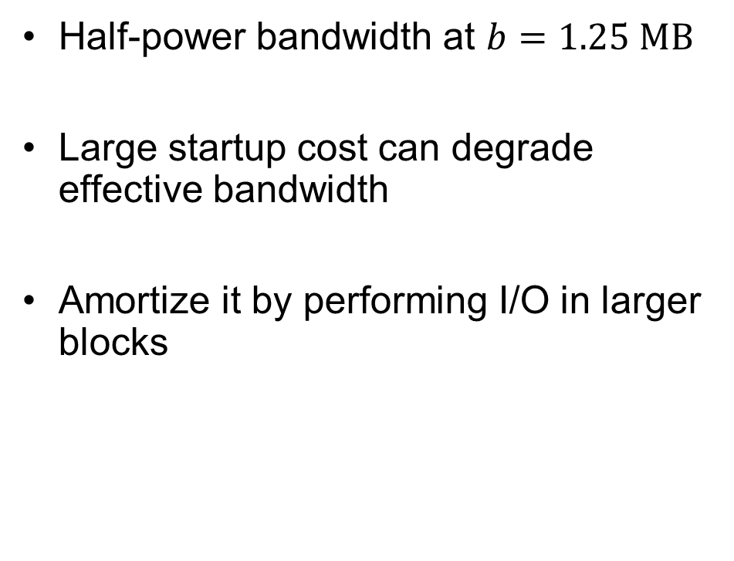
Example: 10 ms Startup Cost (e.g., Disk)
Half-power bandwidth at $b=1.25 \text{MB}$
Large startup cost can degrade effective bandwidth
Amortize it by performing I/O in larger blocks
  Half-power b = 1,250,000 bytes!

Slide 45
What Determines Peak BW for I/O?
Bus Speed
  PCI-X: 1064 MB/s = 133 MHz x 64 bit (per lane)
  ULTRA WIDE SCSI: 40 MB/s
  Serial Attached SCSI & Serial ATA & IEEE 1394 (firewire): 1.6 Gb/s full duplex (200 MB/s)
  USB 3.0 – 5 Gb/s
  Thunderbolt 3 – 40 Gb/s
Device Transfer Bandwidth
  Rotational speed of disk
  Write / Read rate of NAND flash
  Signaling rate of network link
Whatever is the bottleneck in the path…

Slide 46
Overall Performance for I/O Path
Controller
Performance of I/O subsystem
  Metrics: Response Time, Throughput
  Effective BW = transfer size / response time
  Contributing factors to latency:
    Software paths (can be loosely modeled by a queue)
    Hardware controller
    I/O device service time
Queuing behavior:
  Can lead to big increases of latency as utilization increases
  Solutions?
User
Thread
I/O
device
Queue
[OS Paths]
Response Time = Queue + I/O device service time
300
Response
Time (ms)
200
100
0
0%
100%
Throughput (Utilization)
(% total BW)

Slide 47
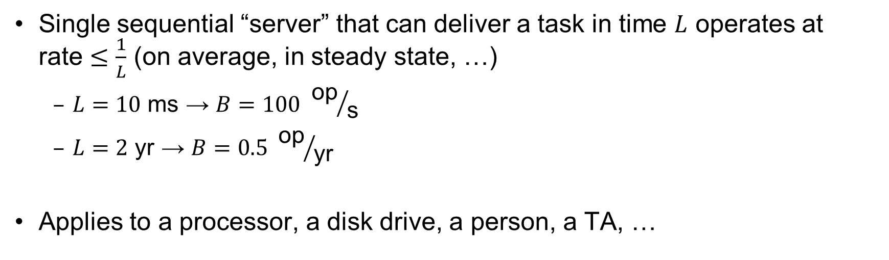
Sequential Server Performance
L
L
L
L
…
L
time
Single sequential “server” that can deliver a task in time $L$ operates at
rate $≤\frac{1}{L}$ (on average, in steady state, …)
  $L=10 \text{ms}$ → $B=100 {\text{op}}/{\text{s}}$
  $L=2 \text{yr}$ → $B=0.5 {\text{op}}/{\text{yr}}$
Applies to a processor, a disk drive, a person, a TA, …

Slide 48
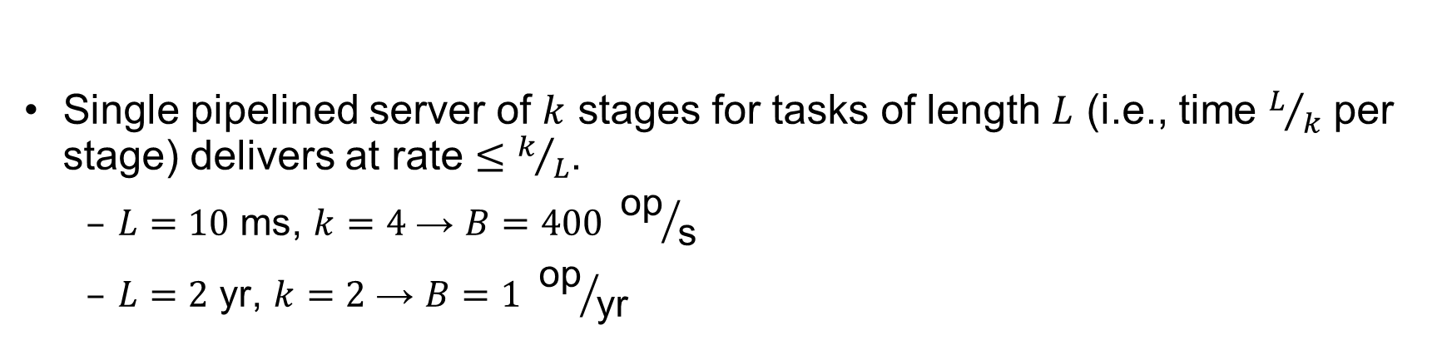
Single Pipelined Server
L
L
divided over distinct resources
logical operation
L
L
L
L
L
L
L
…
time
Single pipelined server of $k$ stages for tasks of length $L$ (i.e., time $L/k$ per stage) delivers at rate $≤k/L$.
  $L=10 \text{ms}$, $k=4$ → $B=400 {\text{op}}/{\text{s}}$
  $L=2 \text{yr}$, $k=2$ → $B=1 {\text{op}}/{\text{yr}}$

Slide 49
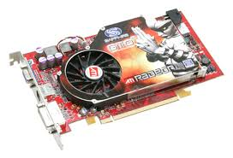

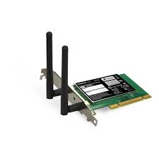
Example Systems “Pipelines”
I/O Processing
File
System
Upper Driver
Lower Driver
User Process
syscall
Communication
Anything with queues between operational process behaves roughly “pipeline like”
Important difference is that “initiations” are decoupled from processing
  May have to queue up a burst of operations
  Not synchronous and deterministic like in 61C

Slide 50
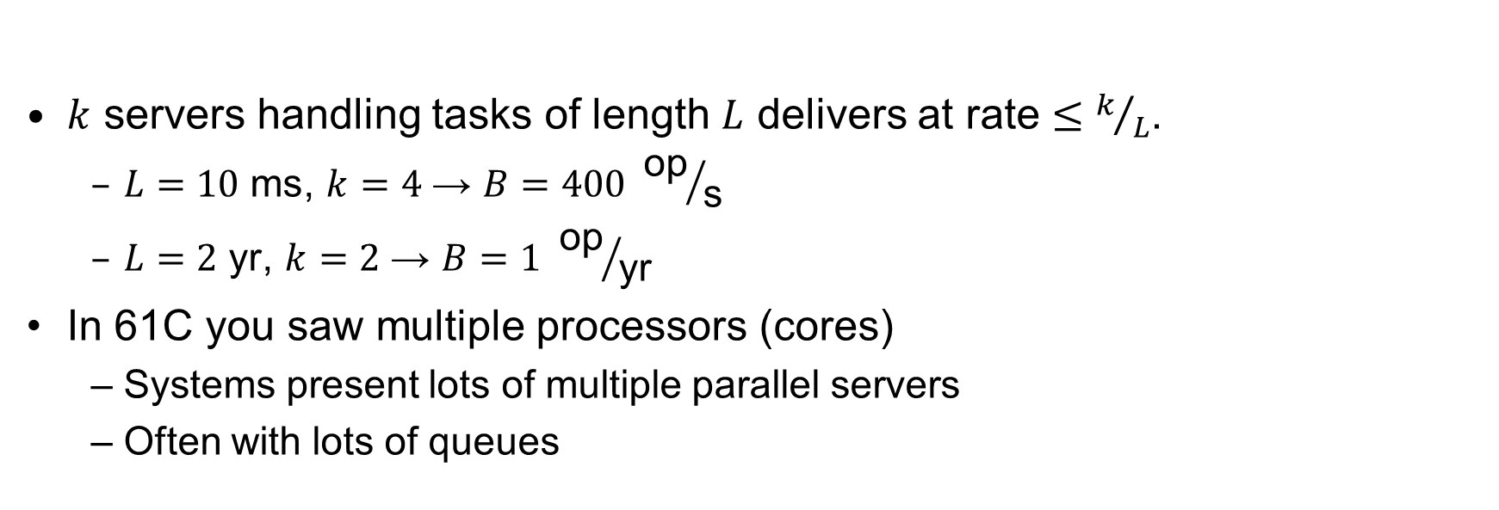
Multiple Servers
L
…
k
$k$ servers handling tasks of length $L$ delivers at rate $≤k/L$.
  $L=10 \text{ms}$, $k=4$ → $B=400 {\text{op}}/{\text{s}}$
  $L=2 \text{yr}$, $k=2$ → $B=1 {\text{op}}/{\text{yr}}$
In 61C you saw multiple processors (cores)
  Systems present lots of multiple parallel servers
  Often with lots of queues

Slide 51

Example Systems “Parallelism”
I/O Processing
syscall
File
System
Upper Driver
Lower Driver
User Process
User Process
User Process
Communication
Parallel Computation, Databases, …

Slide 52
Conclusion (1/2)
Notification mechanisms
  Interrupts
  Polling: Report results through status register that processor looks at periodically
Device drivers interface to I/O devices
  Provide clean Read/Write interface to OS above
  Manipulate devices through PIO, DMA & interrupt handling
  Three types: block, character, and network
Direct Memory Access (DMA)
  Permit devices to directly access memory
  Free up processor from transferring every byte

Slide 53
Conclusion (2/2)
Disk Performance:
  Queuing time + Controller + Seek + Rotational + Transfer
  Rotational latency: on average ½ rotation
  Transfer time: spec of disk depends on rotation speed and bit storage density
Devices have complex interaction and performance characteristics
  Response time (Latency) = Queue + Overhead + Transfer
    Effective BW = BW * T/(S+T)
  HDD: Queuing time + controller + seek + rotation + transfer
  SSD: Queuing time + controller + transfer (erasure & wear)
Systems (e.g., file system) designed to optimize performance and reliability
  Relative to performance characteristics of underlying device
Next time: Bursts & High Utilization introduce queuing delays
Next time: Queuing Latency:
  M/M/1 and M/G/1 queues: simplest to analyze
  As utilization approaches 100%, latency → ∞
  T_{q} = T_{ser} x ½(1+C) x ρ/(1 – ρ))

