Slide 1
CS162 Operating Systems and Systems Programming Lecture 11 Scheduling 2: Case Studies, Real Time, and Forward Progress
February 24, 2022
Prof. Anthony Joseph and John Kubiatowicz
http://cs162.eecs.Berkeley.edu

Slide 2
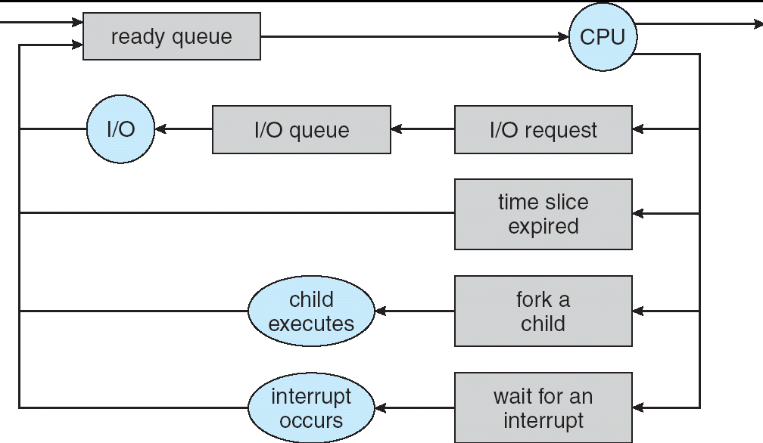
Recall: Scheduling
Question: How is the OS to decide which of several tasks to take off a queue?
Scheduling: deciding which threads are given access to resources from moment to moment
Often, we think in terms of CPU time, but could also think about access to resources like network BW or disk access

Slide 3
Recall: Scheduling Policy Goals/Criteria
Minimize Response Time
Minimize elapsed time to do an operation (or job)
Response time is what the user sees:
Time to echo a keystroke in editor
Time to compile a program
Real-time Tasks: Must meet deadlines imposed by World
Maximize Throughput
Maximize operations (or jobs) per second
Throughput related to response time, but not identical:
Minimizing response time will lead to more context switching than if you only maximized throughput
Two parts to maximizing throughput
Minimize overhead (for example, context-switching)
Efficient use of resources (CPU, disk, memory, etc)
Fairness
Share CPU among users in some equitable way
Fairness is not minimizing average response time:
Better average response time by making system less fair
Notes:
What does CPU scheduling have to do with efficient use of the disk?
A lot! Have to have the CPU to make a disk request
Fairness: Minimize # of angry phone calls? Minimize my response time?

Slide 4
Recall: Example of RR with Time Quantum = 20
Example: Process Burst Time P₁ 53 P₂ 8 P₃ 68 P₄ 24
The Gantt chart is:
Waiting time for P₁=(68-20)+(112-88)=72 P₂=(20-0)=20 P₃=(28-0)+(88-48)+(125-108)=85 P₄=(48-0)+(108-68)=88
Average waiting time = (72+20+85+88)/4=66¼
Average completion time = (125+28+153+112)/4 = 104½
Thus, Round-Robin Pros and Cons:
Better for short jobs, Fair (+)
Context-switching time adds up for long jobs (-)
P₁
P₂
P₃
P₄
P₁
P₃
P₄
P₁
P₃
P₃
0
20
28
48
68
88
108
112
125
145
153

Slide 5
Recall: What if we Knew the Future?
Could we always mirror best FCFS?
Shortest Job First (SJF):
Run whatever job has least amount of computation to do
Sometimes called “Shortest Time to Completion First” (STCF)
Shortest Remaining Time First (SRTF):
Preemptive version of SJF: if job arrives and has a shorter time to completion than the remaining time on the current job, immediately preempt CPU
Sometimes called “Shortest Remaining Time to Completion First” (SRTCF)
These can be applied to whole program or current CPU burst
Idea is to get short jobs out of the system
Big effect on short jobs, only small effect on long ones
Result is better average response time
Notes:
Rich get richer, and poor get poorer = short jobs get through the system faster, long jobs take even longer

Slide 6
Example to illustrate benefits of SRTF
A or B
C
C’s
I/O
C’s
I/O
C’s
I/O
Three jobs:
A, B: both CPU bound, run for week C: I/O bound, loop 1ms CPU, 9ms disk I/O
If only one at a time, C uses 90% of the disk, A or B could use 100% of the CPU
With FCFS:
Once A or B get in, keep CPU for two weeks
What about RR or SRTF?
Easier to see with a timeline

Slide 7
SRTF Example continued:
Disk Utilization:
9/201 ~ 4.5%
C
A
B
C
RR 100ms time slice
Disk Utilization:
~90% but lots of wakeups!
C’s
I/O
C’s
I/O
CABAB…
C
RR 1ms time slice
C’s
I/O
C’s
I/O
Disk Utilization:
90%
C
A
A
A
SRTF
C’s
I/O
C’s
I/O

Slide 8
SRTF Further discussion
Starvation
SRTF can lead to starvation if many small jobs!
Large jobs never get to run
Somehow need to predict future
How can we do this?
Some systems ask the user
When you submit a job, have to say how long it will take
To stop cheating, system kills job if takes too long
But: hard to predict job’s runtime even for non-malicious users
Bottom line, can’t really know how long job will take
However, can use SRTF as a yardstick for measuring other policies
Optimal, so can’t do any better
SRTF Pros & Cons
Optimal (average response time) (+)
Hard to predict future (-)
Unfair (-)

Slide 9
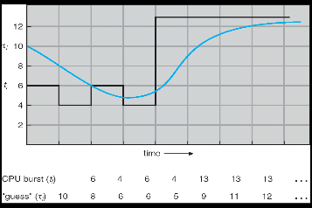
Predicting the Length of the Next CPU Burst
Adaptive: Changing policy based on past behavior
CPU scheduling, in virtual memory, in file systems, etc
Works because programs have predictable behavior
If program was I/O bound in past, likely in future
If computer behavior were random, wouldn’t help
Example: SRTF with estimated burst length
Use an estimator function on previous bursts: Let tn-1, tn-2, tn-3, etc. be previous CPU burst lengths. Estimate next burst τn = f(tn-1, tn-2, tn-3, …)
Function f could be one of many different time series estimation schemes (Kalman filters, etc)
For instance, exponential averaging τn = αtn-1+(1-α)τn-1 with (0<α≤1)

Slide 10
Lottery Scheduling
Yet another alternative: Lottery Scheduling
Give each job some number of lottery tickets
On each time slice, randomly pick a winning ticket
On average, CPU time is proportional to number of tickets given to each job
How to assign tickets?
To approximate SRTF, short running jobs get more, long running jobs get fewer
To avoid starvation, every job gets at least one ticket (everyone makes progress)
Advantage over strict priority scheduling: behaves gracefully as load changes
Adding or deleting a job affects all jobs proportionally, independent of how many tickets each job possesses

Slide 11
Lottery Scheduling Example (Cont.)
Lottery Scheduling Example
Assume short jobs get 10 tickets, long jobs get 1 ticket
What if too many short jobs to give reasonable response time?
If load average is 100, hard to make progress
One approach: log some user out
# short jobs/ # long jobs | % of CPU each short jobs gets | % of CPU each long jobs gets
1/1 | 91% | 9%
0/2 | N/A | 50%
2/0 | 50% | N/A
10/1 | 9.9% | 0.99%
1/10 | 50% | 5%

Slide 12
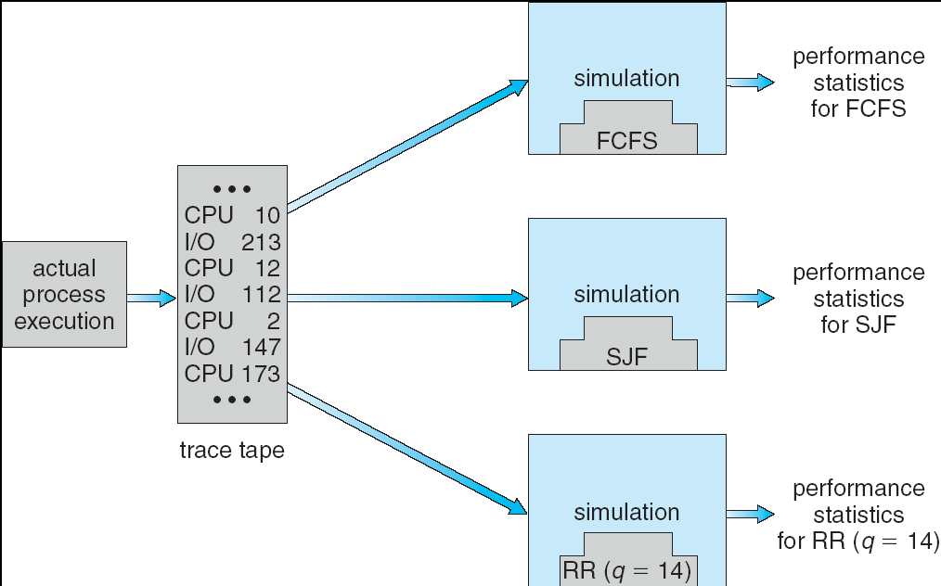
How to Evaluate a Scheduling algorithm?
Deterministic modeling
takes a predetermined workload and compute the performance of each algorithm for that workload
Queueing models
Mathematical approach for handling stochastic workloads
Implementation/Simulation:
Build system which allows actual algorithms to be run against actual data
Most flexible/general

Slide 13
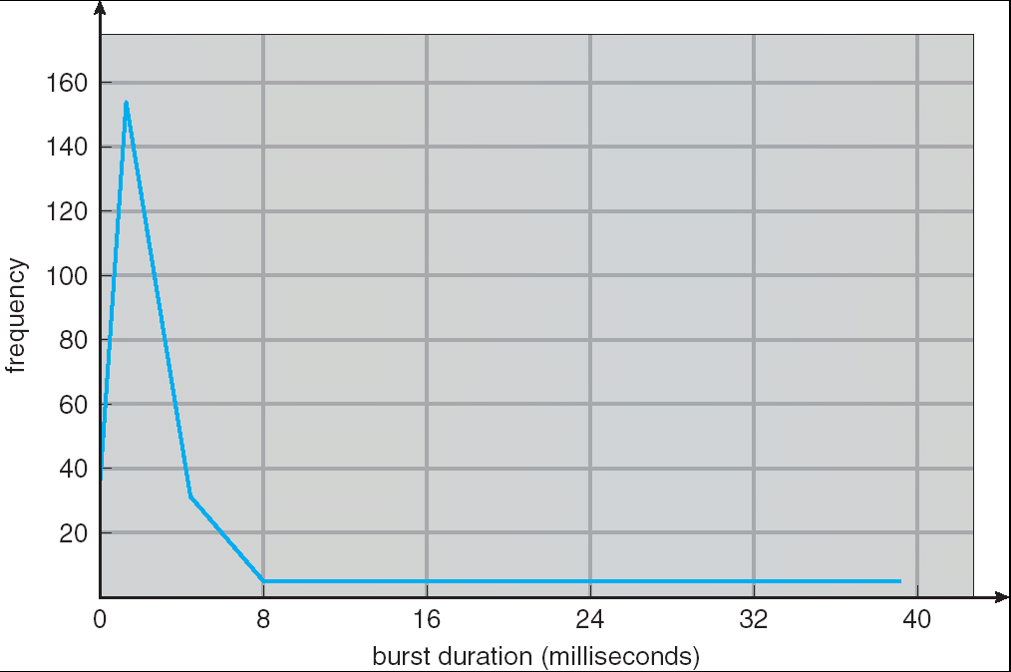
How to Handle Simultaneous Mix of Diff Types of Apps?
Consider mix of interactive and high throughput apps:
How to best schedule them?
How to recognize one from the other?
Do you trust app to say that it is “interactive”?
Should you schedule the set of apps identically on servers, workstations, pads, and cellphones?
For instance, is Burst Time (observed) useful to decide which application gets CPU time?
Short Bursts ⇒ Interactivity ⇒ High Priority?
Assumptions encoded into many schedulers:
Apps that sleep a lot and have short bursts must be interactive apps – they should get high priority
Apps that compute a lot should get low(er?) priority, since they won’t notice intermittent bursts from interactive apps
Hard to characterize apps:
What about apps that sleep for a long time, but then compute for a long time?
Or, what about apps that must run under all circumstances (say periodically)
Weighted toward small bursts

Slide 14
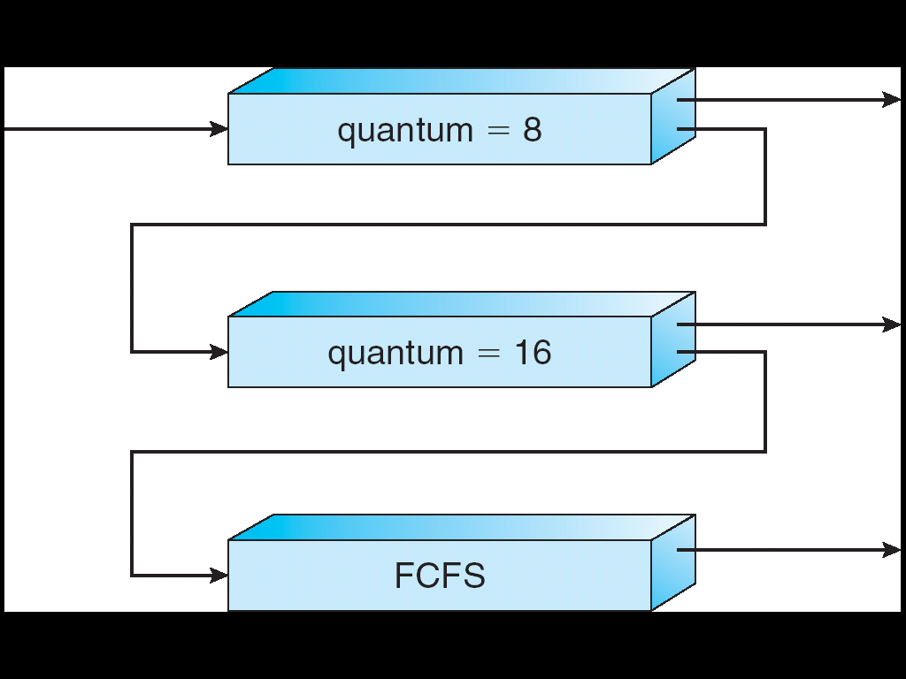
Multi-Level Feedback Scheduling
Another method for exploiting past behavior (first use in CTSS)
Multiple queues, each with different priority
Higher priority queues often considered “foreground” tasks
Each queue has its own scheduling algorithm
e.g. foreground – RR, background – FCFS
Sometimes multiple RR priorities with quantum increasing exponentially (highest:1ms, next: 2ms, next: 4ms, etc)
Adjust each job’s priority as follows (details vary)
Job starts in highest priority queue
If timeout expires, drop one level
If timeout doesn’t expire, push up one level (or to top)
Long-Running Compute Tasks Demoted to Low Priority

Slide 15
Scheduling Details
Long-Running Compute Tasks Demoted to Low Priority
Result approximates SRTF:
CPU bound jobs drop like a rock
Short-running I/O bound jobs stay near top
Scheduling must be done between the queues
Fixed priority scheduling:
serve all from highest priority, then next priority, etc.
Time slice:
each queue gets a certain amount of CPU time
e.g., 70% to highest, 20% next, 10% lowest

Slide 16
Scheduling Details
Long-Running Compute Tasks Demoted to Low Priority
Countermeasure: user action that can foil intent of the OS designers
For multilevel feedback, put in a bunch of meaningless I/O to keep job’s priority high
Of course, if everyone did this, wouldn’t work!
Example of Othello program:
Playing against competitor, so key was to do computing at higher priority the competitors.
Put in printf’s, ran much faster!

Slide 17
Case Study: Linux O(1) Scheduler
Kernel/Realtime Tasks
User Tasks
0
100
139
Priority-based scheduler: 140 priorities
40 for “user tasks” (set by “nice”), 100 for “Realtime/Kernel”
Lower priority value ⇒ higher priority (for realtime values)
Highest priority value ⇒ Lower priority (for nice values)
All algorithms O(1)
Timeslices/priorities/interactivity credits all computed when job finishes time slice
140-bit bit mask indicates presence or absence of job at given priority level
Two separate priority queues: “active” and “expired”
All tasks in the active queue use up their timeslices and get placed on the expired queue, after which queues swapped
Timeslice depends on priority – linearly mapped onto timeslice range
Like a multi-level queue (one queue per priority) with different timeslice at each level
Execution split into “Timeslice Granularity” chunks – round robin through priority

Slide 18
Linux O(1) Scheduler
Lots of ad-hoc heuristics
Try to boost priority of I/O-bound tasks
Try to boost priority of starved tasks

Slide 19
O(1) Scheduler Continued
Heuristics
User-task priority adjusted ±5 based on heuristics
p->sleep_avg = sleep_time – run_time
Higher sleep_avg ⇒ more I/O bound the task, more reward (and vice versa)
Interactive Credit
Earned when a task sleeps for a “long” time
Spend when a task runs for a “long” time
IC is used to provide hysteresis to avoid changing interactivity for temporary changes in behavior
However, “interactive tasks” get special dispensation
To try to maintain interactivity
Placed back into active queue, unless some other task has been starved for too long…
Real-Time Tasks
Always preempt non-RT tasks
No dynamic adjustment of priorities
Scheduling schemes:
SCHED_FIFO: preempts other tasks, no timeslice limit
SCHED_RR: preempts normal tasks, RR scheduling amongst tasks of same priority

Slide 20
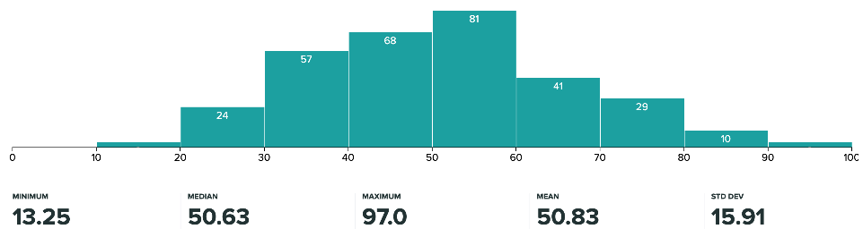
Administrivia
Midterm I graded:
Mean 47.8, Std Dev: 12.8, Low: 17.5, High: 83.0
Regrade requests before Sunday 2/27@midnight
We will take reasonable arguments for regrades..!
Solutions are posted

Slide 21
Administrivia (Con’t)
Project 1 final report is due Tuesday March 1st
Also due Tuesday March 1st: Peer evaluations
These are a required mechanism for evaluating group dynamics
Project scores are a zero-sum game
In the normal/best case, all partners get the same grade
In groups with issues, we may take points from non-participating group members and give them to participating group members!
How does this work?
You get 20 points/partner to distribute as you want: Example—4 person group, you get 3 x 20 = 60 points
If all your partners contributed equally, give the 20 points each
Or, you could do something like:
22 points partner 1
22 points partner 2
16 points partner 3
DO NOT GIVE YOURSELF POINTS!
You are NOT an unbiased evaluator of your group behavior

Slide 22
So, Does the OS Schedule Processes or Threads?
Many textbooks use the “old model”—one thread per process
Usually it's really: threads (e.g., in Linux)
One point to notice: switching threads vs. switching processes incurs different costs:
Switch threads: Save/restore registers
Switch processes: Change active address space too!
Expensive
Disrupts caching
Recall, However: Simultaneous Multithreading (or “Hyperthreading”)
Different threads interleaved on a cycle-by-cycle basis and can be in different processes (have different address spaces)

Slide 23
Multi-Core Scheduling
Algorithmically, not a huge difference from single-core scheduling
Implementation-wise, helpful to have per-core scheduling data structures
Cache coherence
Affinity scheduling: once a thread is scheduled on a CPU, OS tries to reschedule it on the same CPU
Cache reuse

Slide 24
Recall: Spinlocks for multiprocessing
Spinlock implementation:
int value = 0; // Free
Acquire() { while (test&set(&value)) {}; // spin while busy }
Release() { value = 0; // atomic store }
Spinlock doesn’t put the calling thread to sleep—it just busy waits
When might this be preferable?
Waiting for limited number of threads at a barrier in a multiprocessing (multicore) program
Wait time at barrier would be greatly increased if threads must be woken inside kernel
Every test&set() is a write, which makes value ping-pong around between core-local caches (using lots of memory!)
So – really want to use test&test&set() !
As we discussed in Lecture 8, the extra read eliminates the ping-ponging issues:
// Implementation of test&test&set(): Acquire() { do { while(value); // wait until might be free } while (test&set(&value)); // exit if acquire lock }

Slide 25
Gang Scheduling and Parallel Applications
When multiple threads work together on a multi-core system, try to schedule them together
Makes spin-waiting more efficient (inefficient to spin-wait for a thread that’s suspended)
Alternative: OS informs a parallel program how many processors its threads are scheduled on (Scheduler Activations)
Application adapts to number of cores that it has scheduled
“Space sharing” with other parallel programs can be more efficient, because parallel speedup is often sublinear with the number of cores

Slide 26
Real-Time Scheduling
Goal: Predictability of Performance!
We need to predict with confidence worst case response times for systems!
In RTS, performance guarantees are:
Task- and/or class centric and often ensured a priori
In conventional systems, performance is:
System/throughput oriented with post-processing (… wait and see …)
Real-time is about enforcing predictability, and does not equal fast computing!!!
Hard real-time: for time-critical safety-oriented systems
Meet all deadlines (if at all possible)
Ideally: determine in advance if this is possible
Earliest Deadline First (EDF), Least Laxity First (LLF), Rate-Monitonic Scheduling (RMS), Deadline Monotonic Scheduling (DM)
Soft real-time: for multimedia
Attempt to meet deadlines with high probability
Constant Bandwidth Server (CBS)

Slide 27
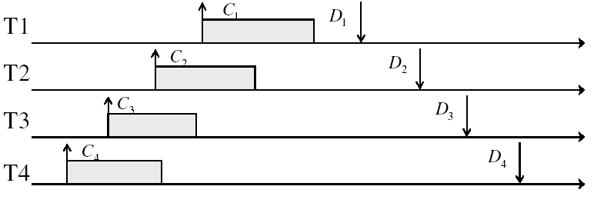
Example: Workload Characteristics
Tasks are preemptable, independent with arbitrary arrival (=release) times
Tasks have deadlines (D) and known computation times (C)
Example Setup:

Slide 28
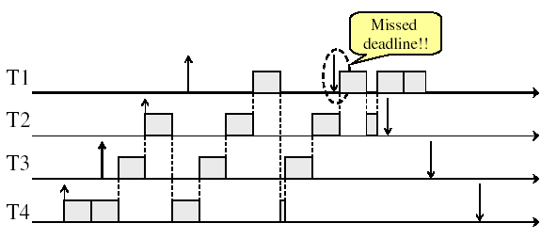
Example: Round-Robin Scheduling Doesn’t Work
Time

Slide 29

Earliest Deadline First (EDF)
Tasks periodic with period P and computation C in each period: ($P_{i}$, $C_{i}$) for each task $i$
Preemptive priority-based dynamic scheduling:
Each task is assigned a (current) priority based on how close the absolute deadline is (i.e. $D_{i}^{t+1}=D_{i}^{t}+P_{i}$for each task!)
The scheduler always schedules the active task with the closest absolute deadline
0
5
10
15

Slide 30
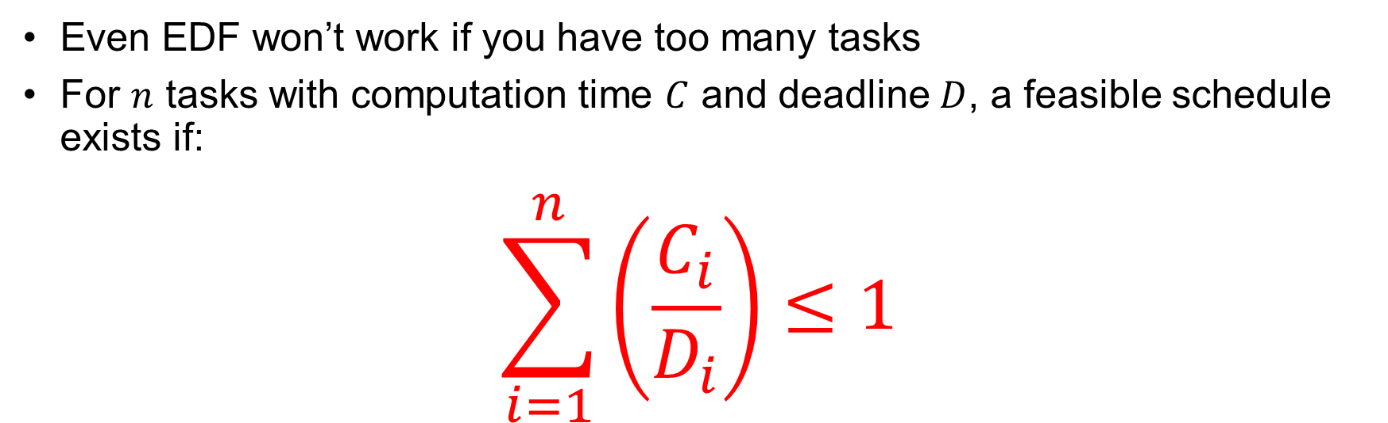
EDF Feasibility Testing
Even EDF won’t work if you have too many tasks
For $n$ tasks with computation time $C$ and deadline $D$, a feasible schedule exists if:
$$\sum_{i=1}^{n}{\left(\frac{C_{i}}{D_{i}}\right)}≤1$$

Slide 31
Ensuring Progress
Starvation: thread fails to make progress for an indefinite period of time
Starvation (this lecture) ≠ Deadlock (next lecture) because starvation could resolve under right circumstances
Deadlocks are unresolvable, cyclic requests for resources
Causes of starvation:
Scheduling policy never runs a particular thread on the CPU
Threads wait for each other or are spinning in a way that will never be resolved
Let’s explore what sorts of problems we might encounter and how to avoid them…

Slide 32
Strawman: Non-Work-Conserving Scheduler
A work-conserving scheduler is one that does not leave the CPU idle when there is work to do
A non-work-conserving scheduler could trivially lead to starvation
In this class, we’ll assume that the scheduler is work-conserving (unless stated otherwise)

Slide 33
Strawman: Last-Come, First-Served (LCFS)
Stack (LIFO) as a scheduling data structure
Late arrivals get fast service
Early ones wait – extremely unfair
In the worst case – starvation
When would this occur?
When arrival rate (offered load) exceeds service rate (delivered load)
Queue builds up faster than it drains
Queue can build in FIFO too, but “serviced in the order received”…

Slide 34
Is FCFS Prone to Starvation?
Scheduled Task (process, thread)
time
Scheduling Queue
arrivals
If a task never yields (e.g., goes into an infinite loop), then other tasks don’t get to run
Problem with all non-preemptive schedulers…
And early personal OSes such as original MacOS, Windows 3.1, etc

Slide 35
Is Round Robin (RR) Prone to Starvation?
Each of N processes gets ~1/N of CPU (in window)
With quantum length Q ms, process waits at most (N-1)*Q ms to run again
So a process can’t be kept waiting indefinitely
So RR is fair in terms of waiting time
Not necessarily in terms of throughput… (if you give up your time slot early, you don’t get the time back!)

Slide 36
Is Priority Scheduling Prone to Starvation?
Recall: Priority Scheduler always runs the thread with highest priority
Low priority thread might never run!
Starvation…
But there are more serious problems as well…
Priority inversion: even high priority threads might become starved
Priority 3
Job 1
Job 2
Job 3
Priority 2
Job 4
Priority 1
Priority 0
Job 5
Job 6
Job 7

Slide 37

Priority Inversion
Priority 3
Job 3
Priority 2
Job 2
Priority 1
Job 1
Acquire()
At this point, which job does the scheduler choose?
Job 3 (Highest priority)

Slide 38
Priority Inversion
Priority 3
Job 3
Acquire()
Priority 2
Job 2
Priority 1
Job 1
Job 3 attempts to acquire lock held by Job 1

Slide 39
Priority Inversion
Job 3
Blocked on Acquire
Priority 3
Priority 2
Job 2
Priority 1
Job 1
At this point, which job does the scheduler choose?
Job 2 (Medium Priority)
Priority Inversion

Slide 40
Priority Inversion
Where high priority task is blocked waiting on low priority task
Low priority one must run for high priority to make progress
Medium priority task can starve a high priority one
When else might priority lead to starvation or “live lock”?
High Priority
Low Priority
while (try_lock) {
…
}
lock.acquire(…)
…
lock.release(…)

Slide 41
One Solution: Priority Donation/Inheritance
Priority 3
Job 3
Acquire()
Priority 2
Job 2
Priority 1
Job 1
Job 3 temporarily grants Job 1 its “high priority” to run on its behalf

Slide 42
One Solution: Priority Donation/Inheritance
Job 3
Blocked on Acquire
Priority 3
Job 1
Release()
Priority 2
Job 2
Priority 1
Job 3 temporarily grants Job 1 its “high priority” to run on its behalf

Slide 43
One Solution: Priority Donation/Inheritance
Priority 3
Job 3
Acquire()
Priority 2
Job 2
Priority 1
Job 1
Project 2: Scheduling
Job 1 completes critical section and releases lock
Job 3 acquires lock, runs again
How does the scheduler know?

Slide 44

Case Study: Martian Pathfinder Rover
July 4, 1997 – Pathfinder lands on Mars
First US Mars landing since Vikings in 1976; first rover
Novel delivery mechanism: inside air-filled balloons bounced to stop on the surface from orbit!
And then…a few days into mission…:
Multiple system resets occur to realtime OS (VxWorks)
System would reboot randomly, losing valuable time and progress
Problem? Priority Inversion!
Low priority task grabs mutex trying to communicate with high priority task:
Realtime watchdog detected lack of forward progress and invoked reset to safe state
High-priority data distribution task was supposed to complete with regular deadline
Solution: Turn priority donation back on and upload fixes!
Original developers turned off priority donation (also called priority inheritance)
Worried about performance costs of donating priority!
Priority 2
Data Distribution Task: needs lock
Priority 1
Lots of random medium stuff
Priority 0
ASI/MET collector: grab lock

Slide 45
Are SRTF and MLFQ Prone to Starvation?
Long-Running Compute Tasks Demoted to Low Priority
In SRTF, long jobs are starved in favor of short ones
Same fundamental problem as priority scheduling
MLFQ is an approximation of SRTF, so it suffers from the same problem

Slide 46
Cause for Starvation: Priorities?
The policies we’ve studied so far:
Always prefer to give the CPU to a prioritized job
Non-prioritized jobs may never get to run
But priorities were a means, not an end
Our end goal was to serve a mix of CPU-bound, I/O bound, and Interactive jobs effectively on common hardware
Give the I/O bound ones enough CPU to issue their next file operation and wait (on those slow discs)
Give the interactive ones enough CPU to respond to an input and wait (on those slow humans)
Let the CPU bound ones grind away without too much disturbance

Slide 47
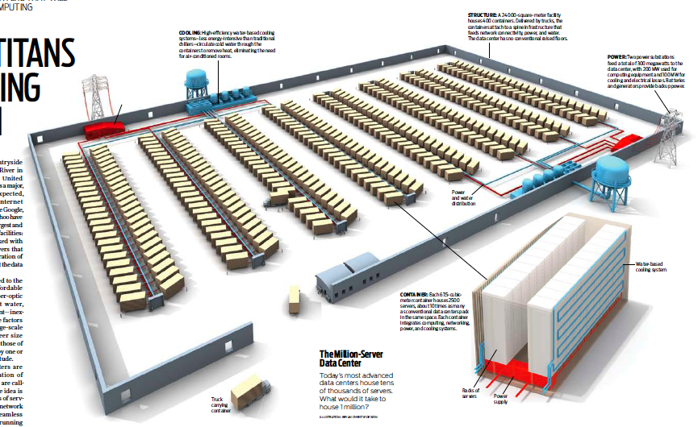
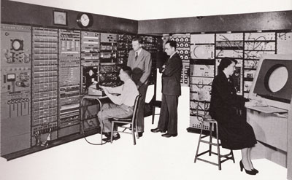
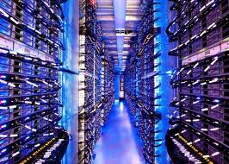
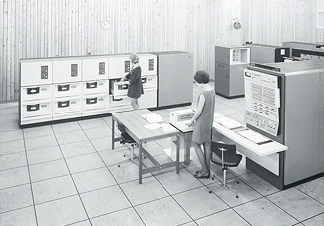
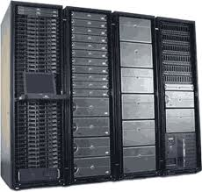
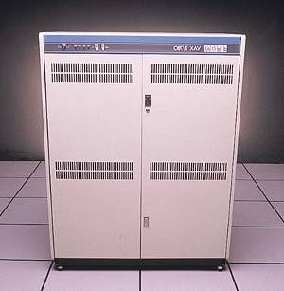
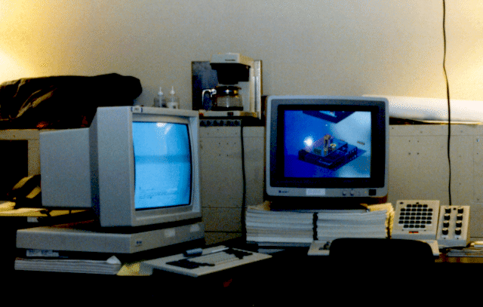

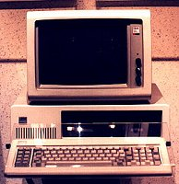





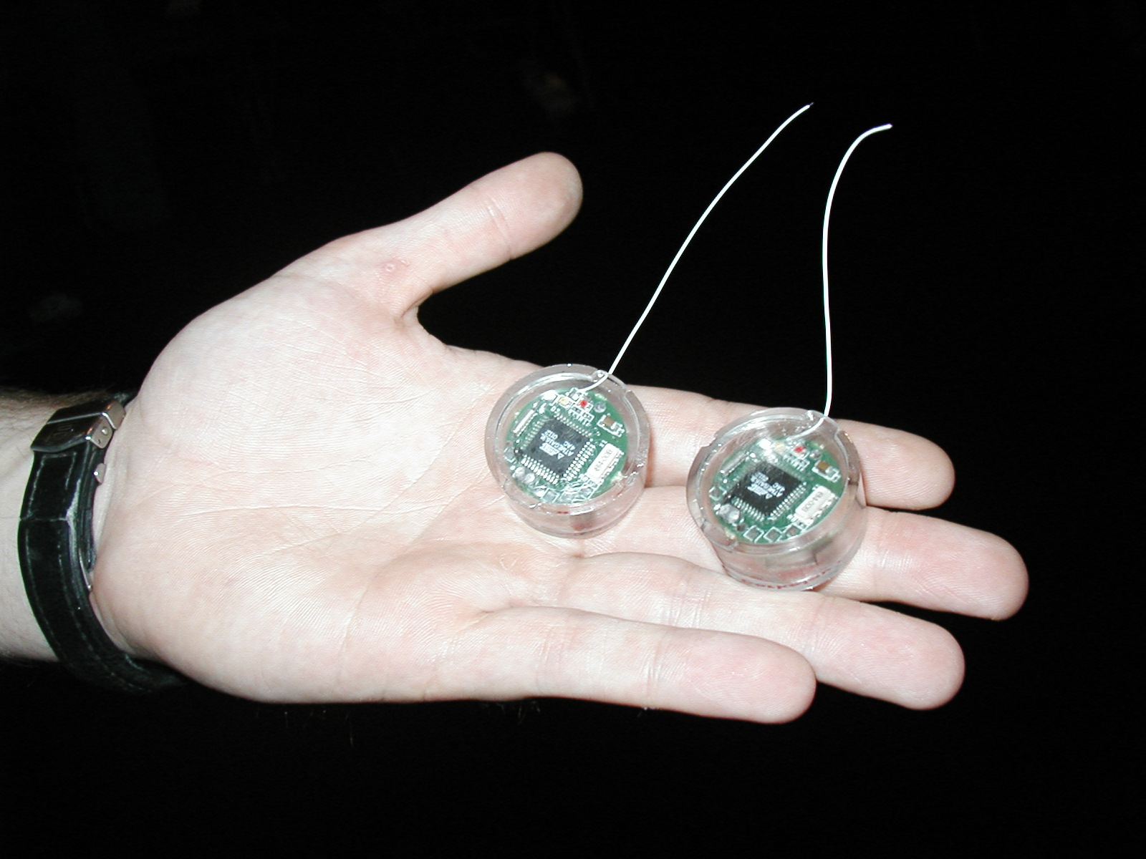
Recall: Changing Landscape…
Computers
Per Person
Number crunching, Data Storage, Massive Inet Services,
ML, …
1:10⁶
Mainframe
Bell’s Law: New computer class every 10 years
Mini
1:10³
Workstation
Productivity,
Interactive
PC
Laptop
1:1
PDA
Cell
Streaming from/to the physical world
10³:1
years
Mote!
The Internet of Things!

Slide 48
Changing Landscape of Scheduling
Priority-based scheduling rooted in “time-sharing”
Allocating precious, limited resources across a diverse workload
CPU bound, vs interactive, vs I/O bound
80’s brought about personal computers, workstations, and servers on networks
Different machines of different types for different purposes
Shift to fairness and avoiding extremes (starvation)
90’s emergence of the web, rise of internet-based services, the data-center-is-the-computer
Server consolidation, massive clustered services, huge flashcrowds
It’s about predictability, 95th percentile performance guarantees

Slide 49
Does prioritizing some jobs necessarily starve those that aren’t prioritized?

Slide 50
Key Idea: Proportional-Share Scheduling
The policies we’ve studied so far:
Always prefer to give the CPU to a prioritized job
Non-prioritized jobs may never get to run
Instead, we can share the CPU proportionally
Give each job a share of the CPU according to its priority
Low-priority jobs get to run less often
But all jobs can at least make progress (no starvation)

Slide 51
Recall: Lottery Scheduling
Q _{i}
Q _{i+1}
time
Given a set of jobs (the mix), provide each with a share of a resource
e.g., 50% of the CPU for Job A, 30% for Job B, and 20% for Job C
Idea: Give out tickets according to the proportion each should receive,
Every quantum (tick): draw one at random, schedule that job (thread) to run

Slide 52
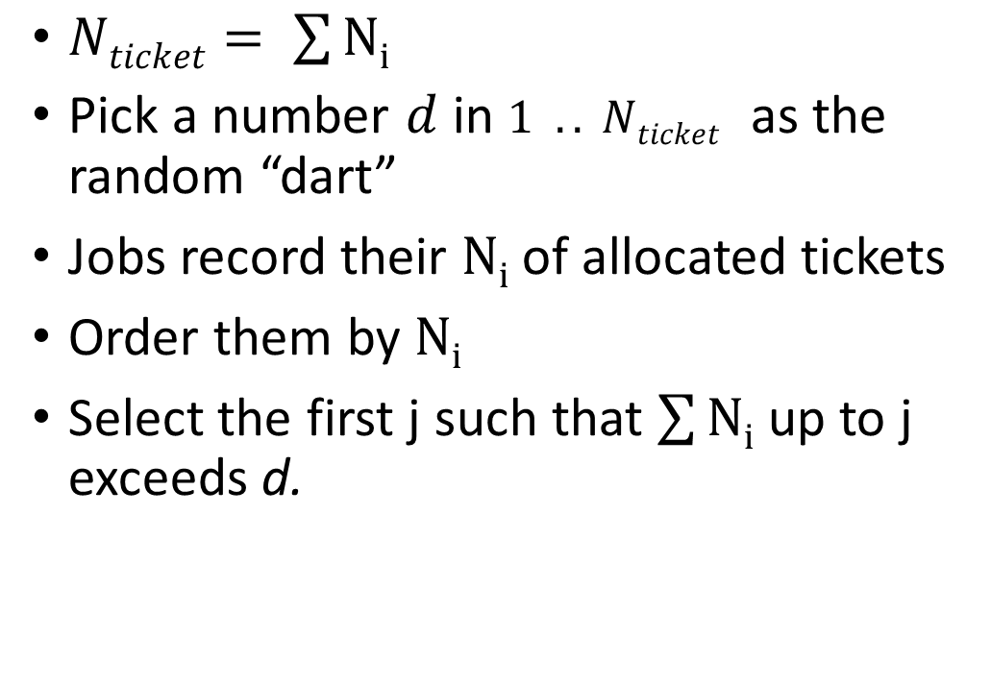
Lottery Scheduling: Simple Mechanism
10
$Nticket= \sum{Ni}$
Pick a number $d$ in $1 .. Nticket$ as the random “dart”
Jobs record their $Ni$ of allocated tickets
Order them by $Ni$
Select the first j such that $\sum{Ni}$ up to j exceeds d.
1

Slide 53
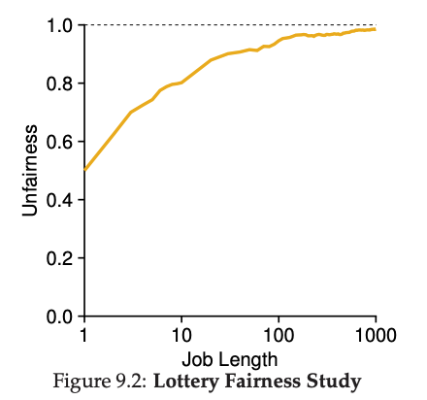
Unfairness
E.g., Given two jobs A and B of same run time (# Qs) that are each supposed to receive 50%,
U = finish time of first / finish time of last
As a function of run time

Slide 54
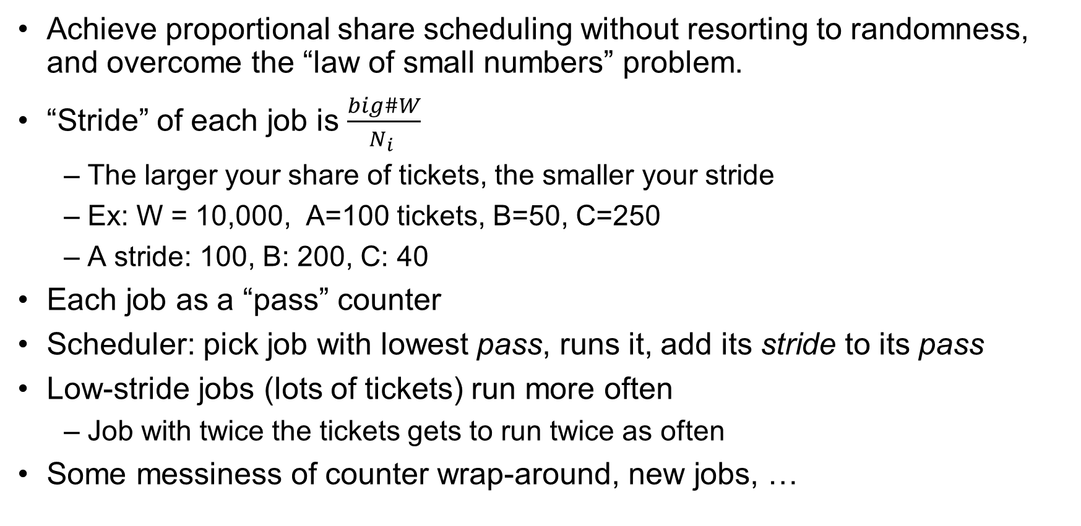
Stride Scheduling
Achieve proportional share scheduling without resorting to randomness, and overcome the “law of small numbers” problem.
“Stride” of each job is $\frac{big\#W}{N_{i} }$
The larger your share of tickets, the smaller your stride
Ex: W = 10,000, A=100 tickets, B=50, C=250
A stride: 100, B: 200, C: 40
Each job as a “pass” counter
Scheduler: pick job with lowest pass, runs it, add its stride to its pass
Low-stride jobs (lots of tickets) run more often
Job with twice the tickets gets to run twice as often
Some messiness of counter wrap-around, new jobs, …

Slide 55

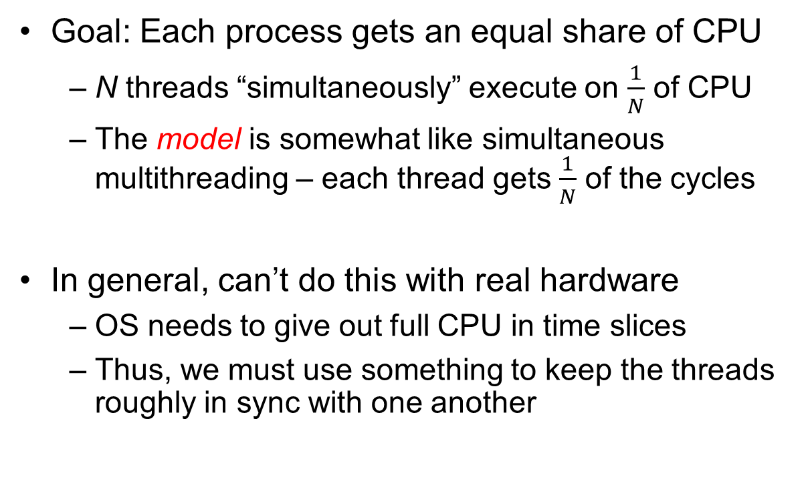
Linux Completely Fair Scheduler (CFS)
Goal: Each process gets an equal share of CPU
N threads “simultaneously” execute on $\frac{1}{N}$ of CPU
The model is somewhat like simultaneous multithreading – each thread gets $\frac{1}{N}$ of the cycles
In general, can’t do this with real hardware
OS needs to give out full CPU in time slices
Thus, we must use something to keep the threads roughly in sync with one another
Model: “Perfectly” subdivided CPU:
$$\frac{1}{N}$$
T₁
T₂
T₃
CPU Time

Slide 56
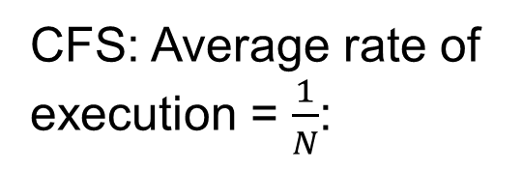

Linux Completely Fair Scheduler (CFS)
Basic Idea: track CPU time per thread and schedule threads to match up average rate of execution
Scheduling Decision:
“Repair” illusion of complete fairness
Choose thread with minimum CPU time
Closely related to Fair Queueing
Use a heap-like scheduling queue for this…
O(log N) to add/remove threads, where N is number of threads
Sleeping threads don’t advance their CPU time, so they get a boost when they wake up again…
Get interactivity automatically!
CFS: Average rate of execution = $\frac{1}{N}$:
T₁
$$\frac{1}{N}$$
T₃
CPU Time
T₂

Slide 57
Linux CFS: Responsiveness/Starvation Freedom
In addition to fairness, we want low response time and starvation freedom
Make sure that everyone gets to run at least a bit!
Constraint 1: Target Latency
Period of time over which every process gets service
Quanta = Target_Latency / n
Target Latency: 20 ms, 4 Processes
Each process gets 5ms time slice
Target Latency: 20 ms, 200 Processes
Each process gets 0.1ms time slice (!!!)
Recall Round-Robin: large context switching overhead if slice gets to small

Slide 58
Linux CFS: Throughput
Goal: Throughput
Avoid excessive overhead
Constraint 2: Minimum Granularity
Minimum length of any time slice
Target Latency 20 ms, Minimum Granularity 1 ms, 200 processes
Each process gets 1 ms time slice

Slide 59
Aside: Priority in Unix – Being Nice
The industrial operating systems of the 60s and 70’s provided priority to enforced desired usage policies.
When it was being developed at Berkeley, instead it provided ways to “be nice”.
nice values range from -20 to 19
Negative values are “not nice”
If you wanted to let your friends get more time, you would nice up your job
Scheduler puts higher nice-value tasks (lower priority) to sleep more …
In O(1) scheduler, this translated fairly directly to priority (and time slice)
How does this idea translate to CFS?
Change the rate of CPU cycles given to threads to change relative priority

Slide 60
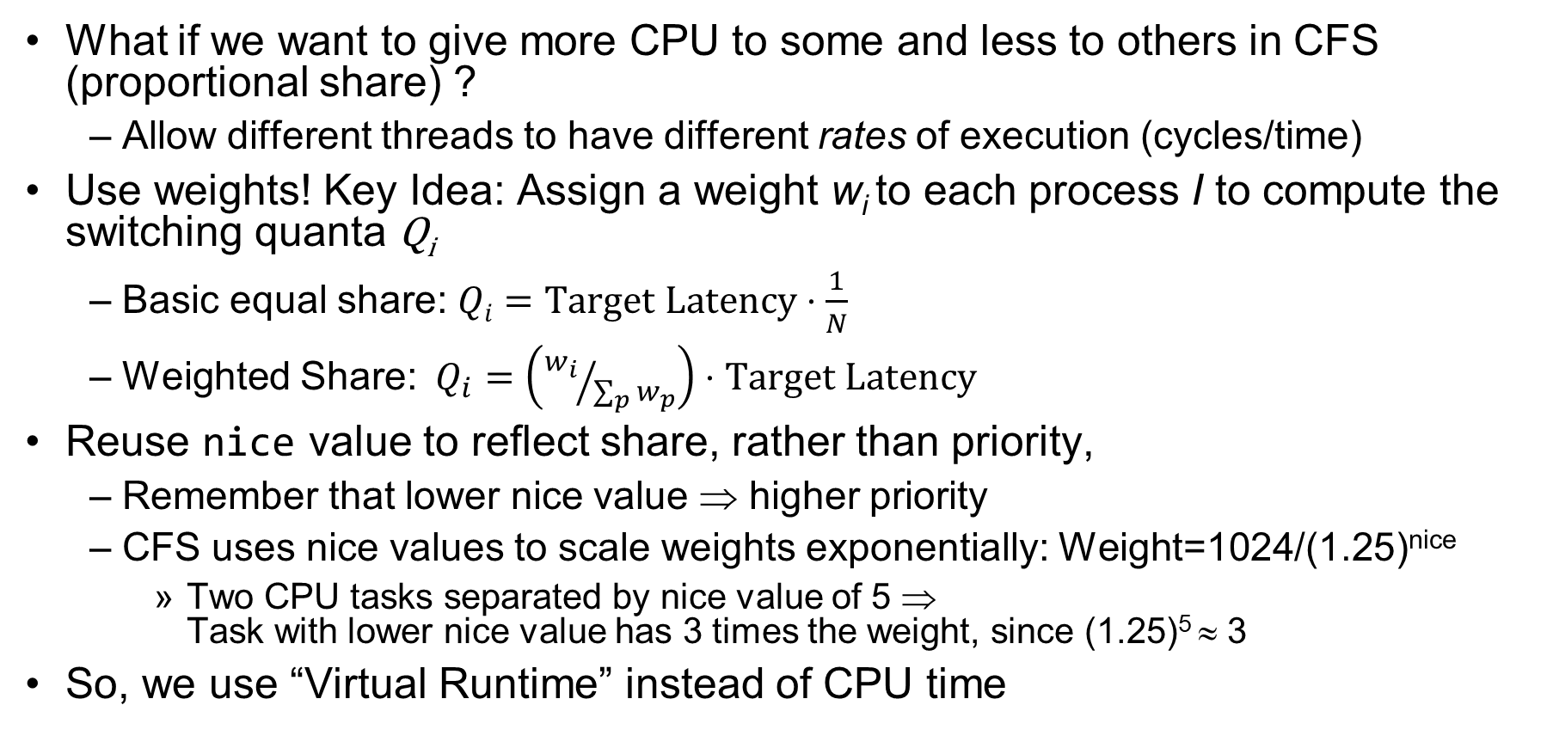
Linux CFS: Proportional Shares
What if we want to give more CPU to some and less to others in CFS (proportional share) ?
Allow different threads to have different rates of execution (cycles/time)
Use weights! Key Idea: Assign a weight w_{i} to each process I to compute the switching quanta Q_{i}
Basic equal share: $Qi=Target Latency⋅\frac{1}{N}$
Weighted Share:$Q_{i}=\left({w_{i}}/{\sum_{p}{w_{p}}}\right)⋅Target Latency$
Reuse nice value to reflect share, rather than priority,
Remember that lower nice value ⇒ higher priority
CFS uses nice values to scale weights exponentially: Weight=1024/(1.25)^{nice}
Two CPU tasks separated by nice value of 5 ⇒ Task with lower nice value has 3 times the weight, since (1.25)⁵ ≈ 3
So, we use “Virtual Runtime” instead of CPU time

Slide 61
Example: Linux CFS: Proportional Shares
Target Latency = 20ms
Minimum Granularity = 1ms
Example: Two CPU-Bound Threads
Thread A has weight 1
Thread B has weight 4
Time slice for A? 4 ms
Time slice for B? 16 ms

Slide 62
Linux CFS: Proportional Shares
16 (w_{B}=4)
B
Physical
CPU Time
Virtual
CPU Time
B
A
4 (w_{A}=1)
A
Track a thread's virtual runtime rather than its true physical runtime
Higher weight: Virtual runtime increases more slowly
Lower weight: Virtual runtime increases more quickly
Scheduler’s Decisions are based on Virtual CPU Time
Use of Red-Black tree to hold all runnable processes as sorted on vruntime variable
O(1) time to find next thread to run (top of heap!)
O(log N) time to perform insertions/deletions
Cash the item at far left (item with earliest vruntime)
When ready to schedule, grab version with smallest vruntime (which will be item at the far left).

Slide 63
Choosing the Right Scheduler
I Care About: | Then Choose:
CPU Throughput | FCFS
Avg. Response Time | SRTF Approximation
I/O Throughput | SRTF Approximation
Fairness (CPU Time) | Linux CFS
Fairness – Wait Time to Get CPU | Round Robin
Meeting Deadlines | EDF
Favoring Important Tasks | Priority

Slide 64
A Final Word On Scheduling
When do the details of the scheduling policy and fairness really matter?
When there aren’t enough resources to go around
When should you simply buy a faster computer?
(Or network link, or expanded highway, or …)
One approach: Buy it when it will pay for itself in improved response time
Perhaps you’re paying for worse response time in reduced productivity, customer angst, etc…
Might think that you should buy a faster X when X is utilized 100%, but usually, response time goes to infinity as utilization⇒100%
An interesting implication of this curve:
Most scheduling algorithms work fine in the “linear” portion of the load curve, fail otherwise
Argues for buying a faster X when hit “knee” of curve
Response
time
100%
Utilization

Slide 65
Summary (1 of 2)
Scheduling Goals:
Minimize Response Time (e.g. for human interaction)
Maximize Throughput (e.g. for large computations)
Fairness (e.g. Proper Sharing of Resources)
Predictability (e.g. Hard/Soft Realtime)
Round-Robin Scheduling:
Give each thread a small amount of CPU time when it executes; cycle between all ready threads
Pros: Better for short jobs
Shortest Job First (SJF)/Shortest Remaining Time First (SRTF):
Run whatever job has the least amount of computation to do/least remaining amount of computation to do
Multi-Level Feedback Scheduling:
Multiple queues of different priorities and scheduling algorithms
Automatic promotion/demotion of process priority in order to approximate SJF/SRTF

Slide 66
Summary (2 of 2)
Realtime Schedulers such as EDF
Guaranteed behavior by meeting deadlines
Realtime tasks defined by tuple of compute time and period
Schedulability test: is it possible to meet deadlines with proposed set of processes?
Lottery Scheduling:
Give each thread a priority-dependent number of tokens (short tasks⇒more tokens)
Linux CFS Scheduler: Fair fraction of CPU
Approximates an “ideal” multitasking processor
Practical example of “Fair Queueing”

