Slide 1
CS162 Operating Systems and Systems Programming Lecture 17 General I/O, Storage Devices

Slide 2

Course Map
Introduction
OS Concepts
Concurrency
Scheduling
Memory Management
Devices and file systems
Reliability, networking and cloud

Slide 3
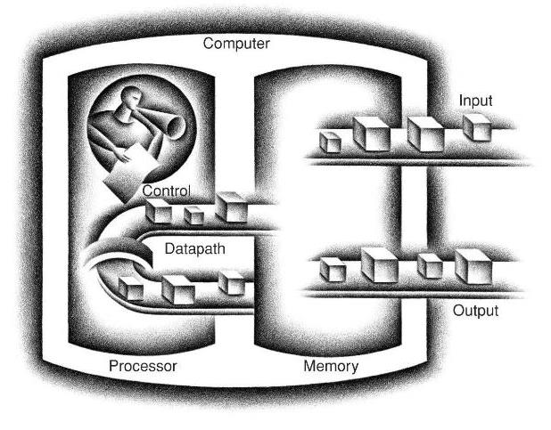
Recall: Five Components of a Computer

Slide 4
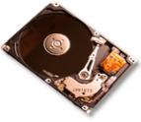
CPU: You need to get out more!
Input/output is the mechanism through which the computer communicates with the outside world

Slide 5
Want Standard Interfaces to Devices
Block Devices: e.g. disk drives, tape drives, DVD-ROM
Access blocks of data
Commands include open(), read(), write(), seek()
Raw I/O or file-system access
Character Devices: e.g. keyboards, mice, serial ports, some USB devices
Single characters at a time
Commands include get(), put()
Network Devices: e.g. Ethernet, Wireless, Bluetooth
Different enough from block/character to have own interface
Unix and Windows include socket interface
Separates network protocol from network operation
Includes select() functionality
Usage: pipes, FIFOs, streams, queues, mailboxes

Slide 6
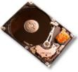
IO Subsystem: Abstraction, abstraction, abstraction
Process 1
Process 2
Process 3
OS Hardware Virtualization
Memory
Processor
IO Layer
OS Memory
Virtual Machine Abstraction
IO Devices

Slide 7
IO Subsystem: Abstraction, abstraction, abstraction
This code
FILE fd = fopen("/dev/something", "rw"); for (int i = 0; i < 10; i++) { fprintf(fd, "Count %d\n", i); } close(fd);
Why? Because code that controls devices (“device driver”) implements standard interface
We will try to get a flavor for what is involved in actually controlling devices in rest of lecture
Can only scratch surface!

Slide 8
Requirements of I/O layer
But… thousands of devices, each slightly different
OS: How can we standardize the interfaces to these devices?
Devices unreliable: media failures and transmission errors
OS: How can we make them reliable???
Devices unpredictable and/or slow
OS: How can we manage them if we don’t know what they will do or how they will perform?

Slide 9
Simplified IO architecture
Follows a hierarchical structure because of cost: the faster the bus, the more expensive it is

Slide 10
Intel’s Z270 Chipset

Slide 11
Sky Lake I/O: PCH
Platform Controller Hub
Connected to processor with proprietary bus
Direct Media Interface
Types of I/O on PCH:
USB, Ethernet
Thunderbolt 3
Audio, BIOS support
More PCI Express (lower speed than on Processor)
SATA (for Disks)
Sky Lake
System Configuration

Slide 12
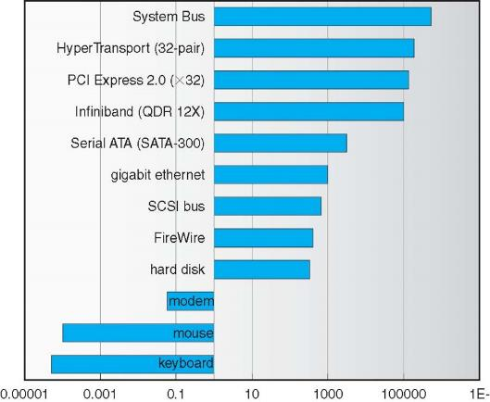
Example: Device Transfer Rates in Mb/s (Sun Enterprise 6000)
Device rates vary over 12 orders of magnitude!!!

Slide 13
Two questions
What is a bus?
How does the processor talk to the devices?

Slide 14
What’s a bus?
Common set of wires for communication among hardware devices plus protocols for carrying out data transfer transactions
Split into three parts: data bus, address bus, and control bus
Protocol: initiator requests access, arbitration to grant, identification of recipient, handshake to convey address, length, data

Slide 15

Why a Bus?
Buses let us connect $n$ devices over a single set of wires, connections, and protocols
$O\left(n^{2}\right)$ relationships with 1 set of wires (!)
Downside: Only one transaction at a time
The rest must wait
“Arbitration” aspect of bus protocol ensures the rest wait

Slide 16
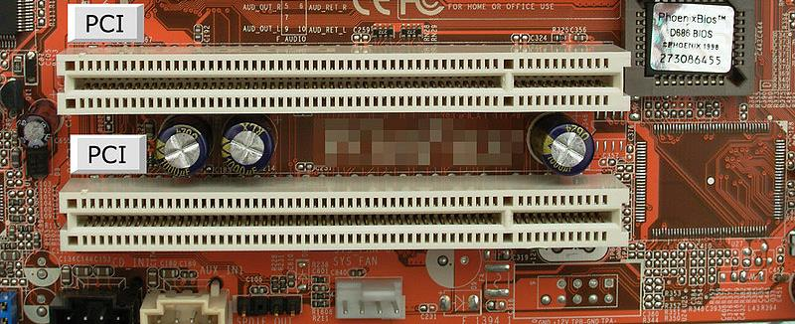
PCI Bus Evolution
PCI started life out as a parallel bus
But a parallel bus has many limitations
Multiplexing address/data for many requests
Slowest devices must be able to tell what’s happening (e.g., for arbitration)
Bus speed is set to that of the slowest device

Slide 17
PCI Express “Bus”
No longer a parallel bus
Really a collection of fast serial channels or “lanes”
Devices can use as many as they need to achieve a desired bandwidth
Slow devices don’t have to share with fast ones
One of the successes of device abstraction in Linux was the ability to migrate from PCI to PCI Express
The physical interconnect changed completely, but the old API still worked

Slide 18
How does the processor talk to devices?
Remember, it’s all about abstractions!
Device Controller
Interface
(What the OS sees)
It’s a file!
(What the user sees)
Hardware interface device presents to OS
Internals
(What is needed to implement the abstraction)
Hardware interface device presents to OS
Microcontroller
Memory
Other chips

Slide 19
How does the processor talk to devices?
Interface
(What the OS sees)
Registers
Status
Command
Data
Port-Mapped I/O:
Privileged in/out instructions
Example from the Intel architecture: out 0x21,AL
Memory-mapped I/O: load/store instructions
Registers/memory appear in physical address space
I/O accomplished with load and store instructions

Slide 20
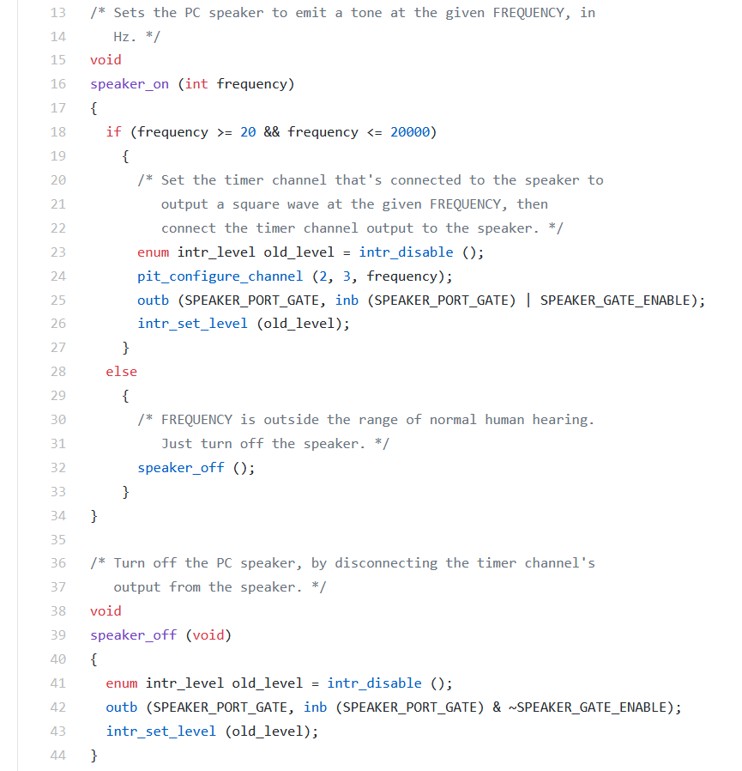
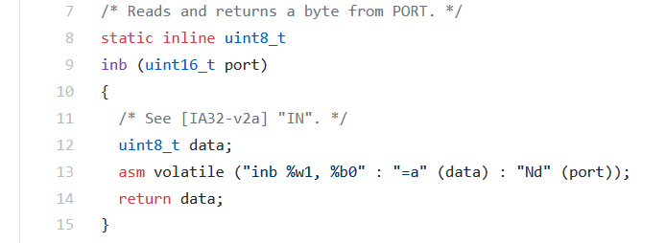
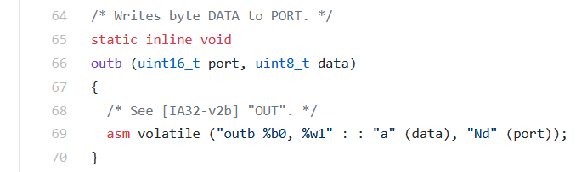
Port-Mapped I/O in Pintos Speaker Driver
Pintos: devices/speaker.c
Pintos: threads/io.h

Slide 21
A simple protocol
CPU is responsible for moving data
Protocol does a lot of polling!
How can we lower this overhead?

Slide 22
Polling vs Interrupt-driven IO
Use hardware interrupts:
Allows CPU to process another task. Will get notified when task is done
Interrupt handler will read data & error code
Is it always better to use interrupts?

Slide 23
From programmed IO to direct memory access
With programmed IO (simple protocol):
CPU issues read request
Device interrupts CPU with data
CPU writes data to memory
Pros: simple hardware. Cons: Poor CPU is always busy!
With direct-memory-access (DMA):
CPU sets up DMA request
Gives controller access to memory bus
Device puts data on bus & RAM accepts it
Device interrupts CPU when done
Device
CPU
RAM
CPU
Device
RAM

Slide 24
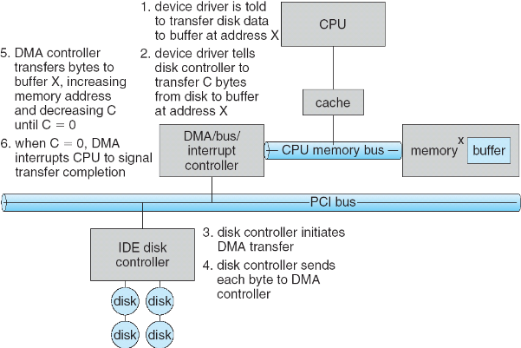
DMA in more detail
1
2
3

Slide 25
How can the OS handle one all devices
How do we fit devices with specific interfaces into OS, which should remain general?
Build a “device neutral” OS and hide details of devices from most of OS
Abstraction to the rescue!
Device Drivers encapsulate all specifics of device interaction
Implement device neutral interfaces

Slide 26
Device Drivers
Device Driver: Device-specific code in the kernel that interacts directly with the device hardware
Supports a standard, internal interface
Special device-specific configuration supported with the ioctl() system call
Device Drivers typically divided into two pieces:
Top half: accessed in call path from system calls
implements a set of standard, cross-device calls like open(), close(), read(), write(), ioctl(), strategy()
This is the kernel’s interface to the device driver
Top half will start I/O to device, may put thread to sleep until finished
Bottom half: run as interrupt routine
Gets input or transfers next block of output
May wake sleeping threads if I/O now complete
Your body is 90% water, the OS is 70% device-drivers

Slide 27
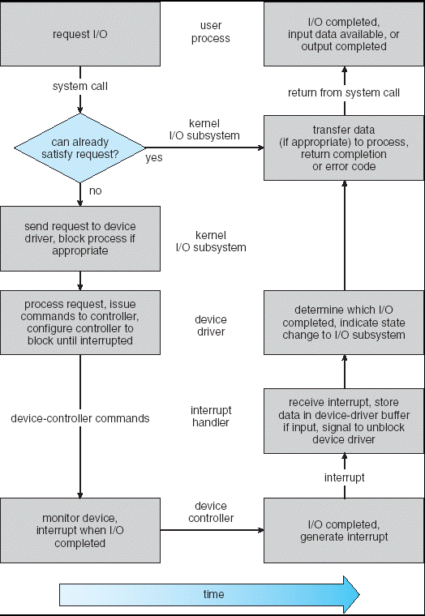
Putting it together: Life Cycle of An I/O Request
User
Program
Kernel I/O
Subsystem
Device Driver
Top Half
Device Driver
Bottom Half
Device
Hardware

Slide 28
Conclusion
I/O Devices Types:
Many different speeds (0.1 bytes/sec to GBytes/sec)
Different Access Patterns:
Block Devices, Character Devices, Network Devices
I/O Controllers: Hardware that controls actual device
Processor Accesses through I/O instructions, load/store to special physical memory
Notification mechanisms
Interrupts
Polling: Report results through status register that processor looks at periodically
Device drivers interface to I/O devices
Provide clean Read/Write interface to OS above
Manipulate devices through PIO, DMA & interrupt handling

