Slide 1
CS162
Operating Systems and
Systems Programming
Lecture 14
Memory 2: Virtual Memory (Con’t), Caching and TLBs
March 9th, 2021
Profs. Natacha Crooks and Anthony D. Joseph
http://cs162.eecs.Berkeley.edu

Slide 2
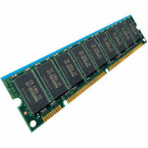
Recall: General Address translation
Virtual
Addresses
Physical
Addresses
CPU
MMU
Untranslated read or write
Consequently, two views of memory:
  View from the CPU (what program sees, virtual memory)
  View from memory (physical memory)
  Translation box (Memory Management Unit or MMU) converts between the two views
Translation ⇒ much easier to implement protection!
  If task A cannot even gain access to task B’s data, no way for A to
  adversely affect B
  Extra benefit: every program can be linked/loaded into same region
  of user address space

Slide 3
Recall: How to Implement Simple Paging?
Virtual Address:
Virtual
Page #
Offset
PageTablePtr
page #0
V,R
Physical
Page #
Offset
page #1
V,R
page #1
V,R
page #2
V,R,W
Physical Address
PageTableSize
>
page #3
V,R,W
Check Perm
Access Error
page #4
N
page #5
V,R,W
Access
Error
Page Table (One per process)
  Resides in physical memory
  Contains physical page and permission for each virtual page (e.g., Valid bits, Read, Write, etc)
Virtual address mapping
  Offset from Virtual address copied to Physical Address
    Example: 10 bit offset ⇒ 1024-byte pages
  Virtual page # is all remaining bits
    Example for 32-bits: 32-10 = 22 bits, i.e., 4 million entries
    Physical page # copied from table into physical address
  Check Page Table bounds and permissions

Slide 4
Recall: Simple Page Table Example
Example (4-byte pages)
0x00
0000 0000
0x00
a
b
c
d
0001 0000
0x04
0
4
i
j
k
l
0x04
0000 0100
0000 1100
0x05!
e
f
g
h
1
3
2
1
0000 0100
0x08
0x06?
0x08
0000 1000
Page
Table
0x0C
i
j
k
l
e
f
g
h
0x09?
0x0E!
0x10
Virtual
Memory
0000 0110
0000 1110
a
b
c
d
0000 1001
0000 0101
Physical
Memory
Notes:
What is virtual address 0x6? 1|10 = 3|2 = 0xE
What is virtual address 0x9? 10|01 = 1|1 = 0x5

Slide 5
Recall: What about Sharing?
Virtual Address
(Process A):
Virtual
Page #
Offset
Shared
Page
PageTablePtrA
page #0
V,R
page #1
V,R
page #2
V,R,W
page #2
V,R,W
page #3
V,R,W
page #4
N
This physical page appears in address space of both processes
  They can share information by read and writing to this page
However, this mapping not great:
  Process A, R/W at address: 0x00002xxx
  Process B, RO at address: 0x00004xxx
Better to map at same virtual address so that you can share linked objects!
page #5
V,R,W
PageTablePtrB
page #0
V,R
page #1
N
page #2
V,R,W
page #3
N
page #4
V,R
page #4
V,R
page #5
V,R,W
Virtual Address
(Process B):
Virtual
Page #
Offset

Slide 6
Recall: Where is page sharing used ?
The “kernel region” of every process has the same page table entries
  The process cannot access it at user level
  But on U->K switch, kernel code can access it AS WELL AS the region for THIS user
    What does the kernel need to do to access other user processes?
Different processes running same binary!
  Execute-only, but do not need to duplicate code segments
User-level system libraries (execute only)
Shared-memory segments between different processes
  Can actually share objects directly between processes
    Must map page into same place in address space!
  This is a limited form of the sharing that threads have
  within a single process

Slide 7
Recall: Some simple security measures
Address Space Randomization
  Position-Independent Code ⇒ can place user code anywhere in address space
    Random start address makes much harder for attacker to cause jump to code that it seeks to take over
  Stack & Heap can start anywhere, so randomize placement
Kernel address space isolation
  Don’t map whole kernel space into each process, switch to kernel page table
  Meltdown⇒map none of kernel into user mode!

Slide 8
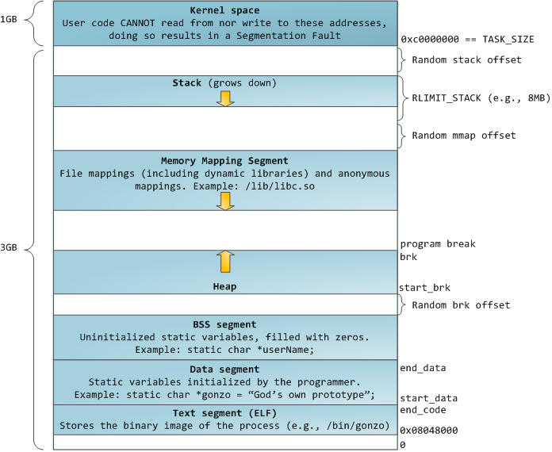
Memory Layout for Linux 32-bit (Pre-Meltdown patch!)
http://static.duartes.org/img/blogPosts/linuxFlexibleAddressSpaceLayout.png

Slide 9
Summary: Paging
Virtual memory view
Page Table
11111 11101
11110 11100
11101 null
11100 null
11011 null
11010 null
11001 null
11000 null
10111 null
10110 null
10101 null
10100 null
10011 null
10010 10000
10001 01111
10000 01110
01111 null
01110 null
01101 null
01100 null
01011 01101
01010 01100
01001 01011
01000 01010
00111 null
00110 null
00101 null
00100 null
00011 00101
00010 00100
00001 00011
00000 00010
Physical memory view
1111 1111
1110 1111
1111 0000
stack
stack
1110 0000
1100 0000
heap
1000 0000
heap
0111 000
data
data
0101 000
0100 0000
code
code
0001 0000
0000 0000
0000 0000
page #
offset

Slide 10
Summary: Paging
Virtual memory view
Page Table
11111 11101
11110 11100
11101 null
11100 null
11011 null
11010 null
11001 null
11000 null
10111 null
10110 null
10101 null
10100 null
10011 null
10010 10000
10001 01111
10000 01110
01111 null
01110 null
01101 null
01100 null
01011 01101
01010 01100
01001 01011
01000 01010
00111 null
00110 null
00101 null
00100 null
00011 00101
00010 00100
00001 00011
00000 00010
Physical memory view
1111 1111
stack
1110 0000
stack
1110 0000
1100 0000
What happens if stack grows to 1110 0000?
heap
1000 0000
heap
0111 000
data
data
0101 000
0100 0000
code
code
0001 0000
0000 0000
0000 0000
page #
offset

Slide 11
Summary: Paging
Virtual memory view
Page Table
11111 11101
11110 11100
11101 10111
11100 10110
11011 null
11010 null
11001 null
11000 null
10111 null
10110 null
10101 null
10100 null
10011 null
10010 10000
10001 01111
10000 01110
01111 null
01110 null
01101 null
01100 null
01011 01101
01010 01100
01001 01011
01000 01010
00111 null
00110 null
00101 null
00100 null
00011 00101
00010 00100
00001 00011
00000 00010
Physical memory view
1111 1111
stack
1110 0000
stack
1110 0000
1100 0000
stack
Allocate new pages where room!
heap
1000 0000
heap
0111 000
data
data
0101 000
Challenge: Table size equal to # of pages in virtual memory!
0100 0000
code
code
0001 0000
0000 0000
0000 0000
page #
offset

Slide 12
Recall: How big do things get?
32-bit address space => 2³² bytes (4 GB)
  Note: “b” = bit, and “B” = byte
  And for memory:
    “K”(kilo) = 2¹⁰ = 1024 ≈ 10³ (But not quite!): Sometimes called “Ki” (Kibi)
    “M”(mega) = 2²⁰ = (1024)² = 1,048,576 ≈ 10⁶ (But not quite!): Sometimes called “Mi” (Mibi)
    “G”(giga) = 2³⁰ = (1024)³ = 1,073,741,824 ≈ 10⁹ (But not quite!): Sometimes called “Gi” (Gibi)
Typical page size: 4 KB
  how many bits of the address is that ? (remember 2¹⁰ = 1024)
  Ans – 4KB = 4×2¹⁰ = 2¹² ⇒ 12 bits of the address
So how big is the simple page table for each process?
  2³²/2¹² = 2²⁰ (that’s about a million entries) x 4 bytes each => 4 MB
  When 32-bit machines got started (vax 11/780, intel 80386), 16 MB was a LOT of memory
How big is a simple page table on a 64-bit processor (x86_64)?
  2⁶⁴/2¹² = 2⁵²(that’s 4.5×10¹⁵ or 4.5 exa-entries)×8 bytes each =
  36×10¹⁵ bytes or 36 exa-bytes!!!! This is a ridiculous amount of memory!
  This is really a lot of space – for only the page table!!!
The address space is sparse, i.e. has holes that are not mapped to physical memory
  So, most of this space is taken up by page tables mapped to nothing

Slide 13
Recall: Page Table Discussion
What needs to be switched on a context switch?
  Page table pointer and limit
What provides protection here?
  Translation (per process) and dual-mode!
  Can’t let process alter its own page table!
Analysis
  Pros
    Simple memory allocation
    Easy to share
  Con: What if address space is sparse?
    E.g., on UNIX, code starts at 0, stack starts at (2³¹-1)
    With 1K pages, need 2 million page table entries!
  Con: What if table is really big?
    Not all pages used all the time ⇒ would be nice to have working
    set of page table in memory
Simple Page table is way too big!
  Does it all need to be in memory?
  How about multi-level paging?
  or combining paging and segmentation
Notes:
What if page size is very small? VAX had a 512-byte page size = lots of space for page table entries
What if page size is really big? Wastes space inside of page (internal fragmentation)

Slide 14
How to Structure a Page Table
Page Table is a map (function) from VPN to PPN
Simple page table corresponds to a very large lookup table
  VPN is index into table, each entry contains PPN
What other map structures can you think of?
  Trees?
  Hash Tables?
Page
Table
Virtual Address
Physical Address

Slide 15
Fix for sparse address space: The two-level page table
Physical
Address:
Physical
Page #
Offset
10 bits
10 bits
12 bits
Virtual
Address:
Virtual
P1 index
Virtual
P2 index
Offset
4KB
PageTablePtr
Tree of Page Tables
  “Magic” 10b-10b-12b pattern!
Tables fixed size (1024 entries)
  On context-switch: save single
  PageTablePtr register (i.e., CR3)
Valid bits on Page Table Entries
  Don’t need every 2nd-level table
  Even when exist, 2nd-level tables can
  reside on disk if not in use
4 bytes
4 bytes

Slide 16
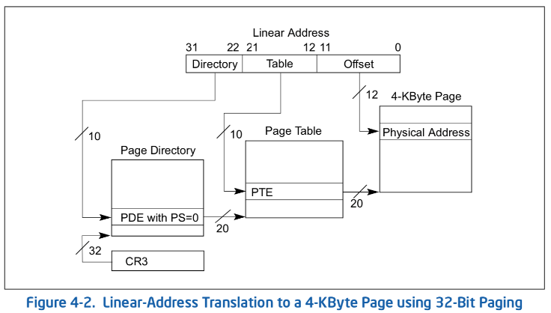
Example: x86 classic 32-bit address translation
Intel terminology: Top-level page-table called a “Page Directory”
  With “Page Directory Entries”
CR3 provides physical address of the page directory
  This is what we have called the “PageTablePtr” in previous slides
  Change in CR3 changes the whole translation table!

Slide 18
Administrivia
Midterm 2: Coming up on Thursday 3/18 5-6:30PM (two weeks from today)
  Topics: up and including Lecture 16: Scheduling, Deadlock, Address Translation, Virtual Memory, Caching, TLBs, Demand Paging
  Lecture 16 will be released early
  Will REQUIRE you to have your zoom proctoring setup working again
    You must have screen sharing (entire desktop not just the browser), audio unmuted, and your camera working
    Make sure to get your setup debugged and ready!
Review Session: 3/16 (5-7pm)
  Details TBA

Slide 20
What is in a Page Table Entry (PTE)?
What is in a Page Table Entry (or PTE)?
  Pointer to next-level page table or to actual page
  Permission bits: valid, read-only, read-write, write-only
Example: Intel x86 architecture PTE:
  Address same format as prior slides (10, 10, 12-bit offset)
  Intermediate page tables called “Directories”
  P: Present (same as “valid” bit in other architectures)
  W: Writeable
  U: User accessible
  PWT: Page write transparent: external cache write-through
  PCD: Page cache disabled (page cannot be cached)
  A: Accessed: page has been accessed recently
  D: Dirty (PTE only): page has been modified recently
  PS: Page Size: PS=1⇒4MB page (directory only).
  Bottom 22 bits of virtual address serve as offset
Page Frame Number
(Physical Page Number)
Free
(OS)
0
PS
D
A
PCD
PWT
U
W
P
31-12
11-9
8
7
6
5
4
3
2
1
0

Slide 21
Examples of how to use a PTE
How do we use the PTE?
  Invalid PTE can imply different things:
    Region of address space is actually invalid or
    Page/directory is just somewhere else than memory
  Validity checked first
    OS can use other (say) 31 bits for location info
Usage Example: Demand Paging
  Keep only active pages in memory
  Place others on disk and mark their PTEs invalid
Usage Example: Copy on Write
  UNIX fork gives copy of parent address space to child
    Address spaces disconnected after child created
  How to do this cheaply?
    Make copy of parent’s page tables (point at same memory)
    Mark entries in both sets of page tables as read-only
    Page fault on write creates two copies
Usage Example: Zero Fill On Demand
  New data pages must carry no information (say be zeroed)
  Mark PTEs as invalid; page fault on use gets zeroed page
  Often, OS creates zeroed pages in background

Slide 22
Sharing with multilevel page tables
10 bits
10 bits
12 bits
Physical
Page #
Offset
Virtual
Address:
Virtual
P1 index
Virtual
P2 index
Offset
4KB
PageTablePtr
PageTablePtr’
Entire regions of the address space can be efficiently shared

Slide 23
Summary: Two-Level Paging
Virtual memory view
Page Table
(level 1)
Page Tables
(level 2)
Physical memory view
1111 1111
stack
11 11101
10 11100
01 10111
00 10110
stack
1110 0000
1111 0000
1100 0000
stack
111
110 null
101 null
100
011 null
010
001 null
000
11 null
10 10000
01 01111
00 01110
heap
1000 0000
heap
0111 000
11 01101
10 01100
01 01011
00 01010
data
data
0101 000
0100 0000
11 00101
10 00100
01 00011
00 00010
code
page2 #
code
0001 0000
0000 0000
0000 0000
page1 #
offset

Slide 24
Summary: Two-Level Paging
Virtual memory view
Page Table
(level 1)
Page Tables
(level 2)
Physical memory view
stack
11 11101
10 11100
01 10111
00 10110
stack
1110 0000
stack
111
110 null
101 null
100
011 null
010
001 null
000
11 null
10 10000
01 01111
00 01110
1001 0000
(0x90)
heap
heap
1000 0000
(0x80)
In best case, total size of page tables ≈ number of pages used by program virtual memory. Requires two additional memory accesses!
11 01101
10 01100
01 01011
00 01010
data
data
11 00101
10 00100
01 00011
00 00010
code
code
0001 0000
0000 0000

Slide 25
Multi-level Translation: Segments + Pages
What about a tree of tables?
  Lowest level page table ⇒ memory still allocated with bitmap
  Higher levels often segmented
Could have any number of levels. Example (top segment):
What must be saved/restored on context switch?
  Contents of top-level segment registers (for this example)
  Pointer to top-level table (page table)
Virtual
Address:
Virtual
Seg #
Virtual
Page #
Offset
page #0
V,R
Base0
Limit0
V
page #1
V,R
Physical
Page #
Offset
page #2
V,R,W
Base1
Limit1
V
page #2
V,R,W
Physical Address
Base2
Limit2
V
page #3
V,R,W
Base2
Limit2
V
Base3
Limit3
N
page #4
N
Base4
Limit4
V
page #5
V,R,W
Check Permissions
Base5
Limit5
N
Base6
Limit6
N
Base7
Limit7
V
>
Access
Error
Access
Error

Slide 26
What about Sharing (Complete Segment)?
Process A:
Virtual
Seg #
Virtual
Page #
Offset
page #0
V,R
page #1
V,R
page #2
V,R,W
Base0
Limit0
V
page #3
V,R,W
Base1
Limit1
V
page #4
N
Base2
Limit2
V
Base2
Limit2
V
page #5
V,R,W
Base3
Limit3
N
Base4
Limit4
V
Shared Segment
Base5
Limit5
N
Base6
Limit6
N
Base0
Limit0
V
Base7
Limit7
V
Base1
Limit1
V
Base2
Base2
Limit2
Limit2
V
V
Base3
Limit3
N
Base4
Limit4
V
Base5
Limit5
N
Base6
Limit6
N
Base7
Limit7
V
Process B:
Virtual
Seg #
Virtual
Page #
Offset

Slide 27
Multi-level Translation Analysis
Pros:
  Only need to allocate as many page table entries as we need for application
    In other wards, sparse address spaces are easy
  Easy memory allocation
  Easy Sharing
    Share at segment or page level (need additional reference counting)
Cons:
  One pointer per page (typically 4K – 16K pages today)
  Page tables need to be contiguous
    However, the 10b-10b-12b configuration keeps tables to exactly one page in size
  Two (or more, if >2 levels) lookups per reference
    Seems very expensive!

Slide 29
Recall: Dual-Mode Operation
Can a process modify its own translation tables? NO!
  If it could, could get access to all of physical memory (no protection!)
To Assist with Protection, Hardware provides at least two modes (Dual-Mode Operation):
  “Kernel” mode (or “supervisor” or “protected”)
  “User” mode (Normal program mode)
  Mode set with bit(s) in control register only accessible in Kernel mode
  Kernel can easily switch to user mode; User program must invoke an exception of some sort to get back to kernel mode (more in moment)
Note that x86 model actually has more modes:
  Traditionally, four “rings” representing priority; most OSes use only two:
    Ring 0 ⇒ Kernel mode, Ring 3 ⇒ User mode
    Called “Current Privilege Level” or CPL
  Newer processors have additional mode for hypervisor (“Ring -1”)
Certain operations restricted to Kernel mode:
  Modifying page table base (CR3 in x86), and segment descriptor tables
    Have to transition into Kernel mode before you can change them!
  Also, all page-table pages must be mapped only in kernel mode

Slide 30
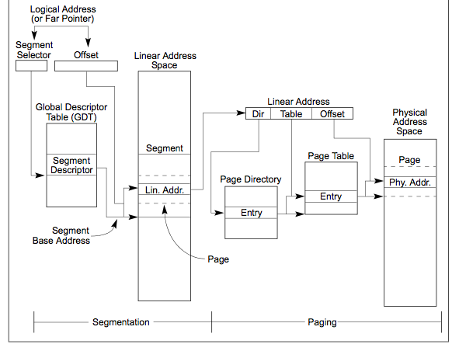
Making it real: x86 Memory model with segmentation (16/32-bit)
Segment Selector from
instruction: mov eax, gs(0x0)
2-level page table
in 10-10-12 bit address
Second level
called “table”
Combined address
Is 32-bit “linear”
Virtual address
First level
called “directory”

Slide 31

X86 Segment Descriptors (32-bit Protected Mode)
Segments are implicit in the instruction (e.g., code segments) or part of the instruction
  There are 6 registers: SS, CS, DS, ES, FS, GS
What is in a segment register?
  A pointer to the actual segment description:
  G/L selects between GDT and LDT tables (global vs local descriptor tables)
  RPL: Requestor’s Privilege Level (RPL of CS ⇒ Current Privilege Level)
Two registers: GDTR/LDTR hold pointers to global/local descriptor tables in memory
  Descriptor format (64 bits):
G: Granularity of segment [ Limit Size ] (0: 16bit, 1: 4KiB unit)
DB: Default operand size (0: 16bit, 1: 32bit)
A: Freely available for use by software
P: Segment present
DPL: Descriptor Privilege Level: Access requires Max(CPL,RPL)≤DPL
S: System Segment (0: System, 1: code or data)
Type: Code, Data, Segment
Segment selector [13 bits]
G/L
RPL
Segment Register

Slide 32
How are segments used?
One set of global segments (GDT) for everyone, different set of local segments (LDT) for every process
In legacy applications (16-bit mode):
  Segments provide protection for different components of user programs
  Separate segments for chunks of code, data, stacks
    RPL of Code Segment ⇒CPL (Current Privilege Level)
  Limited to 64K segments
Modern use in 32-bit Mode:
  Even though there is full segment functionality, segments are set up as “flattened”, i.e., every segment is 4GB in size
  One exception: Use of GS (or FS) as a pointer to “Thread Local Storage” (TLS)
    A thread can make accesses to TLS like this:
    mov eax, gs(0x0)
Modern use in 64-bit (“long”) mode
  Most segments (SS, CS, DS, ES) have zero base and no length limits
  Only FS and GS retain their functionality TLS

Slide 33
X86_64: Four-level page table!
9 bits
9 bits
9 bits
9 bits
12 bits
48-bit Virtual
Address:
Virtual
P1 index
Virtual
P2 index
Virtual
P3 index
Virtual
P4 index
Offset
PageTablePtr
8 bytes
4096-byte pages (12 bit offset)
Page tables also 4k bytes (pageable)
Physical
Address:
(40-50 bits)
Physical Page #
12bit Offset

Slide 34
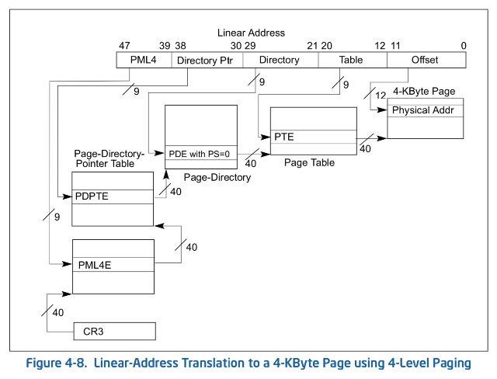
From x86_64 architecture specification
All current x86 processor support a 64-bit operation
64-bit words (so ints are 8 bytes) but 48-bit addresses

Slide 35
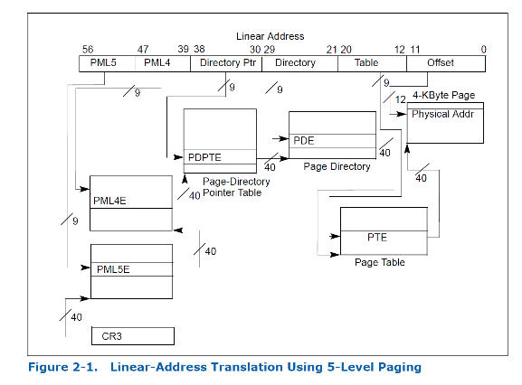
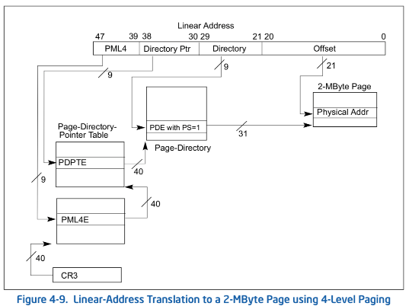
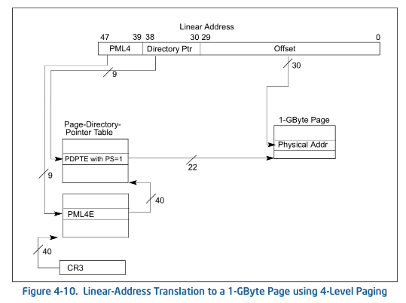
Larger page sizes supported as well
Larger page sizes (2MB, 1GB) make sense since memory is now cheap
  Great for kernel, large libraries, etc.
  Use limited primarily by internal fragmentation…

Slide 36
IA64: 64bit addresses: Six-level page table?!?
64bit Virtual
Address:
7 bits
9 bits
9 bits
9 bits
9 bits
9 bits
12 bits
Virtual
P1 index
Virtual
P2 index
Virtual
P3 index
Virtual
P4 index
Virtual
P5 index
Virtual
P6 index
Offset
No!
Too slow
Too many almost-empty tables
Notes:
Only really use last two levels (1 GB)

Slide 37
Alternative: Inverted Page Table
With all previous examples (“Forward Page Tables”)
  Size of page table is at least as large as amount of virtual memory allocated to processes
  Physical memory may be much less
    Much of process space may be out on disk or not in use
Answer: use a hash table
  Called an “Inverted Page Table”
  Size is independent of virtual address space
  Directly related to amount of physical memory
  Very attractive option for 64-bit address spaces
    PowerPC, UltraSPARC, IA64
Cons:
  Complexity of managing hash chains: Often in hardware!
  Poor cache locality of page table
Virtual
Page #
Offset
Hash
Table
Physical
Page #
Offset
Total size of page table ≈ number of pages used by program in physical memory. Hash more complex

Slide 38
Address Translation Comparison
 | Advantages | Disadvantages
Simple Segmentation | Fast context switching (segment map maintained by CPU) | External fragmentation
Paging (Single-Level) | No external fragmentation Fast and easy allocation | Large table size (~ virtual memory) Internal fragmentation
Paged Segmentation | Table size ~ # of pages in virtual memory Fast and easy allocation | Multiple memory references per page access
Multi-Level Paging
Inverted Page Table | Table size ~ # of pages in physical memory | Hash function more complex No cache locality of page table

Slide 40
How is the Translation Accomplished?
Virtual
Addresses
Physical
Addresses
CPU
MMU
The MMU must translate virtual address to physical address on:
  Every instruction fetch
  Every load
  Every store
What does the MMU need to do to translate an address?
  1-level Page Table
    Read PTE from memory, check valid, merge address
    Set “accessed” bit in PTE, Set “dirty bit” on write
  2-level Page Table
    Read and check first level
    Read, check, and update PTE
  N-level Page Table …
MMU does Page Table Tree Traversal to translate each address

Slide 41
Where and What is the MMU ?
Read <Phs_Addr X >
Physical
Memory
Read <V_Addr m>
Processor
(core)
pgm data
MMU
Cache(s)
Memory Bus
PTBR
page tables
< data @ mem[VtoP(m)] >
The processor requests READ Virtual-Address to memory system
  Through the MMU to the cache (to the memory)
Some time later, the memory system responds with the data stored at the physical address (resulting from virtual → physical) translation
  Fast on a cache hit, slow on a miss
So what is the MMU doing?
On every reference (I-fetch, Load, Store) read (multiple levels of) page table entries to get physical frame or FAULT
  Through the caches to the memory
  Then read/write the physical location

Slide 42
Recall: CS61c Caching Concept
Cache: a repository for copies that can be accessed more quickly than the original
  Make frequent case fast and infrequent case less dominant
Caching underlies many techniques used today to make computers fast
  Can cache: memory locations, address translations, pages, file blocks, file names, network routes, etc…
Only good if:
  Frequent case frequent enough and
  Infrequent case not too expensive
Important measure: Average Access time =
(Hit Rate x Hit Time) + (Miss Rate x Miss Time)

Slide 43
Recall: In Machine Structures (eg. 61C) …
Caching is the key to memory system performance
Main
Memory
(DRAM)
Processor
Access time = 100ns
Main
Memory
(DRAM)
Cache
(SRAM)
Processor
1 ns
100ns
Average Memory Access Time (AMAT)
= (Hit Rate x HitTime) + (Miss Rate x MissTime)
Where HitRate + MissRate = 1
HitRate = 90% => AMAT = (0.9 x 1) + (0.1 x 101)=11.1 ns
HitRate = 99% => AMAT = (0.99 x 1) + (0.01 x 101)=2.01 ns
MissTime_{L1} includes HitTime_{L1}+MissPenalty_{L1} ≡ HitTime_{L1} +AMAT_{L2}
Notes:
So, the role of a cache is to reduce the average memory access time. So, here we have a processor; if it directly needs to go to memory to access something, it takes 100ns.
Remember, processors are superfast, they compute in small cycles, and hence 100ns is a really long time for them.
If we add a second level cache, we can instead access the same data in 10ns, i.e.,10 times faster than directly going to memory.
To quantify the gain due to a cache, we can compute the average access time: and its simply the hit-rate (times we find it in the cache). …
So, we get an illusion that we can access the main memory at such a fast speed, due to caching.

Slide 44
Another Major Reason to Deal with Caching
Virtual
Address:
Virtual
Seg #
Virtual
Page #
Offset
Cannot afford to translate on every access
  At least three DRAM accesses per actual DRAM access
  Or: perhaps I/O if page table partially on disk!
Even worse: What if we are using caching to make memory access faster than DRAM access?
Solution? Cache translations!
  Translation Cache: TLB (“Translation Lookaside Buffer”)
page #0
V,R
Base0
Limit0
V
page #1
V,R
Physical
Page #
Offset
Base1
Limit1
V
page #2
V,R,W
Physical Address
Base2
Limit2
V
page #3
V,R,W
Base3
Limit3
N
page #4
N
Base4
Limit4
V
page #5
V,R,W
Check Perm
Base5
Limit5
N
Base6
Limit6
N
Base7
Limit7
V
>
Access
Error
Access
Error

Slide 45
Why Does Caching Help? Locality!
Probability
of reference
0
Address Space
2^{n} - 1
Temporal Locality (Locality in Time):
  Keep recently accessed data items closer to processor
Spatial Locality (Locality in Space):
  Move contiguous blocks to the upper levels
Lower Level
Memory
To Processor
Upper Level
Memory
Blk X
From Processor
Blk Y
Notes:
How does the memory hierarchy work? Well it is rather simple, at least in principle.
In order to take advantage of the temporal locality, that is the locality in time, the memory hierarchy will keep those more recently accessed data items closer to the processor because chances are (points to the principle), the processor will access them again soon.
In order to take advantage of the spatial locality, not ONLY do we move the item that has just been accessed to the upper level, but we ALSO move the data items that are adjacent to it.
+1 = 15 min. (X:55)

Slide 46
Recall: Memory Hierarchy
Caching: Take advantage of the principle of locality to:
  Present the illusion of having as much memory as in the cheapest technology
  Provide average speed similar to that offered by the fastest technology
Address Translation needs to occur here
Page table lives here (perhaps cached)
Processor
Secondary
Storage
(Disk)
Core
L2 Cache
Registers
L1 Cache
Secondary
Storage
(SSD)
Main
Memory
(DRAM)
L3 Cache
(shared)
Core
L2 Cache
Registers
L1 Cache
Speed (ns):
0.3
1
3
10-30
100
100,000
(0.1 ms)
10,000,000
(10 ms)
Size (bytes):
100Bs
10kBs
100kBs
MBs
GBs
100GBs
TBs
Notes:
The design goal is to present the user with as much memory as is available in the cheapest technology (points to the disk).
While by taking advantage of the principle of locality, we like to provide the user an average access speed that is very close to the speed that is offered by the fastest technology.
(We will go over this slide in details in the next lecture on caches).
+1 = 16 min. (X:56)

Slide 47
How do we make Address Translation Fast?
Cache results of recent translations !
  Different from a traditional cache
  Cache Page Table Entries using Virtual Page # as the key
Read <Phs_Addr X >
Physical
Memory
Read <V_Addr m>
Processor
(core)
pgm data
MMU
Cache(s)
Memory Bus
PTBR
page tables
V_Pg M₁ : <Phs_Frame #₁, V, … >
V_Pg M₂ : <Phs_Frame #₂, V, … >
V_Pg M_{k} : <Phs_Frame #_{k}, V, … >

Slide 48
Translation Look-Aside Buffer
Record recent Virtual Page # to Physical Frame # translation
If present, have the physical address without reading any of the page tables !!!
  Even if the translation involved multiple levels
  Caches the end-to-end result
Was invented by Sir Maurice Wilkes – prior to caches
  When you come up with a new concept, you get to name it!
  People realized “if it’s good for page tables, why not the rest of the data in memory?”
On a TLB miss, the page tables may be cached, so only go to memory when both miss

Slide 49
Caching Applied to Address Translation
Virtual
Address
TLB
Physical
Memory
CPU
Physical
Address
Cached?
Yes
No
Save
Result
Translate
(MMU)
Data Read or Write
(untranslated)
Question is one of page locality: does it exist?
  Instruction accesses spend a lot of time on the same page (since accesses sequential)
  Stack accesses have definite locality of reference
  Data accesses have less page locality, but still some…
Can we have a TLB hierarchy?
  Sure: multiple levels at different sizes/speeds

Slide 51
What kind of Cache for TLB?
Set Size (k) - Associativity
# of Sets (N)
. . .
. . .
tag
data
line size (L)
Remember all those cache design parameters and trade-offs?
  Amount of Data = N * L * K
  Tag is portion of address that identifies line (w/o line offset)
  Write Policy (write-thru, write-back), Eviction Policy (LRU, …)

Slide 52
How might organization of TLB differ from that of a conventional instruction or data cache?
Let’s do some review …

Slide 53
A Summary on Sources of Cache Misses
Compulsory (cold start or process migration, first reference): first access to a block
  “Cold” fact of life: not a whole lot you can do about it
  Note: If you are going to run “billions” of instruction, Compulsory Misses are insignificant
Capacity:
  Cache cannot contain all blocks access by the program
  Solution: increase cache size
Conflict (collision):
  Multiple memory locations mapped to the same cache location
  Solution 1: increase cache size
  Solution 2: increase associativity
Coherence (Invalidation): other process (e.g., I/O) updates memory
Notes:
(Capacity miss) That is the cache misses are due to the fact that the cache is simply not large enough to contain all the blocks that are accessed by the program.
The solution to reduce the Capacity miss rate is simple: increase the cache size.
Here is a summary of other types of cache miss we talked about.
First is the Compulsory misses. These are the misses that we cannot avoid. They are caused when we first start the program.
Then we talked about the conflict misses. They are the misses that caused by multiple memory locations being mapped to the same cache location.
There are two solutions to reduce conflict misses. The first one is, once again, increase the cache size. The second one is to increase the associativity.
For example, say using a 2-way set associative cache instead of directed mapped cache.
But keep in mind that cache miss rate is only one part of the equation. You also have to worry about cache access time and miss penalty. Do NOT optimize miss rate alone.
Finally, there is another source of cache miss we will not cover today. Those are referred to as invalidation misses caused by another process, such as IO , update the main memory so you have to flush the cache to avoid inconsistency between memory and cache.
+2 = 43 min. (Y:23)

Slide 54
How is a Block found in a Cache?
Block Address
Block
offset
Tag
Index
Set Select
Data Select
Block is minimum quantum of caching
  Data select field used to select data within block
  Many caching applications don’t have data select field
Index Used to Lookup Candidates in Cache
  Index identifies the set
Tag used to identify actual copy
  If no candidates match, then declare cache miss

Slide 55
Review: Direct Mapped Cache
Direct Mapped 2^{N} byte cache:
  The uppermost (32 - N) bits are always the Cache Tag
  The lowest M bits are the Byte Select (Block Size = 2^{M})
Example: 1 KB Direct Mapped Cache with 32 B Blocks
  Index chooses potential block
  Tag checked to verify block
  Byte select chooses byte within block
31
9
4
0
Cache Tag
Cache Index
Byte Select
Ex: 0x50
Ex: 0x01
Ex: 0x00
Valid Bit
Cache Tag
Cache Data
Byte 31
:
Byte 1
Byte 0
0
0x50
Byte 63
:
Byte 33
Byte 32
1
2
3
:
:
:
Byte 1023
:
Byte 992
31
Notes:
Let’s use a specific example with realistic numbers: assume we have a 1 KB direct mapped cache with block size equals to 32 bytes.
In other words, each block associated with the cache tag will have 32 bytes in it (Row 1).
With Block Size equals to 32 bytes, the 5 least significant bits of the address will be used as byte select within the cache block.
Since the cache size is 1K byte, the upper 32 minus 10 bits, or 22 bits of the address will be stored as cache tag.
The rest of the address bits in the middle, that is bit 5 through 9, will be used as Cache Index to select the proper cache entry.
+2 = 30 min. (Y:10)

Slide 56
Review: Set Associative Cache
N-way set associative: N entries per Cache Index
  N direct mapped caches operates in parallel
Example: Two-way set associative cache
  Cache Index selects a “set” from the cache
  Two tags in the set are compared to input in parallel
  Data is selected based on the tag result
31
8
4
0
Cache Tag
Cache Index
Byte Select
Valid
Cache Tag
Cache Data
Cache Data
Cache Tag
Valid
Cache Block 0
Cache Block 0
:
:
:
:
:
:
Compare
Sel1
1
Mux
0
Sel0
Compare
OR
Hit
Cache Block
Notes:
This is called a 2-way set associative cache because there are two cache entries for each cache index. Essentially, you have two direct mapped cache works in parallel.
This is how it works: the cache index selects a set from the cache. The two tags in the set are compared in parallel with the upper bits of the memory address.
If neither tag matches the incoming address tag, we have a cache miss.
Otherwise, we have a cache hit and we will select the data on the side where the tag matches occur.
This is simple enough. What is its disadvantages?
+1 = 36 min. (Y:16)

Slide 57
Review: Fully Associative Cache
Fully Associative: Every block can hold any line
  Address does not include a cache index
  Compare Cache Tags of all Cache Entries in Parallel
Example: Block Size=32B blocks
  We need N 27-bit comparators
  Still have byte select to choose from within block
31
4
0
Cache Tag (27 bits long)
Byte Select
Ex: 0x01
Cache Tag
Valid Bit
Cache Data
=
Byte 31
:
Byte 1
Byte 0
=
Byte 63
:
Byte 33
Byte 32
=
=
:
:
:
=
Notes:
While the direct mapped cache is on the simple end of the cache design spectrum, the fully associative cache is on the most complex end.
It is the N-way set associative cache carried to the extreme where N in this case is set to the number of cache entries in the cache.
In other words, we don’t even bother to use any address bits as the cache index.
We just store all the upper bits of the address (except Byte select) that is associated with the cache block as the cache tag and have one comparator for every entry.
The address is sent to all entries at once and compared in parallel and only the one that matches are sent to the output. This is called an associative lookup.
Needless to say, it is very hardware intensive. Usually, fully associative cache is limited to 64 or less entries.
Since we are not doing any mapping with the cache index, we will never push any other item out of the cache because multiple memory locations map to the same cache location.
Therefore, by definition, conflict miss is zero for a fully associative cache. This, however, does not mean the overall miss rate will be zero.
Assume we have 64 entries here. The first 64 items we accessed can fit in.
But when we try to bring in the 65th item, we will need to throw one of them out to make room for the new item. This bring us to the third type of cache misses: Capacity Miss.
+3 = 41 min. (Y:21)

Slide 58
Where does a Block Get Placed in a Cache?
Example: Block 12 placed in 8 block cache
32-Block Address Space:
Block
no.
1 1 1 1 1 1 1 1 1 1 2 2 2 2 2 2 2 2 2 2 3 3
0 1 2 3 4 5 6 7 8 9 0 1 2 3 4 5 6 7 8 9 0 1 2 3 4 5 6 7 8 9 0 1
Direct mapped:
block 12 can go only into block 4 (12 mod 8)
Set associative:
block 12 can go anywhere in set 0 (12 mod 4)
Fully associative:
block 12 can go anywhere
Block
no.
0 1 2 3 4 5 6 7
Block
no.
0 1 2 3 4 5 6 7
Block
no.
0 1 2 3 4 5 6 7
Set
0
Set
1
Set
2
Set
3

Slide 59
Which block should be replaced on a miss?
Easy for Direct Mapped: Only one possibility
Set Associative or Fully Associative:
  Random
  LRU (Least Recently Used)
Miss rates for a workload:
2-way 4-way 8-way
Size LRU Random LRU Random LRU Random
16 KB 5.2% 5.7% 4.7% 5.3% 4.4% 5.0%
64 KB 1.9% 2.0% 1.5% 1.7% 1.4% 1.5%
256 KB 1.15% 1.17% 1.13% 1.13% 1.12% 1.12%

Slide 60
Review: What happens on a write?
Write through: The information is written to both the block in the cache and to the block in the lower-level memory
Write back: The information is written only to the block in the cache
  Modified cache block is written to main memory only when it is replaced
  Question is block clean or dirty?
Pros and Cons of each?
  WT:
    PRO: read misses cannot result in writes
    CON: Processor held up on writes unless writes buffered
  WB:
    PRO: repeated writes not sent to DRAM
    processor not held up on writes
    CON: More complex
    Read miss may require writeback of dirty data

Slide 61
Questions about caches ?
How does operating system behavior affect cache performance?
Switching threads?
Switching contexts?
Cache design? What addresses are used?
What does our understanding of caches tell us about TLB organization?

Slide 62
What TLB Organization Makes Sense?
CPU
TLB
Cache
Memory
Needs to be really fast
  Critical path of memory access
    In simplest view: before the cache
    Thus, this adds to access time (reducing cache speed)
  Seems to argue for Direct Mapped or Low Associativity
However, needs to have very few conflicts!
  With TLB, the Miss Time extremely high! (PT traversal)
  Cost of Conflict (Miss Time) is high
  Hit Time – dictated by clock cycle
Thrashing: continuous conflicts between accesses
  What if use low order bits of page as index into TLB?
    First page of code, data, stack may map to same entry
    Need 3-way associativity at least?
  What if use high order bits as index?
    TLB mostly unused for small programs

Slide 63
TLB organization: include protection
How big does TLB actually have to be?
  Usually small: 128-512 entries (larger now)
  Not very big, can support higher associativity
Small TLBs usually organized as fully-associative cache
  Lookup is by Virtual Address
  Returns Physical Address + other info
What happens when fully-associative is too slow?
  Put a small (4-16 entry) direct-mapped cache in front
  Called a “TLB Slice”
Example for MIPS R3000:
Virtual Address Physical Address Dirty Ref Valid Access ASID
0xFA00 0x0003 Y N Y R/W 34
0x0040 0x0010 N Y Y R 0
0x0041 0x0011 N Y Y R 0

Slide 64
Example: R3000 pipeline includes TLB “stages”
MIPS R3000 Pipeline
Inst Fetch
Dcd/ Reg
ALU / E.A
Memory
Write Reg
TLB I-Cache RF Operation WB
E.A. TLB D-Cache
TLB
  64 entry, on-chip, fully associative, software TLB fault handler
Virtual Address Space
ASID
V. Page Number
Offset
6
20
12
0xx User segment (caching based on PT/TLB entry)
100 Kernel physical space, cached
101 Kernel physical space, uncached
11x Kernel virtual space
Allows context switching among
64 user processes without TLB flush

Slide 65
Example: Pentium-M TLBs (2003)
Four different TLBs
  Instruction TLB for 4K pages
    128 entries, 4-way set associative
  Instruction TLB for large pages
    2 entries, fully associative
  Data TLB for 4K pages
    128 entries, 4-way set associative
  Data TLB for large pages
    8 entries, 4-way set associative
All TLBs use LRU replacement policy
Why different TLBs for instruction, data, and page sizes?

Slide 66
Intel Nahelem (2008)
L1 DTLB
  64 entries for 4 K pages and
  32 entries for 2/4 M pages,
L1 ITLB
  128 entries for 4 K pages using 4-way associativity and
  14 fully associative entries for 2/4 MiB pages
unified 512-entry L2 TLB for 4 KiB pages, 4-way associative.

Slide 67
Current Intel x86 (Skylake, Cascade Lake)

Slide 68
Current Example: Memory Hierarchy
Caches (all 64 B line size)
  L1 I-Cache: 32 KiB/core, 8-way set assoc.
  L1 D Cache: 32 KiB/core, 8-way set assoc., 4-5 cycles load-to-use, Write-back policy
  L2 Cache: 1 MiB/core, 16-way set assoc., Inclusive, Write-back policy, 14 cycles latency
  L3 Cache: 1.375 MiB/core, 11-way set assoc., shared across cores, Non-inclusive victim cache, Write-back policy, 50-70 cycles latency
TLB
  L1 ITLB, 128 entries; 8-way set assoc. for 4 KB pages
    8 entries per thread; fully associative, for 2 MiB / 4 MiB page
  L1 DTLB 64 entries; 4-way set associative for 4 KB pages
    32 entries; 4-way set associative, 2 MiB / 4 MiB page translations:
    4 entries; 4-way associative, 1G page translations:
  L2 STLB: 1536 entries; 12-way set assoc. 4 KiB + 2 MiB pages
    16 entries; 4-way set associative, 1 GiB page translations:

Slide 70
What happens on a Context Switch?
Need to do something, since TLBs map virtual addresses to physical addresses
  Address Space just changed, so TLB entries no longer valid!
Options?
  Invalidate TLB: simple but might be expensive
    What if switching frequently between processes?
  Include ProcessID in TLB
    This is an architectural solution: needs hardware
What if translation tables change?
  For example, to move page from memory to disk or vice versa…
  Must invalidate TLB entry!
    Otherwise, might think that page is still in memory!
  Called “TLB Consistency”

Slide 71
Putting Everything Together: Address Translation
Physical
Memory:
Virtual Address:
Virtual
P1 index
Virtual
P2 index
Offset
PageTablePtr
Physical Address:
Physical
Page #
Offset
Page Table
(1st level)
Page Table
(2nd level)

Slide 72
Putting Everything Together: TLB
Physical
Memory:
Virtual Address:
Virtual
P1 index
Virtual
P2 index
Offset
PageTablePtr
Physical Address:
Physical
Page #
Physical
Page #
Offset
Page Table
(1st level)
Page Table
(2nd level)
TLB:
…

Slide 73
Putting Everything Together: Cache
Physical
Memory:
Virtual Address:
Virtual
P1 index
Virtual
P2 index
Offset
PageTablePtr
Physical Address:
Physical
Page #
Offset
Page Table
(1st level)
tag
index
byte
cache:
Page Table
(2nd level)
tag:
block:
TLB:
…
…

Slide 74
Page Fault
The Virtual-to-Physical Translation fails
  PTE marked invalid, Priv. Level Violation, Access violation, or does not exist
  Causes a Fault / Trap
    Not an interrupt because synchronous to instruction execution
  May occur on instruction fetch or data access
  Protection violations typically terminate the instruction
Other Page Faults engage operating system to fix the situation and retry the instruction
  Allocate an additional stack page, or
  Make the page accessible - Copy on Write,
  Bring page in from secondary storage to memory – demand paging
Fundamental inversion of the hardware / software boundary

Slide 75
Next Up: What happens when …
Process
virtual address
physical address
MMU
page#
PT
instruction
frame#
retry
page fault
offset
exception
frame#
Operating System
offset
update PT entry
Page Fault Handler
load page from disk
scheduler

Slide 76
Summary (1/3)
Page Tables
  Memory divided into fixed-sized chunks of memory
  Virtual page number from virtual address mapped through page table to physical page number
  Offset of virtual address same as physical address
  Large page tables can be placed into virtual memory
Multi-Level Tables
  Virtual address mapped to series of tables
  Permit sparse population of address space
Inverted Page Table
  Use of hash-table to hold translation entries
  Size of page table ~ size of physical memory rather than size of virtual memory

Slide 77
Summary (2/3)
The Principle of Locality:
  Program likely to access a relatively small portion of the address space at any instant of time.
    Temporal Locality: Locality in Time
    Spatial Locality: Locality in Space
Three (+1) Major Categories of Cache Misses:
  Compulsory Misses: sad facts of life. Example: cold start misses.
  Conflict Misses: increase cache size and/or associativity
  Capacity Misses: increase cache size
  Coherence Misses: Caused by external processors or I/O devices
Cache Organizations:
  Direct Mapped: single block per set
  Set associative: more than one block per set
  Fully associative: all entries equivalent
Notes:
Let’s summarize today’s lecture. I know you have heard this many times and many ways but it is still worth repeating.
Memory hierarchy works because of the Principle of Locality which says a program will access a relatively small portion of the address space at any instant of time.
There are two types of locality: temporal locality, or locality in time and spatial locality, or locality in space.
So far, we have covered three major categories of cache misses.
Compulsory misses are cache misses due to cold start. You cannot avoid them but if you are going to run billions of instructions anyway, compulsory misses usually don’t bother you.
Conflict misses are misses caused by multiple memory location being mapped to the same cache location.
The nightmare scenario is the ping pong effect when a block is read into the cache but before we have a chance to use it, it was immediately forced out by another conflict miss.
You can reduce Conflict misses by either increase the cache size or increase the associativity, or both.
Finally, Capacity misses occurs when the cache is not big enough to contains all the cache blocks required by the program. You can reduce this miss rate by making the cache larger.
There are two write policy as far as cache write is concerned. Write through requires a write buffer and a nightmare scenario is when the store occurs so frequent that you saturates your write buffer.
The second write polity is write back. In this case, you only write to the cache and only when the cache block is being replaced do you write the cache block back to memory.
+3 = 77 min. (Y:57)

Slide 78
Summary (3/3)
“Translation Lookaside Buffer” (TLB)
  Small number of PTEs and optional process IDs (< 512)
  Fully Associative (Since conflict misses expensive)
  On TLB miss, page table must be traversed and if located PTE is invalid, cause Page Fault
  On change in page table, TLB entries must be invalidated
  TLB is logically in front of cache (need to overlap with cache access)
Next Time: What to do on a page fault?
Notes:
No fancy replacement policy is needed for the direct mapped cache.
As a matter of fact, that is what cause direct mapped trouble to begin with: only one place to go in the cache--causes conflict misses.
No fancy replacement policy is needed for the direct mapped cache.
As a matter of fact, that is what cause direct mapped trouble to begin with: only one place to go in the cache--causes conflict misses.
Besides working at Sun, I also teach people how to fly whenever I have time.
Statistic have shown that if a pilot crashed after an engine failure, he or she is more likely to get killed in a multi-engine light airplane than a single engine airplane.
The joke among us flight instructors is that: sure, when the engine quit in a single engine stops, you have one option: sooner or later, you land. Probably sooner.
But in a multi-engine airplane with one engine stops, you have a lot of options. It is the need to make a decision that kills those people.

